Slide 1



Technical Qualifications
In Land

Slide 2
Contents
Challenges and opportunities
Introducing City & Guilds and National Land Based College
Technical Qualifications
    Key Stage 4
    Key Stage 5 Level 2
    Key Stage 5 Level 3
    Design principles
New Technical Qualifications – Assessment
Assessment model
Time and assessment dates
Assessment examples
Flexible and efficient teaching and learning
Support to deliver
Digital tools
Creating choice for learners
Progression to employment
Progression to university
Progression to an apprenticeship
Notes:
Note: update contents outline to reflect slides

Slide 3


Challenges and opportunities
In Land
The land-based and environmental sector employs approximately 1.3 million people in 230,000 businesses across the UK
Over four out of five businesses in the sector employ fewer than five staff
54% of staff are 45 years old or over
The sector is forecast to need 595,000 new entrants between 2014 and 2020.
The UK land-based and environmental sector: Skills assessment update Spring 2014: Lantra 2014
595,000 JOBS
IN LAND NEEDED BY 2020
Notes:
– Rearrange – graphs

Slide 4


Introducing City & Guilds
City & Guilds is the UK’s leading development organisation.
We enable training providers, employers and trainees to meet the needs of today’s workplace.
The City and Guilds of London Institute was founded by the City of London over 130 years ago and remains the awarding body for City & Guilds qualifications. Our heritage makes us uniquely positioned to anticipate the future of work and learning.
We’re one of the market leaders in training and development for the land-based sector.

Slide 5



City & Guilds is a widely recognised and respected Awarding Organisation for Technical Qualifications in Land
A market leader
City & Guilds accounted for approximately 59% of all the regulated qualifications awarded to learners in England, Wales and Northern Ireland in 2015/2016.
Strong links to the
Land industry
NPTC brand existing since the 1960s
(City & Guilds involved in delivering competency based assessment since the 1950s).
Comprehensive offer
across Key Stages 4 & 5
23 L3 KS 5 Technical Certificate covering 8 subjects
8 L2 KS5 Technical Certificates covering 8 subjects
1 L2 KS4 Technical Award for Land.
Post-16 skills plan
City & Guilds Technical Qualifications are strongly aligned with the routes identified

Slide 6









Delivering Our Purpose
Governments:
professional and technical skills education systems to meet skills needs
=
Growing
economies
Learning providers:
=
Cost savings
and increased
efficiencies
centre support and consultancy services
Employers:
More productive
workforces and
increased
efficiencies
validation of candidate skills
effective corporate learning
accreditation of L&D programmes
=
More capable &
inspiring managers &
measurable
business results
Senior executives:
=
leadership training and coaching
Individuals:
Industry-recognised, market leading qualifications and credentials provide proof of professional and technical skills
=
More confident &
work-ready job
candidates
Notes:
– Rearrange – graphs

Slide 7












The City & Guilds Group
Getting into the job
Training on the job
Progress into the next job
Education
Apprenticeships & EPA
Employment
TechBac = technicals & Workplace Skills
PIVOT
Work based degrees
Higher level Up to level 7
Functional Skills
Compliance & Licence to Practice; accreditation; VRQs, IVQs, NVQs
Credentialing & CPD
Notes:
– Rearrange – graphs

Slide 8


Introducing National Land Based College
NLBC joins industry with education to develop qualifications and training for the land based sector.
NLBC works digitally to champion careers and education, providing relevant information and building networks to develop workforce skills.
NLBC is establishing Industry Skills Groups across land based, to connect industry far closer to the development of careers promotion, skills and training. NLBC aims to ensure future qualifications and apprenticeship standards fully meet the needs of today’s employers.
NLBC has a central hub at Stoneleigh Park, Warwickshire. They are supported by spokes – specialist land based colleges and universities who are integral in the development and delivery of City & Guilds qualifications.

Slide 9
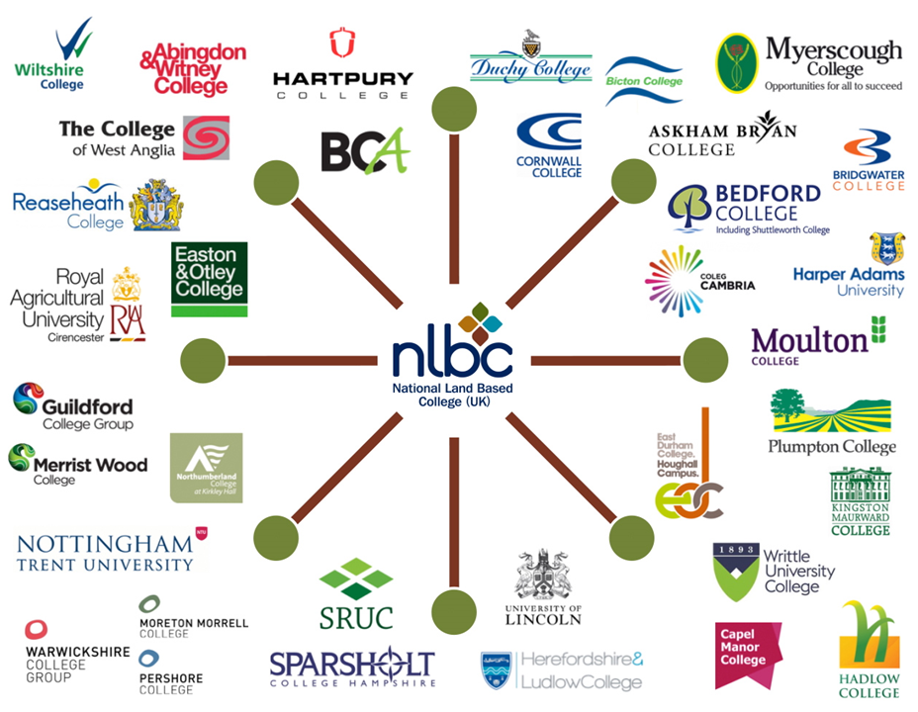

NLBC has 30 specialist land based colleges and universities as its members

Slide 10

About City & Guilds and the National Land Based College collaboration
City & Guilds and the National Land Based College came together through a common ambition to support colleges and providers in facing government reforms to the skills system and creating the skilled workforce needed to meet the demands of the UK land-based sector.
The professional and technical education sector is once again facing enormous change.
The new apprenticeship standards were barely embedded before the Post-16 Skills Plan was announced, bringing with it new more rigorous technical qualifications that colleges and providers must adopt by 2019.

Slide 11

Our Promise
City & Guilds, in collaboration with the National Land Based College (NLBC) has designed Land Based Technical qualifications to increase skills levels in the land-based sector.
Together we have worked with industry to develop the qualifications employers demand, giving learners the skills they need to thrive in the workplace.
Our focus on supporting the sector though times of change is unwavering, demonstrated by our continued investments into land based services from NPTC to our bursary programmes.
Working together enables us to provide an end-to-end solution to take learners from entry level throughout their career, providing new and innovative ways to learn and be recognised.
Subject areas range from Animal Care through to Environmental Conservation and all qualifications are available at various levels of study.

Slide 12



Learners:
Why study a City & Guilds land-based Technical Qualification?
High-quality qualifications which provide you with the technical skills and knowledge required to be effective in your first job straight away.
Choice of progression
Using our extensive expertise in qualification development, our land-based Technical qualifications are designed to allow seamless progression, whether that’s to Apprenticeships or onto employment or directly to university.
Relevant qualifications, closely aligned with industry practice
Whether you’re looking to land your first job, progress in an existing career or find employment, our qualifications will give you the knowledge and skills to actually do the job. That’s why they’re trusted and valued by employers.
Our collaboration with the NLBC ensures our qualifications deliver the knowledge, skills and understanding you need to enhance and develop your career in the land-based industry, no matter where you are.
Recognised by employers across
the country
Increase your choice of employment opportunities.
The NLBC online register of land-based learners and employees, will enable employers to track lifelong continued professional development more easily.
This means your achievements are recorded and maintained throughout your career, promoting career growth and creating opportunities.

Slide 13


Centres:
Why deliver our City & Guilds land-based Technical Qualification?
Comprehensive offer across the pathways you deliver
Our land-based Technical qualifications have been developed in collaboration with NLBC to provide your learners with the knowledge and hands-on practical learning that will prepare them for the workplace.
NLBC champions the full spectrum of land-based careers, linking with and building on the work of existing sector careers initiatives, such as Bright Crop and Grow Careers.
You can be confident of the qualification standard.
Future-proof your qualification
Our land-based Technical Qualifications have been designed to meet the latest 14-19 changes with updated content and a strong focus on employer involvement.
We are committed to helping employers and training providers navigate this period of change to create a world-class skills system that meets the needs of UK industry - today and tomorrow.

Slide 14



Wrap-around support
We have a range of dedicated, specialist support and resources available to support you deliver our land-based Technical Qualifications, including:
curriculum plans
teaching learning and
assessment guide
chief examiner reports
employer involvement
centre guide
marking and moderation guide
... and much more available from our website
High-quality
The qualifications have been designed to meet the latest changes of the land-based industries. You can trust that your learners will come out with a recognised qualification that is the same standard across the country.
Relevant qualifications at all levels
In addition to our Technical offer our portfolio has a number of short courses to equip learners with the specialist skills and knowledge required to achieve a Certificate of Competence qualification. Some of these qualifications are vital for Licence to Practise activities or for membership of CPD registers.
Evidence of credibility makes City & Guilds land-based Qualifications well sought after.

Slide 15
See what our customers say
“The collaboration between National Land Based College and City & Guilds has proved to be invaluable. Having taken the decision to move across to City & Guilds delivery 2 years ago, this Steering Group has afforded the College the opportunity to be closely involved in deciding the strategic direction of land based qualification change. Collaborational working has improved the flow of information to colleges about curriculum changes and enabled subject level specialists to engage in curriculum development, improving their own knowledge and understanding of new Technical Qualifications whilst ensuring the qualifications are also fit for purpose to meet employer and learner needs and efficient use of college resources.”
Alison Robinson, Vice Principal & Deputy Chief Executive, Myerscough College
“The NLBC and City & Guilds national steering group brings together land based Specialists, Senior Managers and Teachers with a common goal to ensure that students in land based education are working towards qualifications that employers value. The group’s primary role is to ensure learners are developing the practical skills, technical and professional knowledge required to operate safely and effectively in industry.”
Jo Maher, Assistant Principal, Reaseheath
“Hartpury is proud to be associated with the development of the new City & Guilds land based qualifications. The development process driven by the relationship between City & Guilds and NLBC, very much involving colleges and employers, has enabled products to be developed that really do meet the needs of the industry and associated skills requirements whilst also aligning with the approval requirements of the DfE.”
Claire Whitworth, Vice Principal FE, Hartpury College

Slide 16

Find out more
You can find out more about the unique collaboration at
cityandguilds.com and nlbc.uk

Slide 17
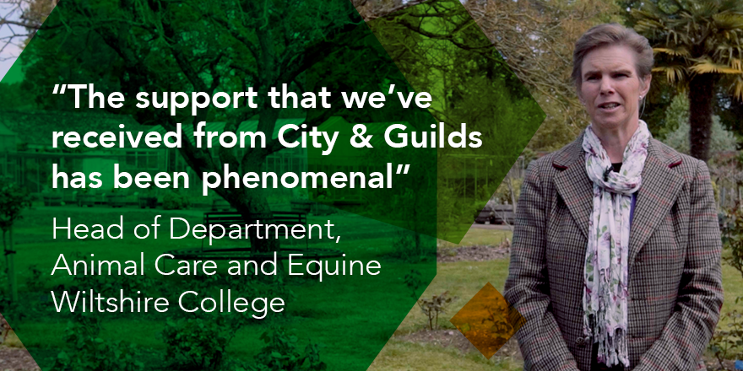

Testimonials
For more case studies and testimonials visit:
cityandguilds.com/techbac/technical-qualifications/technicals-case-studies

Slide 18
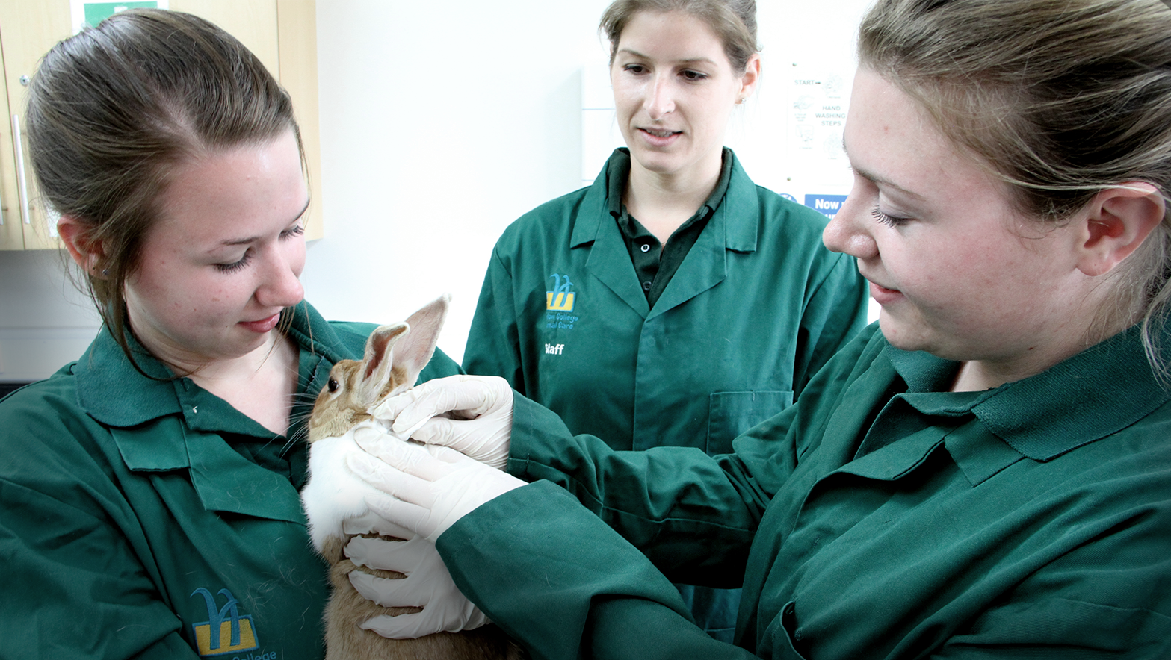
Technical Qualifications in Land
Built to meet industry standards in collaboration with National Land Based College

Slide 19

Key Stage 4
City & Guilds Qualification Number | Qualification Title | QN | GLH
0170-20 | City & Guilds Level 2 Technical Award in Land Based Studies | 601/7240/X | 120
Automatic approval
for Level 2 equivalent Technical Qualifications when accepted at Level 3
Key Stage 5 – Level 2
City & Guilds Qualification Number | Qualification title | QN | GLH
0171-20 | City & Guilds Level 2 Technical Certificate in Agriculture | 603/0067/X | 360
0171-28 | City & Guilds Level 2 Technical Certificate in Land-based Engineering | 603/0145/4 | 360
0172-21 | City & Guilds Level 2 Technical Certificate in Animal Care* | 603/0833/3 | 360
0172-26 | City & Guilds Level 2 Technical Certificate in Equine Care | 603/0834/5 | 360
0173-20 | City & Guilds Level 2 Technical Certificate in Land & Wildlife | 603/1198/8 | 360
0174-20 | City & Guilds Level 2 Technical Certificate in Horticulture | 603/0868/0 | 360
0174-21 | City & Guilds Level 2 Technical Certificate in Forestry & Arboriculture | 603/1175/7 | 360
0175-20 | City & Guilds Level 2 Technical Certificate in Floristry | 603/0839/4 | 360

Slide 20
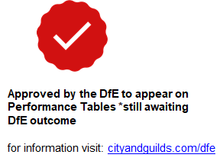
Key Stage 5 – Level 3
City & Guilds Qualification Number | Qualification title | QN | GLH
0171-38 | City & Guilds Level 3 Advanced Technical Extended Diploma in Land-based Engineering | 601/7463/8 | 1080
0173-30 | City & Guilds Level 3 Advanced Technical Certificate in Land and Wildlife Management | 601/7557/6 | 360
0173-31 0173-35 | City & Guilds Level 3 Advanced Technical Diploma in Land and Wildlife Management | 601/7558/8 | 540
0173-32 | City & Guilds Level 3 Advanced Technical Extended Diploma in Land and Wildlife Management | 601/7565/5 | 720
0173-33 0173-37 | City & Guilds Level 3 Advanced Technical Extended Diploma in Land and Wildlife Management | 601/7564/3 | 1080
0171-30 | City & Guilds Level 3 Advanced Technical Certificate in Agriculture | 601/7448/1 | 360
0171-31 | City & Guilds Level 3 Advanced Technical Diploma in Agriculture | 601/7452/3 | 540
0171-32 | City & Guilds Level 3 Advanced Technical Extended Diploma in Agriculture | 601/7451/1 | 720
0171-33 | City & Guilds Level 3 Advanced Technical Extended Diploma in Agriculture | 601/7459/6 | 1080
0172-30 | City & Guilds Level 3 Advanced Technical Certificate in Animal Management | 601/7518/7 | 360
0172-31 | City & Guilds Level 3 Advanced Technical Diploma in Animal Management | 601/7520/5 | 540
0172-32 | City & Guilds Level 3 Advanced Technical Extended Diploma in Animal Management* | 601/7550/3 | 720
0172-33 | City & Guilds Level 3 Advanced Technical Extended Diploma in Animal Management | 601/7549/7 | 1080
Automatic approval
for Level 2 equivalent Technical Qualifications when accepted at Level 3

Slide 21
Key Stage 5 – Level 3 – (continued)
City & Guilds Qualification Number | Qualification title | QN | GLH
0172-35 | City & Guilds Level 3 Advanced Technical Certificate in Equine Management | 601/7184/4 | 360
0172-36 | City & Guilds Level 3 Advanced Technical Diploma in Equine Management | 601/7185/6 | 540
0172-37 | City & Guilds Level 3 Advanced Technical Extended Diploma in Equine Management | 601/7186/8 | 720
0172-38 | City & Guilds Level 3 Advanced Technical Extended Diploma in Equine Management | 601/7187/X | 1080
0174-30 | City & Guilds Level 3 Advanced Technical Certificate in Horticulture | 601/7453/5 | 360
0174-31 0174-36 | City & Guilds Level 3 Advanced Technical Diploma in Horticulture | 601/7456/0 | 540
0174-32 | City & Guilds Level 3 Advanced Technical Extended Diploma in Horticulture | 601/7455/9 | 720
0174-33 0174-37 | City & Guilds Level 3 Advanced Technical Extended Diploma in Horticulture | 601/7454/7 | 1080
0174-35 | City & Guilds Level 3 Advanced Technical Certificate in Forestry & Arboriculture | 601/7507/2 | 360
0174-38 | City & Guilds Level 3 Advanced Technical Extended Diploma in Forestry & Arboriculture | 601/7517/5 | 1080
0175-30 | City & Guilds Level 3 Advanced Technical Diploma in Floristry | 601/7444/4 | 540
Automatic approval
for Level 2 equivalent Technical Qualifications when accepted at Level 3

Slide 22



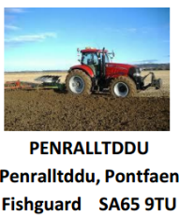





















Employer support
Designed with leading employers
The following employers have provided letters of support for our new Technical Qualifications in Land:
Notes:
Just a small snapshot of supporting employers

Slide 23
Design principles
QCF vs Technical Qualifications
New Technical Qualifications
 | Key Stage 4 – Level 2 | Key Stage 5 – Level 2 |  | Key Stage 5 – Level 3
GLH | 120 Made up of 30, 60 GLH units | 360 Made up of 30, 60 and 150 GLH units |  | 360, 540, 720, 1080 Made up of 30, 60 GLH units
Progression | Apprenticeship Employment Level 2 or 3 Technical qualifications | Apprenticeship Employment Level 3 Technical Level Qualification |  | Apprenticeship Employment Higher education course
Grading | P/M/D/D*
UCAS points | n/a |  | n/a | 16 min – 168 max
Mandatory content and contribution to overall grade | Must make up at least 40% of the qualification
Assessment | A proportion of the qualification content will be assessed externally (minimum 25% for Technical Certificates and 30% Tech Level). Must also include synoptic assessment.
Employer Involvement | In design, recognition, delivery and or assessment, which raises the credibility of the qualification in the eyes of employers, parents and learners.
Old QCF Technical Qualifications
GLH | 15-1080
Types | NVQ, VRQ – Award Certificate & Diploma
Progression | Apprenticeship, next level of employment
Grading | VRQ = P,M, D or D* NVQ = P or F
Mandatory content and contribution to overall grade | VRQ Unitised grading
Assessment | Formative, summative and test/assignment
Employer Involvement | N/A
Notes:
Notes for BMs
- Lead into conversation around support available in shift to Technical Qualifications

Slide 24


Design principles
City & Guilds vs other AOs
Other AOs
Synoptic practical assessment.
End-knowledge assessment.
Synoptic practical assessment.
End-knowledge test papers (A & B).
Service portfolio
A practical observation per mandatory unit (graded and non-graded practical assessment).
Portfolio of evidence.
Methods of
assessment
Externally set.
Internally marked
Externally moderated (City & Guilds).
Marked against assessment objectives.
Contributes to 60% of final grade.
Externally set.
Internally marked
Externally verified
Externally set, internally marked and externally verified
Contributes to 20% of final grade
Synoptic
Practical
assessment
One examination.*
Externally set and externally marked.
Covers a variety of mandatory unit content.
2 windows in first year.
Contributes to 40% of final grade
Multiple examinations.
Contributes to 30% of final grade
End-knowledge
assessment
Externally set, internally marked.
Centres select which units
Graded – Pass/Merit/Distinction employers can see the grade which identifies strengths in specific skills
Does not contribute to final grade
Not graded – Pass/Fail.
Does not contribute to final grade.
Optional
units
* contributes to 40% of the overall mark

Slide 25

New Technical Qualifications

Slide 26
Approvals
Process:
Centre decides which qualification they want to offer
Centre applies for the qualification(s) by submitting a QAP form through the Walled Garden in the Quality tab
Quality team receives QAP and starts to process
Quality team will send out an EQA (External Quality Assurer) to check everything is in order at the centre
Approval either granted or refused
If approved centre can start delivering and registering learners
New Centres: If you’re a college or a private training provider looking to become a City & Guilds centre, please get in touch via our Customer Application Form on our website. Once you've filled out the form you’ll be contacted by us and we’ll guide you through the process of becoming a centre and you could be up and running in as little as 30 days.
Existing Centres: If you're an existing City & Guilds centre looking to offer more qualifications including Technical Qualifications, you’ll need to submit a Qualification Approval (QAP) Form within the Walled Garden Portal.

Slide 27

Assessment considerations
External and synoptic assessment
    Synoptic assessment (60% of the total mark)
    Internal synoptic assessment made up of a series of tasks, many of which will be practical in nature.
    Written by City & Guilds
    The assignment will be launched towards the beginning of January to give learners an opportunity to research and gather relevant evidence. (Released to centres for planning the previous September)
    Compiling the tasks of the assignment will be carried out under controlled conditions, however, learners will be allowed to use their research, notes and any visual evidence (where relevant) to complete this.
    This will be submitted around the middle of May.
    External assessment (40% of the total mark)
    Level 2 are on-demand multiple choice; Level 3 are dated entry and are sat in March, with a resit opportunity in June.
    Confirmation of the date will be communicated to centres as soon as it is known.
    The test will be a combination of MCQs and short-answer questions, based on the mandatory content of the qualification.
    Sample papers are available on the website.
    There will be one resit opportunity within the academic year.
    Learners must pass both the external and internal assessments to pass the qualification.

Slide 28
Key assessment dates 2017
Event | Date
Opening of learner registration window | 4 Sept 2017
Synoptic assignments released to centres | 4 Sept 2017
Optional units released to centres | 4 Sept 2017
Deadline for learner registration | 31 October 2017
Booking window for Spring exam series | 1 November 2017
Booking window for synoptic assignments, optional units (if applicable) and employer involvement (KS5 only) open | 1 November 2017
Deadline for booking Spring exam series | 15 December 2017
Deadline for booking synoptic assignments, optional units (if applicable) and employer involvement (KS5 only) | 15 December 2017

Slide 29
Key assessment dates 2018
Event | Date
Synoptic assignments released to learners | 5 February 2018
First Spring exam series begins | 26 February 2018
Booking window for Summer exam series opens | 1 March 2018
Results of first exam series | 23 April 2018
Booking window for Summer exam series closes | 27 April 2018
Deadline for submitting evidence and marks onto Moderation Portal for synoptic assignments | 14 May 2018
Summer exam series begins | 21 May 2018
Deadline for booking Summer exam series | 25 May 2018
Deadline for submitting evidence and grades onto Moderation Portal on optional units (if applicable) and employer involvement (KS5 only) | 15 June 2018
Final results available | August 2018

Slide 30

Assessment example – synoptic
Level 3 Advanced Technical Certificate in Animal Management
Available on documents tab of the 0172 qualification page
You have recently been appointed as an animal technician at a local domestic animal collection. Within this collection there is a range of small and large animal species.
As part of the duties for the post, you are expected to have knowledge and understanding of animal husbandry, animal handling, behaviour, feeding and nutrition and animal welfare. You will be expected to apply this knowledge to demonstrate the skills required in such a role.
^{Conditions of assessment:}
You must carry the task out on your own, under supervision. Where assistance is required, this is under the guidance of the tutor.
You must follow the given animal management plan for a minimum of 5 days for each animal.
At all times, the health and safety legislation, animal welfare codes of practice and legislation and a risk assessment must be adhered to.

Slide 31
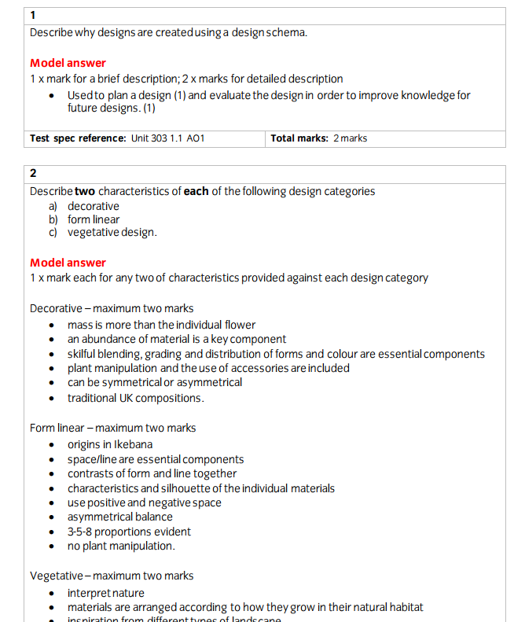

Assessment example – external test
Level 3 Advanced Technical Diploma in Floristry (540)
Notes:
0174 Horticulture L3 e.g.

Slide 32

Flexible and efficient teaching and learning
More time to teach a higher quality curriculum

Slide 33


Flexible and efficient teaching and learning
More time to teach
Other awarding
organisations
  Two clear methods of assessment.
  A high-quality moderation approach.
  Synoptic practical assessment is externally set.
  Tutors spend more time teaching and less time assessing.
  Five different assessment methods.
  Use a verification model which requires ongoing assessments.
  Synoptic practical assessment is internally set.
  Providers have to set assessments internally.
  Assessment
  approach
Option of online or paper-based exams.
16 week window for learners to take the synoptic tests so they can undertake them when they are ready to do so.
Multiple pathways available for learners who wish to enter the Land-based sector
50 available pathways within the land-based suite of technicals.
  Fewer options at Level 2.
  Pathways available for
  for learners
Notes:
noptic, exam, internal assessment related to optional units, multiple choice exam with health and safety, formative - speak with Anita

Slide 34



Flexible and efficient teaching and learning
Flexible delivery
Other awarding
organisations
  Different sizes for most subjects
  Create customised learning programmes for all capabilities
  Fit within a programme of study and support maths and English delivery
  Different sizes available only at some levels.
More time to teach
  GLH
  High recognition of qualifications in Land-based sector.
  Key influential employers involved in the qualification design.
  Valued by providers
  Option of online or paper-based exams
  18-week window for learners to take the synoptic tests so they can undertake when they are ready to do so
  Varying levels of support throughout the industry.
  Assessments
  Valued by employers

Slide 35

Flexible and efficient teaching and learning
  Moderation approach, which means that marks are nationally standardised.
  Bespoke portal of which learner grades and evidence are uploaded and then moderated by City & Guilds for consistency.
  All centres receive an annual moderation visit to give tutors
  extra support.
  Key industry players involved in the
  qualification design
  Quality
  assurance model
High-quality curriculum valued by employers

Slide 36
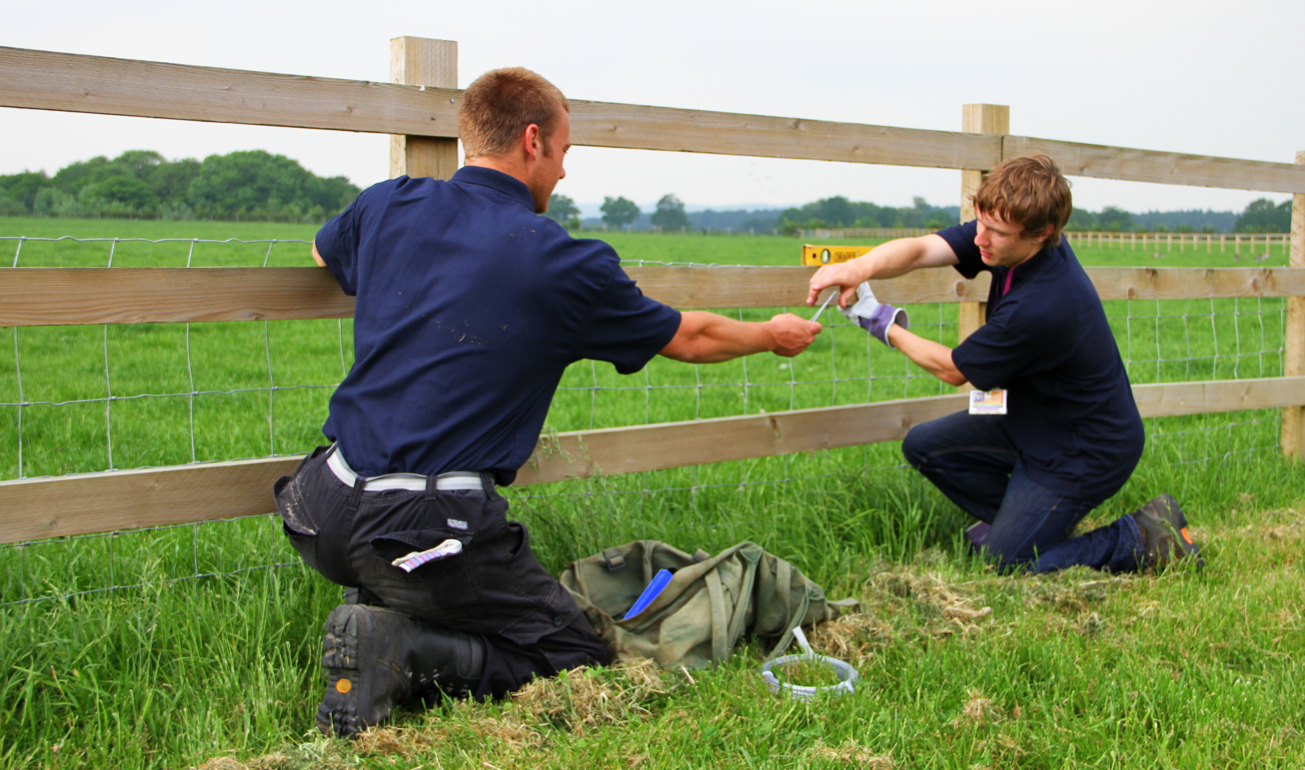
Support to deliver
Seamlessly transition to Technical Qualifications

Slide 37

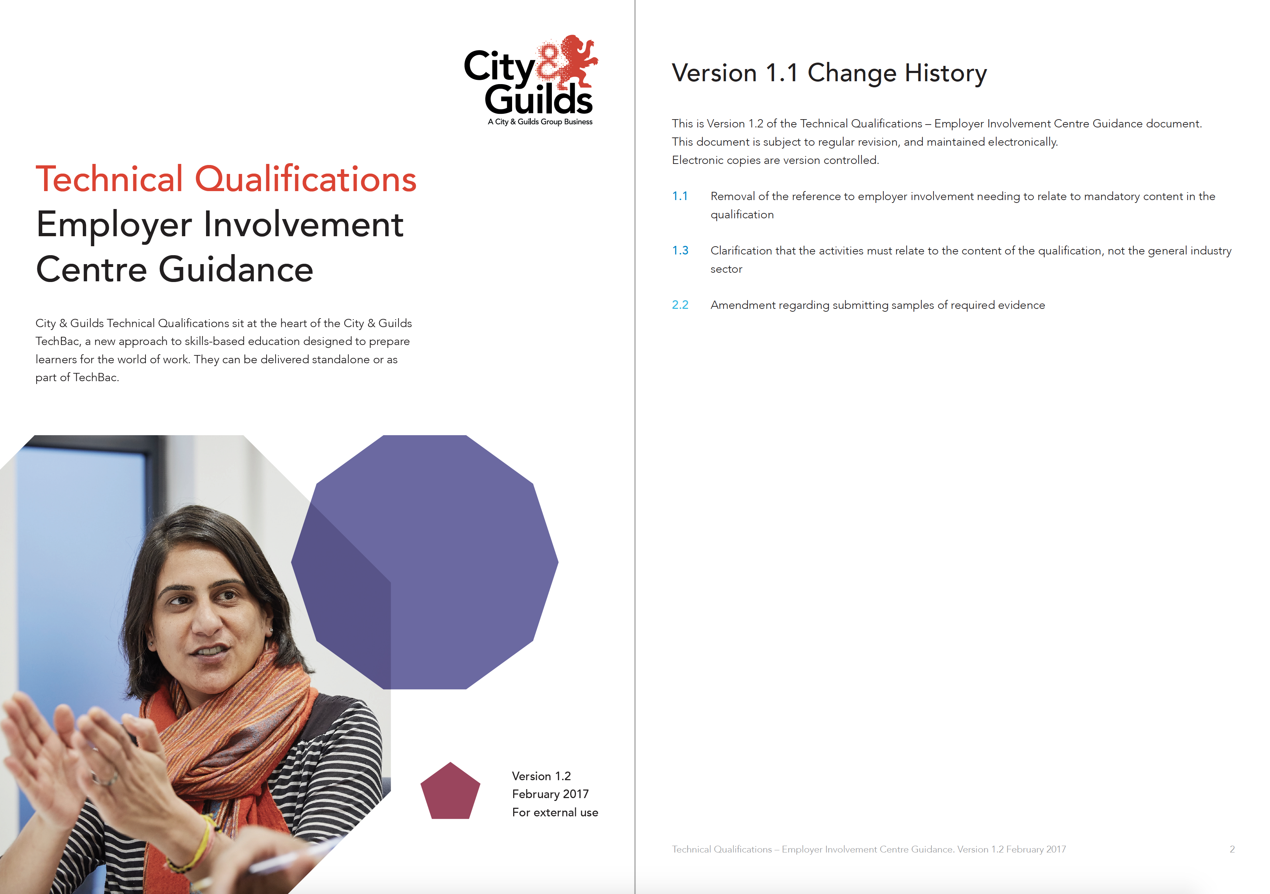



Support to deliver
    Free after-sales support
    1-to-1 consultations with a Technical Advisor to help courses run smoothly.
    National technical advisors to support your delivery teams in house.
    National network support events for centres delivering the qualifications.
    Direct support from National Land Based College.
  Sector
  support and expertise
  Free web resources
Employer Involvement Guide
Understand the new requirements around Employer Involvement.
Teaching, Learning and Assessment Guide
All you need to know about assessments in Technical Qualifications plus what is needed from tutors and curriculum managers to plan effectively for delivery.
Marking and Moderation Guide
Understand the approach to grading and how moderation works in practice.
Sample curriculum plans
How to best structure content and units across the academic year.
PLUS, see cityandguilds.com/technicals
for more

Slide 38

Support to deliver
    Physical resources
    Qualification handbook
    Sample external end test
    Sample synoptic assignment
Refresh teaching methods
and ideas
Download documentation at: cityandguilds.com
Handouts
Worksheets
Presentations
Plus more…
Standardise the delivery of foundation and technique
Ensure industry standards for a guaranteed progression
Notes:
Available online documentation includes:
Qualification Handbooks
Sample synoptic assessments
Sample external end tests
Work Placement Reflective work books for L2 and L3

Slide 39
Workplace Skills Platform Skills Zone
Our Workplace Skills platform Skills Zone is unique in the way that it helps to develop, recognise and showcase the soft skills, attributes and behaviours that aren’t covered by qualifications alone, or aren’t accredited under a current programme of study.
Check out our learner introduction video here
City & Guilds Workplace Skills is designed to complement:
All programmes of study at 14-19
Technicals
The City & Guilds TechBac programme
Employability programmes
Any Level 2 and Level 3 provision
Apprenticeships – mapping to ‘behaviours’
Open Badges assessment framework, Skills Zone acknowledges learners'
work-ready characteristics in form of digital credentials
Incorporates MyCV builder
Clear line of sight to work

Slide 40
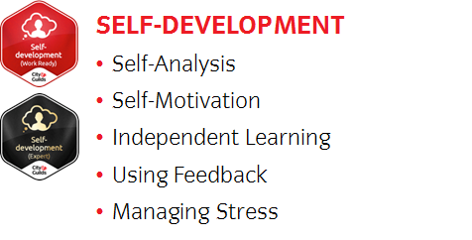
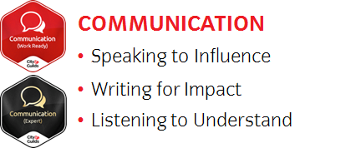

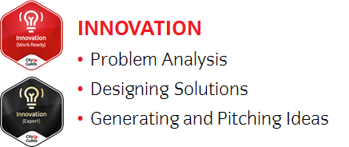
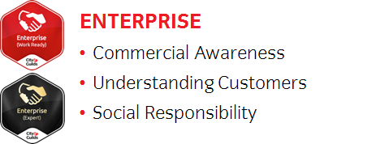


24 attitudes and behaviors are recognised at 2 levels

Slide 41

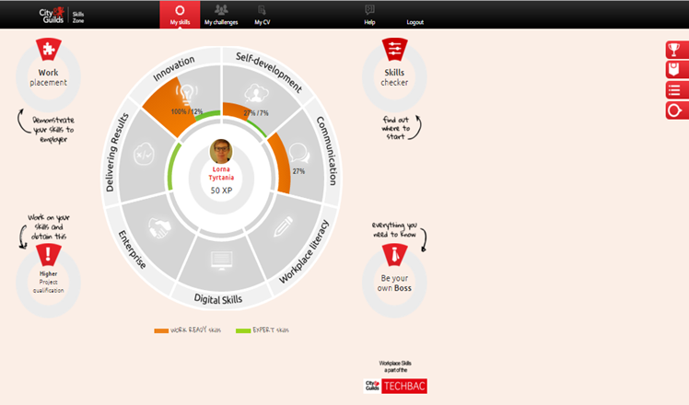
The landing page
Interactive Learner Work Experience Logbook
Interactive quizzes on Workplace Health and Safety, “Making the Most of your placement” and “Making a Good Impression”.
Videos from learners on placements
NEW Work Experience Evidence section – where learners can upload a range of different evidence types in support of their work placement experience.
Tabs to see:
Leader boards
Open badges
Navigation links
Notifications
A personalised learning experience
Click on an a skill area on the ‘skills wheel’ to navigate into the selected area of development
Learners are awarded Experience Points or XP points for their interaction with the platform

Slide 42
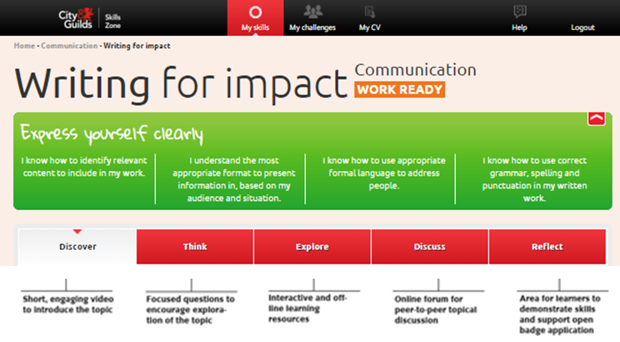
Social learning community
These skill statements tell you what you need to be able to do to claim your Open Badge
Click on these sections to access them. You need to complete ‘Discover and Think’ to unlock the other sections

Slide 43
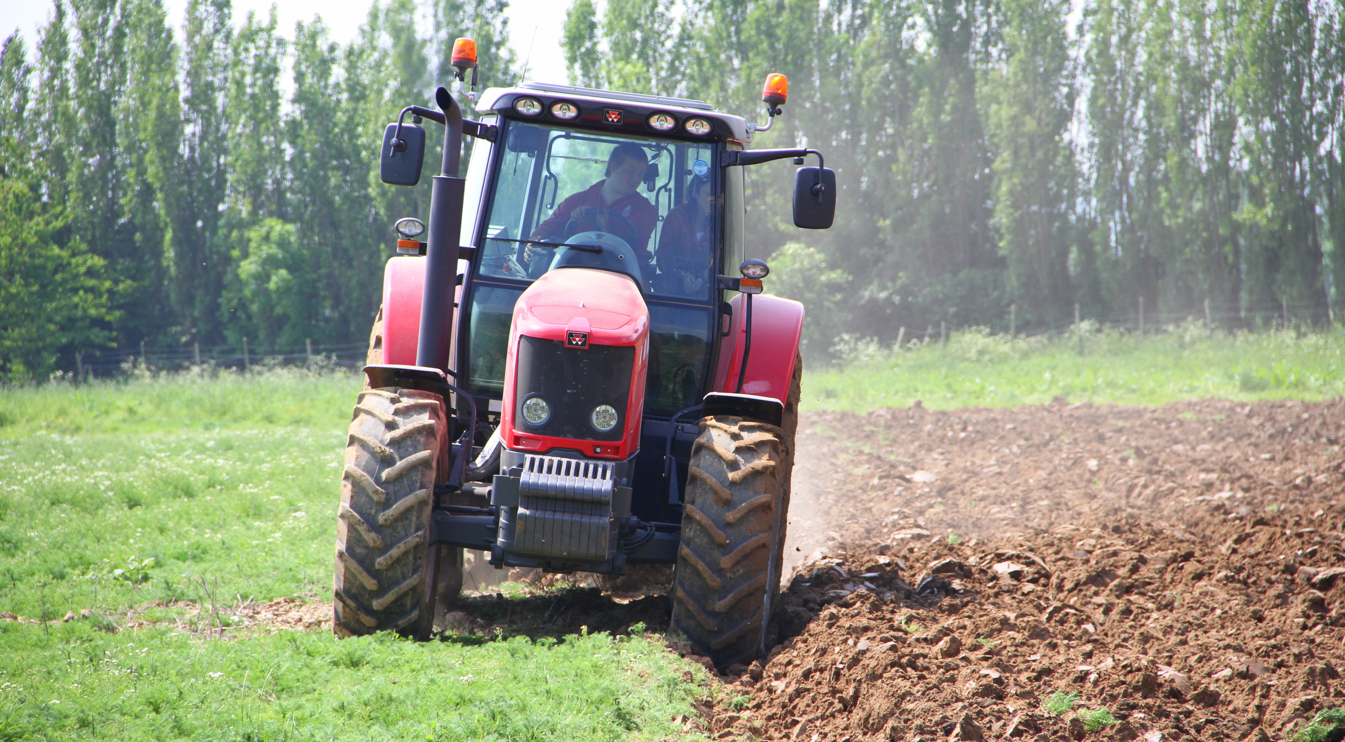
Creating choice for learners
A route to employment

Slide 44
Progression to university
City & Guilds Technical Qualifications
Grade | Level 3 Advanced Technical Certificate (360) | Level 3 Advanced Technical Diploma (450) | Level 3 Advanced Technical Diploma (540) | Level 3 Advanced Extended Technical Diploma (720) | Level 3 Advanced Extended Technical Diploma (1080)
Distinction* | 56 | 56 | 84 | 112 | 168
Distinction | 48 | 48 | 72 | 96 | 144
Merit | 32 | 32 | 48 | 64 | 96
Pass | 16 | 16 | 24 | 32 | 48
Other City & Guilds Technical Qualifications
Grade | Level 3 Extended Project Qualification | Using and Applying Mathematics (Core Maths)
A* | 28 | –
A | 24 | 20
B | 20 | 16
C | 16 | 12
D | 12 | 10
E | 8 | 6
  A level
  equivalent
  points
  2017
^{A level grade} | ^{UCAS points}
A* | 56
A | 48
B | 40
C | 32
D | 24
E | 16

Slide 45
Meeting the challenge with the City & Guilds TechBac
TechBac is a unique combination of:
Technical Skills
New employer-recognised City & Guilds Technical Qualifications:
designed to meet the latest education reforms
relevant to industry needs
rigorous, high-quality practical learning with outcomes in mind
supporting progress to further education, university or employment.
Workplace Skills
City & Guilds Workplace Skills is a blended approach to developing transferable and social skills:
develop, accredit and showcase Workplace Skills to enrich learners’ CVs
help learners to feel confident and ready for work
track learners’ engagement and progress to optimise performance
aligned to changes in policy and digital delivery
support to embed in delivery.
To create, recognise and award these attributes and behaviours, we have developed the Skills Zone, our gateway to Workplace Skills.
A rounded individual who is:
confident, talented, motivated and ready to work

Slide 46


Keep in
touch
Looking to deliver starting September 2017?
Book in a planning meeting with your Business Manager or our Land-based Technical Advisor, Belinda Esdaile
Find out more about how we support City & Guilds centres delivering Technical Qualifications at cityandguilds.com/technicals
Keep up-to-date with the latest news and developments by joining our mailing list at cityandguilds.com/technicals
Speak to National Land Based College to hear about the support they can offer Member Colleges
Belinda Esdaile City & Guilds Technical Advisor for Land M: 07730 764886 E: belinda.esdaile@cityandguilds.com
Sarah Purdell NLBC Programme Development Manager M: 07495683917 E: sarah.purdell@nlbc.uk

