Slide 1


TRAIN THE TRAINER EVENT – TECHNICAL QUALIFICATIONS
2016
Hair & Beauty Spring 2016
Notes:
Start the session off by introducing our new theTechnicals which have been developed as part of our emerging 14-19 offer and the CG TechBac.

Slide 2

AGENDA
WHY ARE WE HERE
THE ONBOARDING/APPROVAL PROCESS
A GUIDE TO DELIVERY
SYNOPTIC ASSESSMENT
EXTERNAL EXAMS PROCESS- EVOLVE EXAM BOOKINGS
MODERATION PROCESSES
ASSESSMENTS AND MARKING TO ASSESSMENT OBJECTIVES
AWARDING AND GRADING
CERTIFICATION
PROGRESS PATHWAYS
AN OVERVIEW OF AVAILABLE C&G TOOLKIT

Slide 3
CHALLENGES FOR 14-19 EDUCATION
A CHANGING LANDSCAPE
The 14-19 landscape is dramatically changing to support learners’ work readiness:
WHAT’S DRIVING THE CHANGES?
The gap between education and employment
2011 Wolf report
Raising of the participation age
Greater technology use
AUG 2013
DFE Introduced 16-19 study programmes
SEPT 2014
First teaching of KS4 Technical Awards
JAN 2015
First Performance Tables to reflect the reforms
SEPT 2016
New performance measures and first teaching of KS5 Tech Levels (L3)
SEPT 2017
First teaching of KS5 Technical Certificates (L2)

Slide 4
A CLOSER LOOK AT:
TECHNICAL
QUALIFICATIONS

Slide 5
WHAT’S AVAILABLE?
CITY & GUILDS ADVANCED TECHNICAL LEVEL QUALIFICATIONS HAVE NOW BEEN APPROVED TO APPEAR ON PERFORMANCE TABLES, PROVIDING EVEN MORE CHOICE FOR PROVIDERS AND LEARNERS. WE HAVE THE MOST CHOICE OF
ANY AWARDING ORGANISATION
THE DFE HAS APPROVED 8 CITY & GUILDS HAIR
& BEAUTY TECHNICAL QUALIFICATIONS FOR SEPTEMBER 2016
TEACHING IN 7 SUBJECT AREAS

Slide 6

WHAT’S AVAILABLE?
BEAUTY
Key Stage 5 - Level 3
6003-30 (601/7352/X) Level 3 Advanced Technical Diploma in Beauty and Spa Therapy (540GLH)
6003-32 (601/7492/4) Level 3 Advanced Technical Diploma in Nail Technology
(450GLH)
6010-30 (601/7501/1) Level 3 Advanced Technical Diploma in Media make-up
Artistry (540GLH)
6010-31 (601/7514/X) Level 3 Advanced Technical Diploma in Theatrical,
Special Effects and Media Make-up Artistry (540GLH)
6004-30 (601/7355/5.) Level 3 Advanced Technical Diploma
in Complementary Therapies (540GLH)
TO VIEW A FULL LIST OF TECHNICALS VISIT:
WWW.CITYANDGUILDS.COM/PERFORMANCETABLES

Slide 7

WHAT’S AVAILABLE?
HAIR
Key Stage 5 - Level 3
6002-30 (601/7348/8) Level 3 Advanced Technical Diploma in Hairdressing (540GLH)
6002- 31 (601/7346/4) Level 3 Advanced Technical Diploma in Barbering (450GLH)
TO VIEW A FULL LIST OF TECHNICALS VISIT:
WWW.CITYANDGUILDS.COM/PERFORMANCETABLES

Slide 8
WHAT’S AVAILABLE?
HAIR
BEAUTY
Key Stage 4 - Level 2
3038-21 (601/7247/2) Level 2 Technical Award In Hair
and Beauty Studies (120 GLH) NOW APPROVED
TO VIEW A FULL LIST OF TECHNICALS VISIT:
WWW.CITYANDGUILDS.COM/PERFORMANCETABLES

Slide 9
TECHNICAL QUALIFICATIONS
QUALIFICATION APPROVAL
PROCESS
(QAP)

Slide 10
CHALLENGES FOR 14-19 EDUCATION
WHAT WILL THEY EXPERIENCE AND WHEN
QAP Process-Welcome on boarding processes
QAP Received
MARCH- SEPTEMBER
QAP RECEIVED BY QUALITY TEAM
Acknowledgement email sent within 48hrs and EQA contacts the centre to arrange suitable visit date
End to end work scale is up to 30 working days
EQA VISIT
To evaluate the centre against qualification approval criteria so as to recommend decision for approval.
POST VISIT:
Quality Team confirm decision on approval within 10 working days of visit.
Final check by Quality Teams of Employer Involvement.
ANY CHANGES:
Complete a centre update form to notify the Quality Team of any resource changes from original approval.
WHAT WILL WE OFFER
EMAIL
TELEPHONE
APPROVAL VISIT PER SECTOR
EMAIL
TELEPHONE
SELF SERVICE ONLINE
EMAIL
TELEPHONE
SELF SERVICE ONLINE
CHANNEL AVAILABLE
Notes:
Approval
New centres will need to gain centre approval. Existing centres who wish to offer this qualification must go through City & Guilds’ full Qualification Approval Process. There is no fast track approval for this qualification. Please refer to the City & Guilds website for further information on the approval process: www.cityandguilds.com
Resource requirements
Centre staff should familiarise themselves with the structure, content and assessment requirements of the qualification before designing a course programme, as detailed under the following headings.
Centre staffing
Physical resources
Internal Quality Assurance
Registration & Booking
All learners must be registered in the usual manner via Walled Garden.
All learners will also need to be booked for assessments in the academic year that they are sitting the assessments. This will need to be done in the relevant window (currently looking at November and January as booking windows). City & Guilds requires this information in order to plan resources (examiners, moderators) etc.

Slide 11
TECHNICAL QUALIFICATIONS
APPROVAL, REGISTRATION & BOOKING
Approval
Approved centres – Qualifcation Approval Process (QAP)
New organisations – Centre Approval Process (CAP)
Approval visit – all centres
Approval visit & employer involvement plan check - KS5 only
Registration
Learners registered as normal through Walled Garden
Booking
Centres must book learners for assessments in the year that they will complete them (synoptic assessment & external assessment)
Two booking windows – November & January
Learners booked for synoptic practical assignment
Learners booked through Evolve for external assessment (dated entry)
Notes:
Approval
New centres will need to gain centre approval. Existing centres who wish to offer this qualification must go through City & Guilds’ full Qualification Approval Process. There is no fast track approval for this qualification. Please refer to the City & Guilds website for further information on the approval process: www.cityandguilds.com
Resource requirements
Centre staff should familiarise themselves with the structure, content and assessment requirements of the qualification before designing a course programme, as detailed under the following headings.
Centre staffing
Physical resources
Internal Quality Assurance
Registration & Booking
All learners must be registered in the usual manner via Walled Garden.
All learners will also need to be booked for assessments in the academic year that they are sitting the assessments. This will need to be done in the relevant window (currently looking at November and January as booking windows). City & Guilds requires this information in order to plan resources (examiners, moderators) etc.
.

Slide 12
TECHNICAL QUALIFICATIONS
EMPLOYER INVOLVEMENT

Slide 13
TECHNICAL QUALIFICATIONS
EMPLOYER INVOLVEMENT (KS5 ONLY)
For the KS5 Technical Qualifications (L2 & L3), the Employer Involvement component MUST be met by all learners in order to achieve the qualification.
Stage 1 - Approval
Centre completes Employer Involvement plan as part of Qualification approval
Stage 2 - Delivery
Learners undertake range of ‘meaningful’ Employer Involvement activities
Stage 3 Submission
Centre completes Employer Involvement declaration and submits evidence for learners in sample
City & Guilds review plan during Approval visit and give improvement actions where necessary
Plan signed off when Approval is granted
City & Guilds review declaration and learner evidence and confirm whether requirement has been met (remote activity)
Contingency arranged for learners unable to complete / access Employer Involvement activities
Centres ensure that learners evidence of Employer Involvement activities is captured
If required, City & Guilds provide actions to be completed by centre in order for requirements to be met
Notes:
For the Key Stage 5 Technical Qualifications, Employer Involvement is a requirement that must be successfully met in order for learners to achieve the qualification. Although it does not contribute to the overall qualification grading, employer involvement in the delivery and/or assessment of these qualifications is essential for all candidates, and will therefore be externally quality assured by City & Guilds.
The ultimate aim of Employer Involvement in the delivery and assessment of Technical qualifications is to develop and enrich student’s experience. Structured programmes of Employer Involvement in the delivery and assessment of the Technical Qualifications will;
prepare 16 -19 learners for work
be mutually beneficial for employers and centres
utilise employer expertise to enrich learner experience
enable employers to feed into curriculums and programmes of study
provide work placements that are tailored to specific learner needs
provide formalised and auditable evidence that centres are meeting the requirement
Employer involvement is a formal component of the delivery of KS5 Technical Qualifications. In order to claim the Employer involvement component for each learner, centres must gather evidence that demonstrates that the learner has been involved in meaningful employer-based activities, relating to the qualification’s mandatory content.
Centres must record the range and type of employer involvement each learner has experienced. These records must be available for external quality assurance by City & Guilds upon request.

Slide 14
TECHNICAL QUALIFICATIONS
EMPLOYER INVOLVEMENT (cont.)
What is considered ‘meaningful’ Employer Involvement?
YES | NO
It must relate to mandatory content of qualification and could include the following; Structured work experience / work placements Adapted / locally set tasks and assessments Practical activities / visits Guest lectures / master classes from employers Employers acting as expert witnesses during assessment | The following activities, whilst valuable, do not meet the requirement for meaningful employer involvement; employers’ or industry practitioners’ input to the initial design and content of a qualification; employers hosting visits, providing premises, facilities or equipment; employers providing talks or contributing to delivery on employability, general careers advice, CV writing, interview training etc; attendance at career fairs, events or other networking opportunities; simulated working environments e.g. hairdressing/beauty internal salons (RWE) employers providing students with job references
Notes:
To be eligible, employer involvement activities must relate to one or more elements of the mandatory content of this qualification. This will be quality assured by City & Guilds and any candidate who does not meet this requirement will not be able to achieve the qualification certificate.
It is expected that the centre will plan a range of activities that provide sufficient live involvement for each learner to have opportunities to interact directly with a range of individuals employed in the related industry. Centres must also provide contingencies for learners who may be absent for part of their teaching, so that they are not disadvantaged. Any absence that results in a learner missing arranged activities must be documented.
The key message for centres is that employer involvement activities must be meaningful, sector specific and relate to the mandatory content. One developed and involving activity could be more beneficial to a learner than a number of less involving activates
Some examples of ‘meaningful’ EI activities:
Work experience activities
Work placement
Practical activities
Adapted or locally set tasks and assessments
Guest lectures from industry professionals
Master classes run by employers
Industry practitioners / employers acting as expert witnesses for practical assessment

Slide 15
TECHNICAL QUALIFICATIONS
STRUCTURE

Slide 16
TECHNICAL QUALIFICATIONS
STRUCTURE
These are the components that make up Technical Qualifications. All components must be completed to achieve the qualification
Technical Qualifications
End assessment: Examinations
Employer Involvement
(KS5 Qualifications L2 & L3 only)
Optional Units
Synoptic Practical Assignment
- Externally set
- Internally marked
- Externally moderated (City & Guilds)
- No Direct Claim Status (DCS)
- Contributes to 60% final grade
- Externally set
- Externally marked
- No Direct Claim Status (DCS)
- Contributes to 40% final grade
- Centres develop programme
- Evidence submitted
- External verification (City & Guilds)
- No Direct Claim Status (DCS)
- Does not contribute to final grade
- Externally set
- Centres select which units
- Internally marked
- Samples externally moderated (City & Guilds)
- No Direct Claim Status (DCS)
- Does not contribute to final grade
Notes:
We will now look at the two main elements of TechBac in more detail, starting with Technical Qualifications.
Our new City & Guilds Technical qualifications have been designed and endorsed by employers, providing up to date and highly relevant skills with graded assessments. A practical and applied approach to assessment ensures that staff have more time to focus on teaching and learning, for more successful outcomes.
Technical qualifications are comprised of the following elements:
Synoptic assessment – this is assessment in which two or more areas of learning are brought together in a single assessment. This approach has been adopted for this qualification in order to help learners make connections between areas of learning and to promote holistic delivery and understanding of the subject. Synoptic assessments are comprised of a Practical Assignment and a written Examination.
The assignments are externally set, internally marked and externally moderated, and are designed to assess a specific optional task or area of the qualification. To do this, the candidate will be required to identify and use effectively an appropriate selection of skills, techniques, concepts, theories and knowledge from across the whole content area.
The examinations are externally set and externally marked, and will be sat online through City & Guilds’ computer-based assessment platform. The exam assesses the depth and breadth of the candidate’s understanding of the mandatory content of the qualification.
Employer Involvement - for the Key Stage 5 Technical Qualifications, Employer Involvement is a requirement that must be successfully met in order for learners to achieve the qualification. Although it does not contribute to the overall qualification grading, employer involvement in the delivery and/or assessment of these qualifications is essential for all candidates, and will therefore be externally quality assured by City & Guilds. The EQAs will review the centre employer involvement plans at approval stage, and then the Quality team will sample the evidence at cohort level, when the centre submits at the end of the academic year.
Optional Units - These assignments are externally set, internally marked and externally moderated, and are designed to assess a specific optional task or area of the qualification. To do this, the candidate will be required to identify and use effectively an appropriate selection of skills, techniques, concepts, theories and knowledge from across the whole content area
All elements are mandatory to achieve the Technical Qualification (although Employer Involvement is only a requirement for KS5 quals). However only the Synoptic Assessments contribute towards the final grade.
There is no Direct Claim Status for any of the components, so centres will no be able to claim results themselves.

Slide 17
TECHNICAL QUALIFICATIONS
ASSESSMENT

Slide 18
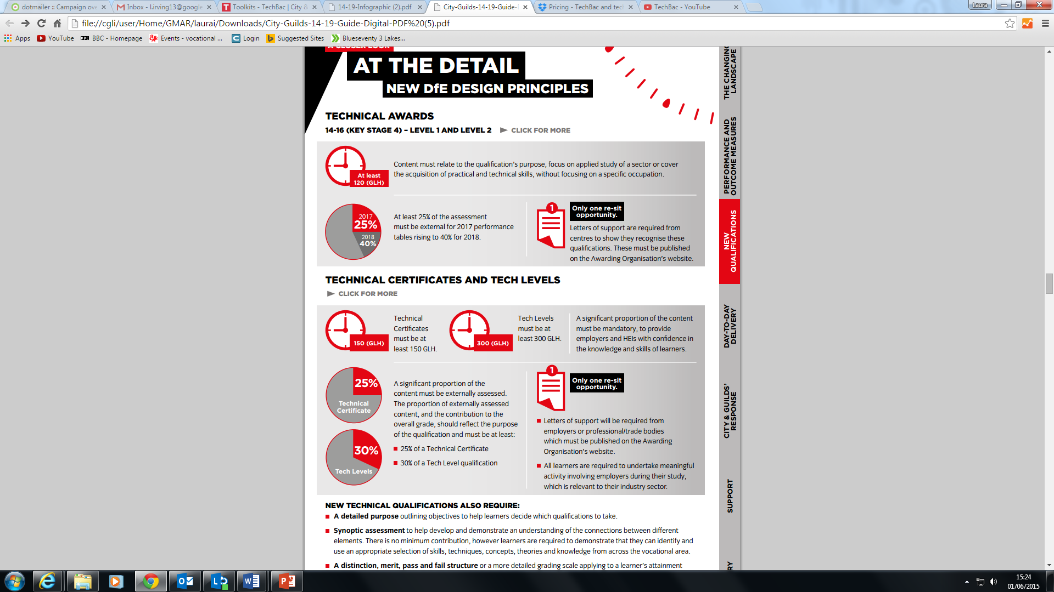
ALIGNED TO DfE CHANGES IN ENGLAND
450 GLH or 540 GLH,
Progression: Enable entry to an apprenticeship or other employment, or progression to a related higher education course.
GRADING: P/M/D/D*
UCAS points: 60 min – 210 max
Mandatory content and the contribution to overall grade must make up at least 40% of the qualification. Where qualifications have one or more pathway, the mandatory content (%) should apply equally to these.
Assessment: A proportion of the qualification content will be assessed externally (minimum 40% Tech Level). Must also include synoptic assessment (60%).
Employer involvement: in design, recognition, delivery and or assessment, which raises the credibility of the qualification in the eyes of employers, parents and learners
Notes:
We will now look at the two main elements of TechBac in more detail, starting with Technical Qualifications.
Our new City & Guilds Technical qualifications have been designed and endorsed by employers, providing up to date and highly relevant skills with graded assessments. A practical and applied approach to assessment ensures that staff have more time to focus on teaching and learning, for more successful outcomes.
Technical qualifications are comprised of the following elements:
Synoptic assessment – this is assessment in which two or more areas of learning are brought together in a single assessment. This approach has been adopted for this qualification in order to help learners make connections between areas of learning and to promote holistic delivery and understanding of the subject. Synoptic assessments are comprised of a Practical Assignment and a written Examination.
The assignments are externally set, internally marked and externally moderated, and are designed to assess a specific optional task or area of the qualification. To do this, the candidate will be required to identify and use effectively an appropriate selection of skills, techniques, concepts, theories and knowledge from across the whole content area.
The examinations are externally set and externally marked, and will be sat online through City & Guilds’ computer-based assessment platform. The exam assesses the depth and breadth of the candidate’s understanding of the mandatory content of the qualification.
Employer Involvement - for the Key Stage 5 Technical Qualifications, Employer Involvement is a requirement that must be successfully met in order for learners to achieve the qualification. Although it does not contribute to the overall qualification grading, employer involvement in the delivery and/or assessment of these qualifications is essential for all candidates, and will therefore be externally quality assured by City & Guilds. The EQAs will review the centre employer involvement plans at approval stage, and then the Quality team will sample the evidence at cohort level, when the centre submits at the end of the academic year.
Optional Units - These assignments are externally set, internally marked and externally moderated, and are designed to assess a specific optional task or area of the qualification. To do this, the candidate will be required to identify and use effectively an appropriate selection of skills, techniques, concepts, theories and knowledge from across the whole content area
All elements are mandatory to achieve the Technical Qualification (although Employer Involvement is only a requirement for KS5 quals). However only the Synoptic Assessments contribute towards the final grade.
There is no Direct Claim Status for any of the components, so centres will no be able to claim results themselves.

Slide 19

ASSESSMENT METHODOLOGIES
TECHNICAL QUALIFICATIONS
Key Stage 5
EXAM
External assessment:
Externally written and marked knowledge Exams, including stretch and challenge questions.
Covers mandatory units
Contributes to 40% of Technical Qualification
Graded DMPX
Only one re-sit opportunity.
Notes:
We will now look at the two main elements of TechBac in more detail, starting with Technical Qualifications.
Our new City & Guilds Technical qualifications have been designed and endorsed by employers, providing up to date and highly relevant skills with graded assessments. A practical and applied approach to assessment ensures that staff have more time to focus on teaching and learning, for more successful outcomes.
Technical qualifications are comprised of the following elements:
Synoptic assessment – this is assessment in which two or more areas of learning are brought together in a single assessment. This approach has been adopted for this qualification in order to help learners make connections between areas of learning and to promote holistic delivery and understanding of the subject. Synoptic assessments are comprised of a Practical Assignment and a written Examination.
The assignments are externally set, internally marked and externally moderated, and are designed to assess a specific optional task or area of the qualification. To do this, the candidate will be required to identify and use effectively an appropriate selection of skills, techniques, concepts, theories and knowledge from across the whole content area.
The examinations are externally set and externally marked, and will be sat online through City & Guilds’ computer-based assessment platform. The exam assesses the depth and breadth of the candidate’s understanding of the mandatory content of the qualification.
Employer Involvement - for the Key Stage 5 Technical Qualifications, Employer Involvement is a requirement that must be successfully met in order for learners to achieve the qualification. Although it does not contribute to the overall qualification grading, employer involvement in the delivery and/or assessment of these qualifications is essential for all candidates, and will therefore be externally quality assured by City & Guilds. The EQAs will review the centre employer involvement plans at approval stage, and then the Quality team will sample the evidence at cohort level, when the centre submits at the end of the academic year.
Optional Units - These assignments are externally set, internally marked and externally moderated, and are designed to assess a specific optional task or area of the qualification. To do this, the candidate will be required to identify and use effectively an appropriate selection of skills, techniques, concepts, theories and knowledge from across the whole content area
All elements are mandatory to achieve the Technical Qualification (although Employer Involvement is only a requirement for KS5 quals). However only the Synoptic Assessments contribute towards the final grade.
There is no Direct Claim Status for any of the components, so centres will no be able to claim results themselves.

Slide 20
Question Types
Exam will have a mix of question formats/types which:
assess essential knowledge/understanding
provide ‘stretch and challenge’ to:
        differentiate candidates on their ability to demonstrate how fully they understand a topic (depth)
  How: ask for causes and effects, benefits and limitations, advantages and disadvantages, to compare and contrast, full topic coverage
        differentiate candidates on their ability to demonstrate upper levels of cognitive demand
  analysis (differentiate), evaluation (critique), create (generate, propose)
  command verbs to use - Discuss, Justify, Assess, Examine, Propose etc
  use knowledge and understanding from across units to answer the question (integration of knowledge/understanding)
Notes:
Note about guide which include preparation for exams and command verbs
Examples of how to set questions that assess depth coming up
Integration – examples coming up
Approx 20% integration, higher % of understanding than recall

Slide 21
Short answer question - breadth
State one main function of the respiratory system. (1 mark)
Any one of the following:
to transport air into the lungs
to facilitate the diffusion of Oxygen into the blood stream
to receive waste Carbon Dioxide from the blood
to exhale Carbon Dioxide from the body
AO1 Knowledge – recall of facts
Notes:
More than one main function as evident by mark scheme, also why only focus on function, why not ask how as well?
Any suggestions on how this could be reworded to assess more depth? And understanding as well as recall

Slide 22
Short answer question - depth
Explain the main functions of the respiratory system. (4 marks)
One mark for each of the following:
To transport air into the lungs (1 mark) which facilitates the diffusion of oxygen into the blood stream (1 mark).
To receive waste carbon dioxide from the blood (1 mark) so carbon dioxide can be exhaled from the body (1 mark)
AO1 Knowledge and AO2 Understanding
Notes:
Explain instead of state, ask for main. I mark for what (AO1) and 1 mark for the affect (AO2)
Candidate that can only state 1 function gets 1 mark, candidate that can state both main functions gets 2 marks.
Candidate that can state the effects of the functions can get extra marks.

Slide 23
Extended response question
An unconstrained question requiring more elaborate answers and explanations of reasoning in order to demonstrate higher order abilities. It aims to elicit evidence of effective thinking and reasoning in the context of the subject rather than a single correct answer. Reference to materials (eg a case study, extract from a source, site plans) may be used to form a basis for analysis, interpretation, problem solving.
Question: Case study
A client had returned from holiday with colour fade, on mid lengths and ends of her hair. She would like to keep the lighter sun kissed colour, but in ensure of the darker roots. She also mentioned she had a tattoo whilst she was away.
Discuss the following
Colour and lightening techniques that could be used
Tests to be carried out and expected results
How the results may impact the service and the advice that should be given
12 Marks
(12 marks)
Notes:
An unconstrained question prompting the candidate to construct an answer in the form of an extended response. Allows the candidate to demonstrate higher order abilities which require more elaborate answers and explanations of reasoning, eg analysis, problem solving, argumentation, creative writing skills. Typically there is not a single correct answer, instead the question intends to elicit evidence of whether the candidate is thinking and reasoning effectively in the context of the subject.
Question - No scaffolding in Question, No mentioning of how many ‘ways’ What is being tested? integration of knowledge and understanding.
So how would you form your response to this question? Types of wear (Eroding, chipping, cracking etc.), how they occur, prevention options, considerations for options of minimising, recommendations supported by justifications
Marking scheme based on quality of response – indicate content on types, prevention and options, then level of marking by quality of response

Slide 24
Checklist for level of response marking
Thoroughness of response
how well did they cover the focus/topic of the question (detail)
were the main issues/ideas/concepts/opinions discussed
was the response clear and coherent or isolated points
Relevance
how appropriate was the discussion/debate/argument/opinion
were the points made relevant
Accuracy
how well was the focus/topic of the question understood
how accurate (and relevant) where the points and linkages made
was their analysis accurate
Considered
did they compare and contrast in their response
did they consider benefits/limitations, causes/effects/impacts/consequences, advantages/disadvantages, pros/cons
Supported
were their explanations supported with examples
did they justify/substantiate their opinions/recommendations/conclusions
Notes:
How will the candidates responses be judged and allocated marks
Show example of IT extended response question

Slide 25
ASSESSMENT METHODOLOGIES
TECHNICAL QUALIFICATIONS
Key Stage 5
SYNOPTIC PRACTICAL ASSIGNMENT
Industry relevant synoptic assignments, bringing together skills and knowledge (Practical trade test).
Research activities
Reflection and evaluation
Moderation approach to ensure robust quality and rigour.
Visiting moderation
Contributes 60% of Technical Qualification
Notes:
We will now look at the two main elements of TechBac in more detail, starting with Technical Qualifications.
Our new City & Guilds Technical qualifications have been designed and endorsed by employers, providing up to date and highly relevant skills with graded assessments. A practical and applied approach to assessment ensures that staff have more time to focus on teaching and learning, for more successful outcomes.
Technical qualifications are comprised of the following elements:
Synoptic assessment – this is assessment in which two or more areas of learning are brought together in a single assessment. This approach has been adopted for this qualification in order to help learners make connections between areas of learning and to promote holistic delivery and understanding of the subject. Synoptic assessments are comprised of a Practical Assignment and a written Examination.
The assignments are externally set, internally marked and externally moderated, and are designed to assess a specific optional task or area of the qualification. To do this, the candidate will be required to identify and use effectively an appropriate selection of skills, techniques, concepts, theories and knowledge from across the whole content area.
The examinations are externally set and externally marked, and will be sat online through City & Guilds’ computer-based assessment platform. The exam assesses the depth and breadth of the candidate’s understanding of the mandatory content of the qualification.
Employer Involvement - for the Key Stage 5 Technical Qualifications, Employer Involvement is a requirement that must be successfully met in order for learners to achieve the qualification. Although it does not contribute to the overall qualification grading, employer involvement in the delivery and/or assessment of these qualifications is essential for all candidates, and will therefore be externally quality assured by City & Guilds. The EQAs will review the centre employer involvement plans at approval stage, and then the Quality team will sample the evidence at cohort level, when the centre submits at the end of the academic year.
Optional Units - These assignments are externally set, internally marked and externally moderated, and are designed to assess a specific optional task or area of the qualification. To do this, the candidate will be required to identify and use effectively an appropriate selection of skills, techniques, concepts, theories and knowledge from across the whole content area
All elements are mandatory to achieve the Technical Qualification (although Employer Involvement is only a requirement for KS5 quals). However only the Synoptic Assessments contribute towards the final grade.
There is no Direct Claim Status for any of the components, so centres will no be able to claim results themselves.

Slide 26
Synoptic Assignment
    Requires the integration of knowledge, understanding and skills from across the units - may be the only valid way to assess the qualification
    High order skills can be assessed (e.g. plan, create, evaluate)
    Should reflect industry, job role/purpose statement – validity
    Marked using Assessment Objectives
    Standardises marking across centres – reliable (more reliable than coursework assessment or centre set assessment)
    Reduces burden of assessment on centres as one synoptic end test rather than unitised testing or continuous assessment. – efficient/cost effective
    May allow for local differences eg contexts, tools and equipment
Notes:
Valid – realistic work environment, but it is important that candidates are given a situation that allows the KSU to be meaningfully assessed.
Level – e.g. the brief is developed around a role that is suitable for the level of candidate (e.g. a marketing executive, rather than a head of marketing); language, instruction etc – is relevant.
Integration means that it is not aiming for 100% coverage, it is looking to sample the KSU from across the qualification.
Strengths
May be the only way of testing some of content of unit
Obvious relevance to job and therefore high acceptance – centres, candidates and employers
Provide dependable source of knowledge about candidate’s practical skills
Generally available on demand

Slide 27
Marking Grid
    The Marking Grid is arranged by Assessment Objectives (AOs)
    AO weightings set prior to development of the assignment
    AO weightings reflect the job role/purpose statement, not what is being applied within the assignment.
    Descriptors for each AO are based on holistic, qualitative statements.
    A single approved marking grid is used for all assignment versions.
    Why?
    More compensatory than holistic grading
    Reduces the risk of repeatedly attributing marks for the same characteristic
    Fixed, to ensure all candidate results are based on the same balance of characteristics on each occasion
    Note
    Not all AOs have to be covered as a default within the marking grid
    The first marking band does not align to Pass
    The marking grid is not to be considered as a mark scheme
Notes:
Descriptors are holistic – these should not be written specifically to the assignment (e.g. not a traditional mark scheme type approach: ‘The candidate completed an interactive presentation in limited detail.’)
More compensatory than holistic grading – as usually placed at lowest performance for VRQ grading i.e. if communication is poor but techniques are good in VRQ candidate usually placed at lowest performance but using AOs rewarded for good techniques
Reduces the risk of repeatedly attributing marks for the same characteristic -i.e. like some VRQs where tasks are graded individually
Fixed, to ensure all candidate results are based on the same balance of characteristics on each occasion – used for every version
Notes – how to use – detail included in marking and moderation guide. Tutors/markers consider all evidence for the AO and then which band best describes a candidate and then rank orders candidates in each band of the AO. This doesn’t mean that they have to allocate every mark and more than one candidate can be allocated the same mark. Moderation will include aligning a centres marking to the national standard.

Slide 28

GROUP ACTIVITY
SYNOPTIC ASSESSMENTS HAIR & BEAUTY
In small groups, discuss the sample assessment provided.
Notes:
Print Synoptic Sample Practical Assignment & Academic planners
Hairdressing
Barbering
Beauty & Spa
Nails
Comp Therapies
Media Make-up
Theatrical Media Make-up

Slide 29
SAMPLE SYNOPTIC ASSESSMENT
HAIRDRESSING
Notes:
Please identify what you end external test is and what is covered in your synoptic assignment.
For example:
External Assessment: Short answer, on line test, with stretch and challenge questions to allow for that distinction * please refer back to the timetable to explain that the end external assessment covers all mandatory knowledge and therefore there maybe a need to front load teaching to be able to accommodate learning and also to plan for practice tests.
Synoptic assignments: you need to give examples of how your technical qualifications meet this, for example:
Synoptic assignment covers, 1 skills test where a learner will need to produce a dish which follows the assignment brief. The learner will need to prepare for this xxxxxxxx synoptic assemmsnt will be marked internally using the gardng objectives and the end result will be moderatored.

Slide 30
SAMPLE SYNOPTIC ASSESSMENT
BEAUTY THERAPY
You are on work placement in a well known beauty salon and spa. The salon and spa are hosting a ‘pamper event’ for a group of clients who are preparing for a special occasion. The clients have all booked in for a range of treatments to include: Body massage, Facial electrical, Body electrical and a dry spa treatment incorporating a wrap.
As a beauty therapist you will be asked to plan a range of effective treatments for your allocated client which will improve their skin and body condition. You will be given up to 5 hours to perform the range of treatments.
You will perform a body and skin analysis as part of your assessment, selecting products and equipment to suit your client.
You should actively promote and identify sales opportunities, reflect on your treatments and services and evaluate the outcomes.
Notes:
Please identify what you end external test is and what is covered in your synoptic assignment.
For example:
External Assessment: Short answer, on line test, with stretch and challenge questions to allow for that distinction * please refer back to the timetable to explain that the end external assessment covers all mandatory knowledge and therefore there maybe a need to front load teaching to be able to accommodate learning and also to plan for practice tests.
Synoptic assignments: you need to give examples of how your technical qualifications meet this, for example:
Synoptic assignment covers, 1 skills test where a learner will need to produce a dish which follows the assignment brief. The learner will need to prepare for this xxxxxxxx synoptic assemmsnt will be marked internally using the gardng objectives and the end result will be moderatored.

Slide 31
SAMPLE SYNOPTIC ASSESSMENT
BEAUTY THERAPY
Meet, greet and consult with the client to discuss their treatment objectives, perform a body and skin analysis to agree a treatment plan for their pampering event.
Your treatments should be applied in the most suitable sequence and must include:
Body massage:
Full body massage including appropriate techniques and treatment application to meet client objectives
Facial electrical:
range of specific products to include exfoliation and mask as applicable
skin warming devices to suit treatment objectives
Body electrical:
minimum of two areas to be treated
minimum of two pieces of equipment to be demonstrated
range of specific products
skin warming devices to suit treatment objectives
Dry spa wrap:
full treatment
range of specific products to include body mask and wrapping material
skin warming devices to suit treatment objectives
Notes:
Please identify what you end external test is and what is covered in your synoptic assignment.
For example:
External Assessment: Short answer, on line test, with stretch and challenge questions to allow for that distinction * please refer back to the timetable to explain that the end external assessment covers all mandatory knowledge and therefore there maybe a need to front load teaching to be able to accommodate learning and also to plan for practice tests.
Synoptic assignments: you need to give examples of how your technical qualifications meet this, for example:
Synoptic assignment covers, 1 skills test where a learner will need to produce a dish which follows the assignment brief. The learner will need to prepare for this xxxxxxxx synoptic assemmsnt will be marked internally using the gardng objectives and the end result will be moderatored.

Slide 32
REWORKING EVIDENCE WITHIN
THE ASSESSMENT WINDOW
Under some circumstances learners may have the opportunity for learners to rework practical assignment before final submission
Candidates who have not yet submitted work for internal marking can rework evidence during the assessment window. This is based on their own judgement of the quality of their work

Slide 33
TECHNICAL QUALIFICATION
RESIT OPPORTUNITIES
Element | Component | Resit rules
Technical Qualification | Examination | One resit opportunity
Technical Qualification | Practical Assignment | Opportunity for learners in exceptional standards to rework assignment before submission One resit opportunity in next academic year If resitting, it must be a new task
Technical Qualification | Optional Units | Internally assessed and managed – C&G provide assessment through: Assignments, practical observation, evolve tests One resit opportunity
Technical Qualification (KS5) | Employer Involvement | No resit opportunity (not assessed) Opportunity to resubmit based on feedback from City & Guilds

Slide 34
ACTIVITY
USING ASSESSMENT OBJECTIVES
AO1 - Recalls knowledge from across the breadth of the qualification.
AO2 - Demonstrates understanding of concepts, theories and processes from across the breadth of the qualification.
AO3 - Demonstrates technical skills from across the breadth of the qualification.
AO4 - Applies knowledge, understanding and skills from across the breadth of the qualification in an integrated and holistic way to achieve specified purposes.
AO5 - Demonstrates perseverance in achieving high standards and attention to detail while showing an understanding of wider impact of their actions.
AO6 - Undertakes independent research for a purpose and uses information/data effectively.
AO7 - Demonstrates originality and creativity to experiment and innovate beyond conventional application of designs and/or use of materials.
AO8 - Communicates effectively, accurately and appropriately for the intended audience.
Notes:
Print off Examples from Qualification handbook – for Hairdressing/Barbering/Nails/ Media Makeup/ Beauty & Spa/Theatrical

Slide 35

GROUP ACTIVITY
SYNOPTIC ASSESSMENTS HAIR & BEAUTY
In small groups, using the
Assessment Objectives(AO) Award marks for the scenarios provided.
Notes:
Print Synoptic Sample Practical Assignment & Academic planners
Hairdressing
Barbering
Beauty & Spa
Nails
Comp Therapies
Media Make-up
Theatrical Media Make-up

Slide 36
TECHNICAL QUALIFICATIONS
MODERATION

Slide 37
PREPARATION Moderation
December
February
Centre marks and ranking submitted to City & Guilds by end February
Formative Assessments – Ranking Learners
Preparation for Final Assessment – Ranking Learners
Standardisation and marking in centres

Slide 38
Key milestones for Moderation
March
April
May
June
July
August
Centre marks and evidence submitted to City & Guilds by end May
Learners completing practical assignments
Release of results
Awarding
Moderation of centre marking
Standardisation and marking in centres
Feedback to centres on marking

Slide 39
TECHNICAL QUALIFICATIONS
PROGRESSION

Slide 40
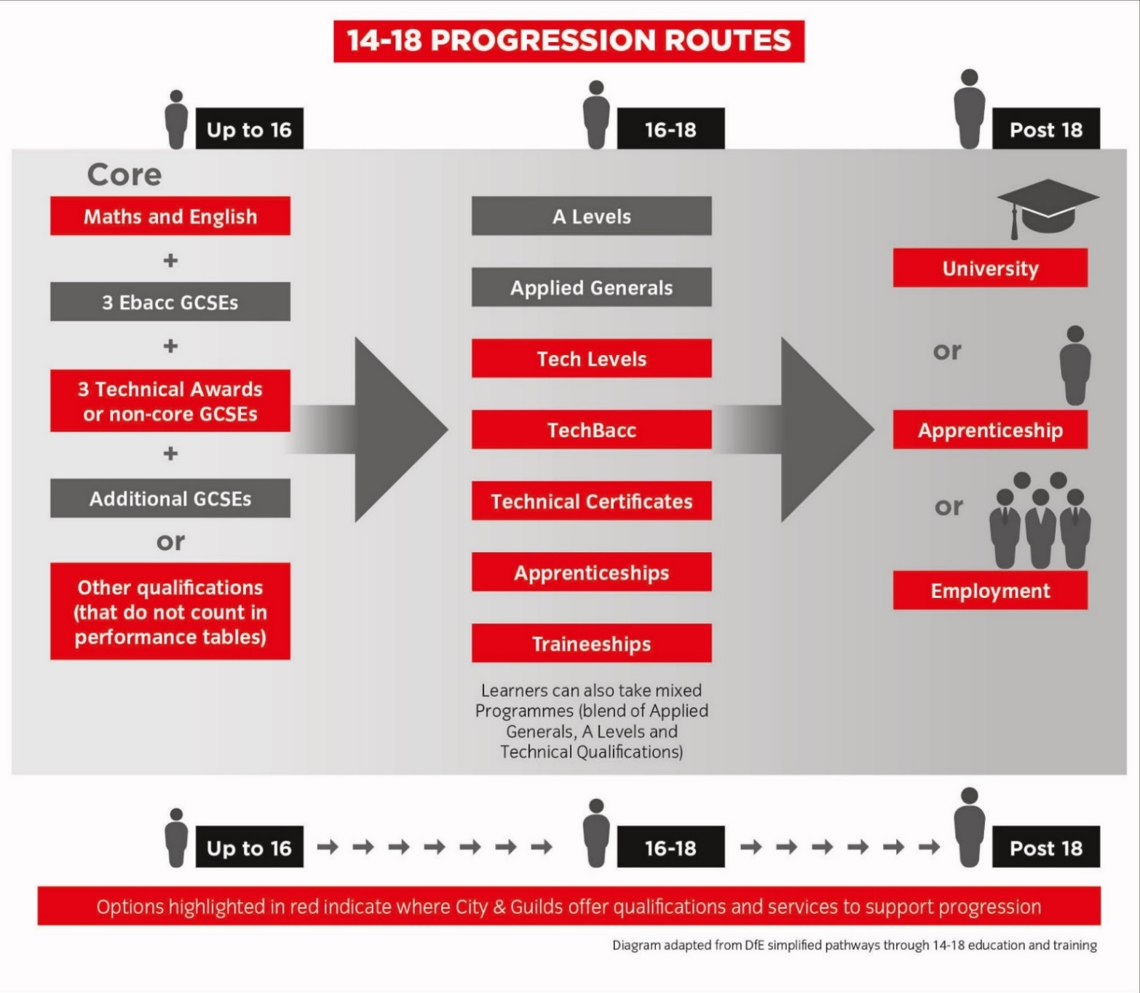
NEW PROGRESSION ROUTES
Notes:
We will now look at the two main elements of TechBac in more detail, starting with Technical Qualifications.
Our new City & Guilds Technical qualifications have been designed and endorsed by employers, providing up to date and highly relevant skills with graded assessments. A practical and applied approach to assessment ensures that staff have more time to focus on teaching and learning, for more successful outcomes.
Technical qualifications are comprised of the following elements:
Synoptic assessment – this is assessment in which two or more areas of learning are brought together in a single assessment. This approach has been adopted for this qualification in order to help learners make connections between areas of learning and to promote holistic delivery and understanding of the subject. Synoptic assessments are comprised of a Practical Assignment and a written Examination.
The assignments are externally set, internally marked and externally moderated, and are designed to assess a specific optional task or area of the qualification. To do this, the candidate will be required to identify and use effectively an appropriate selection of skills, techniques, concepts, theories and knowledge from across the whole content area.
The examinations are externally set and externally marked, and will be sat online through City & Guilds’ computer-based assessment platform. The exam assesses the depth and breadth of the candidate’s understanding of the mandatory content of the qualification.
Employer Involvement - for the Key Stage 5 Technical Qualifications, Employer Involvement is a requirement that must be successfully met in order for learners to achieve the qualification. Although it does not contribute to the overall qualification grading, employer involvement in the delivery and/or assessment of these qualifications is essential for all candidates, and will therefore be externally quality assured by City & Guilds. The EQAs will review the centre employer involvement plans at approval stage, and then the Quality team will sample the evidence at cohort level, when the centre submits at the end of the academic year.
Optional Units - These assignments are externally set, internally marked and externally moderated, and are designed to assess a specific optional task or area of the qualification. To do this, the candidate will be required to identify and use effectively an appropriate selection of skills, techniques, concepts, theories and knowledge from across the whole content area
All elements are mandatory to achieve the Technical Qualification (although Employer Involvement is only a requirement for KS5 quals). However only the Synoptic Assessments contribute towards the final grade.
There is no Direct Claim Status for any of the components, so centres will no be able to claim results themselves.

Slide 41
UCAS POINTS
TECHNICAL LEVELS
Grade | Level 3 Advanced Technical Diploma (450) | Level 3 Advanced Technical Diploma (540)
Distinction* | TBC | 84
Distinction | TBC | 72
Merit | TBC | 48
Pass | TBC | 24
OTHER QUALIFICATIONS TO SUPPORT PROGRESS TO HE
Grde | Level 3 Extended Project Qualification | Using And Applying Mathematics (Core Maths)
A* | 28
A | 24 | 20
B | 20 | 16
C | 16 | 12
D | 12 | 10
E | 8 | 6
A LEVEL EQUIVALENTS
UCAS points | A Level
56 | A*
48 | A
40 | B
32 | C
24 | D
16 | E
*UCAS points for our 450GLH Level 3 Advanced Technical Diploma will be confirmed in May 2016
Notes:
We will now look at the two main elements of TechBac in more detail, starting with Technical Qualifications.
Our new City & Guilds Technical qualifications have been designed and endorsed by employers, providing up to date and highly relevant skills with graded assessments. A practical and applied approach to assessment ensures that staff have more time to focus on teaching and learning, for more successful outcomes.
Technical qualifications are comprised of the following elements:
Synoptic assessment – this is assessment in which two or more areas of learning are brought together in a single assessment. This approach has been adopted for this qualification in order to help learners make connections between areas of learning and to promote holistic delivery and understanding of the subject. Synoptic assessments are comprised of a Practical Assignment and a written Examination.
The assignments are externally set, internally marked and externally moderated, and are designed to assess a specific optional task or area of the qualification. To do this, the candidate will be required to identify and use effectively an appropriate selection of skills, techniques, concepts, theories and knowledge from across the whole content area.
The examinations are externally set and externally marked, and will be sat online through City & Guilds’ computer-based assessment platform. The exam assesses the depth and breadth of the candidate’s understanding of the mandatory content of the qualification.
Employer Involvement - for the Key Stage 5 Technical Qualifications, Employer Involvement is a requirement that must be successfully met in order for learners to achieve the qualification. Although it does not contribute to the overall qualification grading, employer involvement in the delivery and/or assessment of these qualifications is essential for all candidates, and will therefore be externally quality assured by City & Guilds. The EQAs will review the centre employer involvement plans at approval stage, and then the Quality team will sample the evidence at cohort level, when the centre submits at the end of the academic year.
Optional Units - These assignments are externally set, internally marked and externally moderated, and are designed to assess a specific optional task or area of the qualification. To do this, the candidate will be required to identify and use effectively an appropriate selection of skills, techniques, concepts, theories and knowledge from across the whole content area
All elements are mandatory to achieve the Technical Qualification (although Employer Involvement is only a requirement for KS5 quals). However only the Synoptic Assessments contribute towards the final grade.
There is no Direct Claim Status for any of the components, so centres will no be able to claim results themselves.

Slide 42
TECHNICAL QUALIFICATIONS
RESOURCES

Slide 43
RESOURCES AVAILABLE
KEY DOCUMENTATION AND VIDEOS :
  Employer involvement guide
  Handbooks
  Sample assessments
  Holistic delivery and assessment guide
  Academic planners
  Exam calendar
INTRODUCTORY VIDEOS TO:
  Introduction video
  Academic planners
  Moderation
  Assessment
  Quality and approval process
SUPPORTING INFORMATION:
  Sector slides
  Sector flyers
  14-19 guide
  Feltag mapping
  Ofsted mapping
  Understanding performance points
Notes:
We will now look at the two main elements of TechBac in more detail, starting with Technical Qualifications.
Our new City & Guilds Technical qualifications have been designed and endorsed by employers, providing up to date and highly relevant skills with graded assessments. A practical and applied approach to assessment ensures that staff have more time to focus on teaching and learning, for more successful outcomes.
Technical qualifications are comprised of the following elements:
Synoptic assessment – this is assessment in which two or more areas of learning are brought together in a single assessment. This approach has been adopted for this qualification in order to help learners make connections between areas of learning and to promote holistic delivery and understanding of the subject. Synoptic assessments are comprised of a Practical Assignment and a written Examination.
The assignments are externally set, internally marked and externally moderated, and are designed to assess a specific optional task or area of the qualification. To do this, the candidate will be required to identify and use effectively an appropriate selection of skills, techniques, concepts, theories and knowledge from across the whole content area.
The examinations are externally set and externally marked, and will be sat online through City & Guilds’ computer-based assessment platform. The exam assesses the depth and breadth of the candidate’s understanding of the mandatory content of the qualification.
Employer Involvement - for the Key Stage 5 Technical Qualifications, Employer Involvement is a requirement that must be successfully met in order for learners to achieve the qualification. Although it does not contribute to the overall qualification grading, employer involvement in the delivery and/or assessment of these qualifications is essential for all candidates, and will therefore be externally quality assured by City & Guilds. The EQAs will review the centre employer involvement plans at approval stage, and then the Quality team will sample the evidence at cohort level, when the centre submits at the end of the academic year.
Optional Units - These assignments are externally set, internally marked and externally moderated, and are designed to assess a specific optional task or area of the qualification. To do this, the candidate will be required to identify and use effectively an appropriate selection of skills, techniques, concepts, theories and knowledge from across the whole content area
All elements are mandatory to achieve the Technical Qualification (although Employer Involvement is only a requirement for KS5 quals). However only the Synoptic Assessments contribute towards the final grade.
There is no Direct Claim Status for any of the components, so centres will no be able to claim results themselves.

Slide 44




QUALIFICATION SUPPORT RESOURCESS
Learner’s Journal
Textbooks
MHD Academy
Beauty/Spa online resources
© CITY & GUILDS

Slide 45
LEARNERS JOURNALS
Learner Journals
For:
Beauty and Spa Therapy
Barbering
Hairdressing
Media Make-up Artistry
Nails
Theatrical, Special effects & Media Make Arstitry
The new learner journals are designed to help learners work towards their Level 3 Advanced Technical Diploma qualifications by:
• helping learners to record their achievements and evidence
• allowing learners to reflect on their journey.
• helping learners draw together their learning from across the qualification to prepare for assessment.
The learner journal includes:
• unit planners to help learners plan their learning
• useful glossary definitions
• a summary of unit achievement
• progress tracking sheets
• coverage of values and behaviours
• a list of the necessary health and safety legislation
• information on preparing for the Trade Test.
Every unit contains the following main parts:
• ‘What do you need to know?’ contains all of the knowledge areas
• ‘What do you need to cover?’ signposts the scope of content
• ‘Scope record’ for learners to track their coverage of the scope of content
• ‘Self-reflection and observation feedback’ for learners to reflect on their performance.
Notes:
We will now look at the two main elements of TechBac in more detail, starting with Technical Qualifications.
Our new City & Guilds Technical qualifications have been designed and endorsed by employers, providing up to date and highly relevant skills with graded assessments. A practical and applied approach to assessment ensures that staff have more time to focus on teaching and learning, for more successful outcomes.
Technical qualifications are comprised of the following elements:
Synoptic assessment – this is assessment in which two or more areas of learning are brought together in a single assessment. This approach has been adopted for this qualification in order to help learners make connections between areas of learning and to promote holistic delivery and understanding of the subject. Synoptic assessments are comprised of a Practical Assignment and a written Examination.
The assignments are externally set, internally marked and externally moderated, and are designed to assess a specific optional task or area of the qualification. To do this, the candidate will be required to identify and use effectively an appropriate selection of skills, techniques, concepts, theories and knowledge from across the whole content area.
The examinations are externally set and externally marked, and will be sat online through City & Guilds’ computer-based assessment platform. The exam assesses the depth and breadth of the candidate’s understanding of the mandatory content of the qualification.
Employer Involvement - for the Key Stage 5 Technical Qualifications, Employer Involvement is a requirement that must be successfully met in order for learners to achieve the qualification. Although it does not contribute to the overall qualification grading, employer involvement in the delivery and/or assessment of these qualifications is essential for all candidates, and will therefore be externally quality assured by City & Guilds. The EQAs will review the centre employer involvement plans at approval stage, and then the Quality team will sample the evidence at cohort level, when the centre submits at the end of the academic year.
Optional Units - These assignments are externally set, internally marked and externally moderated, and are designed to assess a specific optional task or area of the qualification. To do this, the candidate will be required to identify and use effectively an appropriate selection of skills, techniques, concepts, theories and knowledge from across the whole content area
All elements are mandatory to achieve the Technical Qualification (although Employer Involvement is only a requirement for KS5 quals). However only the Synoptic Assessments contribute towards the final grade.
There is no Direct Claim Status for any of the components, so centres will no be able to claim results themselves.

Slide 46

TEXT BOOKS
These textbook includes:
• Step-by-step photo guides to the technical skills
• Workplace values and behaviours, signposted in each technical unit
• Handy hints and useful words to aid understanding
• Practical activities to help apply knowledge to practice
• Essential maths and English skills embedded in real-world scenarios
• Test Your Knowledge questions
• Eye-catching design to engage and inspire.
ISBN: 9780851933641
Code: TB036002
Price: £27.99
Published: June 2016
ISBN: 9780851933634
Code: TB036003
Price: £27.99
Published: June 2016
Notes:
We will now look at the two main elements of TechBac in more detail, starting with Technical Qualifications.
Our new City & Guilds Technical qualifications have been designed and endorsed by employers, providing up to date and highly relevant skills with graded assessments. A practical and applied approach to assessment ensures that staff have more time to focus on teaching and learning, for more successful outcomes.
Technical qualifications are comprised of the following elements:
Synoptic assessment – this is assessment in which two or more areas of learning are brought together in a single assessment. This approach has been adopted for this qualification in order to help learners make connections between areas of learning and to promote holistic delivery and understanding of the subject. Synoptic assessments are comprised of a Practical Assignment and a written Examination.
The assignments are externally set, internally marked and externally moderated, and are designed to assess a specific optional task or area of the qualification. To do this, the candidate will be required to identify and use effectively an appropriate selection of skills, techniques, concepts, theories and knowledge from across the whole content area.
The examinations are externally set and externally marked, and will be sat online through City & Guilds’ computer-based assessment platform. The exam assesses the depth and breadth of the candidate’s understanding of the mandatory content of the qualification.
Employer Involvement - for the Key Stage 5 Technical Qualifications, Employer Involvement is a requirement that must be successfully met in order for learners to achieve the qualification. Although it does not contribute to the overall qualification grading, employer involvement in the delivery and/or assessment of these qualifications is essential for all candidates, and will therefore be externally quality assured by City & Guilds. The EQAs will review the centre employer involvement plans at approval stage, and then the Quality team will sample the evidence at cohort level, when the centre submits at the end of the academic year.
Optional Units - These assignments are externally set, internally marked and externally moderated, and are designed to assess a specific optional task or area of the qualification. To do this, the candidate will be required to identify and use effectively an appropriate selection of skills, techniques, concepts, theories and knowledge from across the whole content area
All elements are mandatory to achieve the Technical Qualification (although Employer Involvement is only a requirement for KS5 quals). However only the Synoptic Assessments contribute towards the final grade.
There is no Direct Claim Status for any of the components, so centres will no be able to claim results themselves.

Slide 47
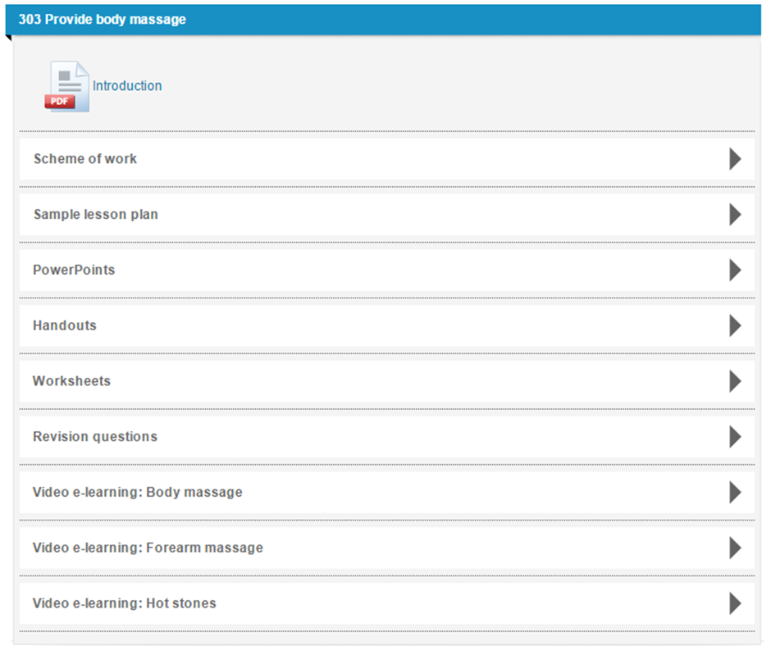
BEAUTY SMARTSCREEN PLUS
SmartScreen resources provided for each unit:
Introduction
Sample scheme of work
Sample lesson plan
PowerPoints
Handouts
Activities
Revision worksheets
Notes:
We will now look at the two main elements of TechBac in more detail, starting with Technical Qualifications.
Our new City & Guilds Technical qualifications have been designed and endorsed by employers, providing up to date and highly relevant skills with graded assessments. A practical and applied approach to assessment ensures that staff have more time to focus on teaching and learning, for more successful outcomes.
Technical qualifications are comprised of the following elements:
Synoptic assessment – this is assessment in which two or more areas of learning are brought together in a single assessment. This approach has been adopted for this qualification in order to help learners make connections between areas of learning and to promote holistic delivery and understanding of the subject. Synoptic assessments are comprised of a Practical Assignment and a written Examination.
The assignments are externally set, internally marked and externally moderated, and are designed to assess a specific optional task or area of the qualification. To do this, the candidate will be required to identify and use effectively an appropriate selection of skills, techniques, concepts, theories and knowledge from across the whole content area.
The examinations are externally set and externally marked, and will be sat online through City & Guilds’ computer-based assessment platform. The exam assesses the depth and breadth of the candidate’s understanding of the mandatory content of the qualification.
Employer Involvement - for the Key Stage 5 Technical Qualifications, Employer Involvement is a requirement that must be successfully met in order for learners to achieve the qualification. Although it does not contribute to the overall qualification grading, employer involvement in the delivery and/or assessment of these qualifications is essential for all candidates, and will therefore be externally quality assured by City & Guilds. The EQAs will review the centre employer involvement plans at approval stage, and then the Quality team will sample the evidence at cohort level, when the centre submits at the end of the academic year.
Optional Units - These assignments are externally set, internally marked and externally moderated, and are designed to assess a specific optional task or area of the qualification. To do this, the candidate will be required to identify and use effectively an appropriate selection of skills, techniques, concepts, theories and knowledge from across the whole content area
All elements are mandatory to achieve the Technical Qualification (although Employer Involvement is only a requirement for KS5 quals). However only the Synoptic Assessments contribute towards the final grade.
There is no Direct Claim Status for any of the components, so centres will no be able to claim results themselves.

Slide 48
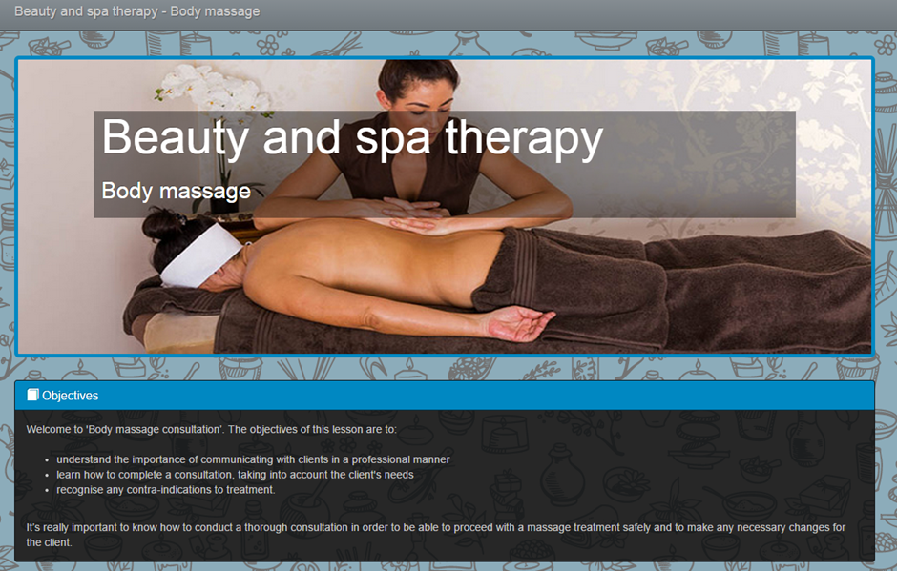
BEAUTY SMARTSCREEN PLUS
In addition, the following units also contain video e-learning:
303 Provide body massage
304 Provide facial electrotherapy treatments
305 Provide body electrotherapy treatments
306 Provide dry spa treatments
307 Provide electrical epilation
308 Provide Indian head massage
309 Tanning treatments
311 Provide individual semi-permanent
lash treatments
320 Provide hot stone treatments
Notes:
We will now look at the two main elements of TechBac in more detail, starting with Technical Qualifications.
Our new City & Guilds Technical qualifications have been designed and endorsed by employers, providing up to date and highly relevant skills with graded assessments. A practical and applied approach to assessment ensures that staff have more time to focus on teaching and learning, for more successful outcomes.
Technical qualifications are comprised of the following elements:
Synoptic assessment – this is assessment in which two or more areas of learning are brought together in a single assessment. This approach has been adopted for this qualification in order to help learners make connections between areas of learning and to promote holistic delivery and understanding of the subject. Synoptic assessments are comprised of a Practical Assignment and a written Examination.
The assignments are externally set, internally marked and externally moderated, and are designed to assess a specific optional task or area of the qualification. To do this, the candidate will be required to identify and use effectively an appropriate selection of skills, techniques, concepts, theories and knowledge from across the whole content area.
The examinations are externally set and externally marked, and will be sat online through City & Guilds’ computer-based assessment platform. The exam assesses the depth and breadth of the candidate’s understanding of the mandatory content of the qualification.
Employer Involvement - for the Key Stage 5 Technical Qualifications, Employer Involvement is a requirement that must be successfully met in order for learners to achieve the qualification. Although it does not contribute to the overall qualification grading, employer involvement in the delivery and/or assessment of these qualifications is essential for all candidates, and will therefore be externally quality assured by City & Guilds. The EQAs will review the centre employer involvement plans at approval stage, and then the Quality team will sample the evidence at cohort level, when the centre submits at the end of the academic year.
Optional Units - These assignments are externally set, internally marked and externally moderated, and are designed to assess a specific optional task or area of the qualification. To do this, the candidate will be required to identify and use effectively an appropriate selection of skills, techniques, concepts, theories and knowledge from across the whole content area
All elements are mandatory to achieve the Technical Qualification (although Employer Involvement is only a requirement for KS5 quals). However only the Synoptic Assessments contribute towards the final grade.
There is no Direct Claim Status for any of the components, so centres will no be able to claim results themselves.

Slide 49

CITY & GUILDS - MHDPRO

Slide 50
HOW TECHBAC WORKS
+
TECHNICAL SKILLS
PROFESSIONAL SKILLS
New employer recognised City & Guilds qualifications;
Designed to meet the latest education reforms
Relevant to the latest industry needs
Rigorous, high quality practical learning with outcomes in mind
UCAS points at Level 3
City & Guilds Workplace Skills is a blended approach to developing the transferable and social skills;
Develop, accredit and showcase 24 workplace skills, enriching your learners’ CVs
Helps learners to feel confident and ready for the world of work
To create, recognise and award these attributes and behaviours, we have developed the Workplace skills, our gateway to Workplace Skills.
=
Rounded individual who is:
CONFIDENT, TALENTED, MOTIVATED AND READY TO WORK
Notes:
Overall offer
What it looks like; levels, key stages etc.
Feature led slide

Slide 51
WORKPLACE SKILLS
DEVELOPING & RECOGNISING KEY ‘SOFT SKILLS’ FOR WORK AND LIFE
MY SKILLS
CV BUILDER
TEAM CHALLENGE
Problem Analysis
Listen & Understand
Social Responsibility
Impact & Audience
Using Digital Technology
Communicating Digitally
Team Working
Generate Pitch Ideas
Decision Making
Using Online Resources
Self Analysis
Understanding Customers
Professionalism
Negotiate & Persuade
Designing Solutions
A series of rich e-learning resources, mapped to the 7 core employability skills of City & Guilds Workplace Skills.
The online CV brings together everything the learner has achieved and allows them to easily share their achievements with potential employers.
This nationally set competition allows learners to work together on a task that is set and jjudged by leading employers like the BBC.
WORK PLACEMENT
MY PROJECT
SUPPORT
QUALIFICATION
Using Feedback
Adapting to Change
Managing Stress
Self Motivation
Planning for Success
Resilience
Financial Awareness
Commercial Awareness
The Techbac Skills Zone provides learners with access to e-learning to help them prepare and get the most from their placement, as well as an interactive Logbook to help them track and review what
they have learnt.
The project qualification available at level 2 and level 3 is highly regarded by universities ans schools for promoting independent learning. Level 3 carries UCAS
points to support progression to higher education.
www.cityandguilds.com/workplace-skills

Slide 52
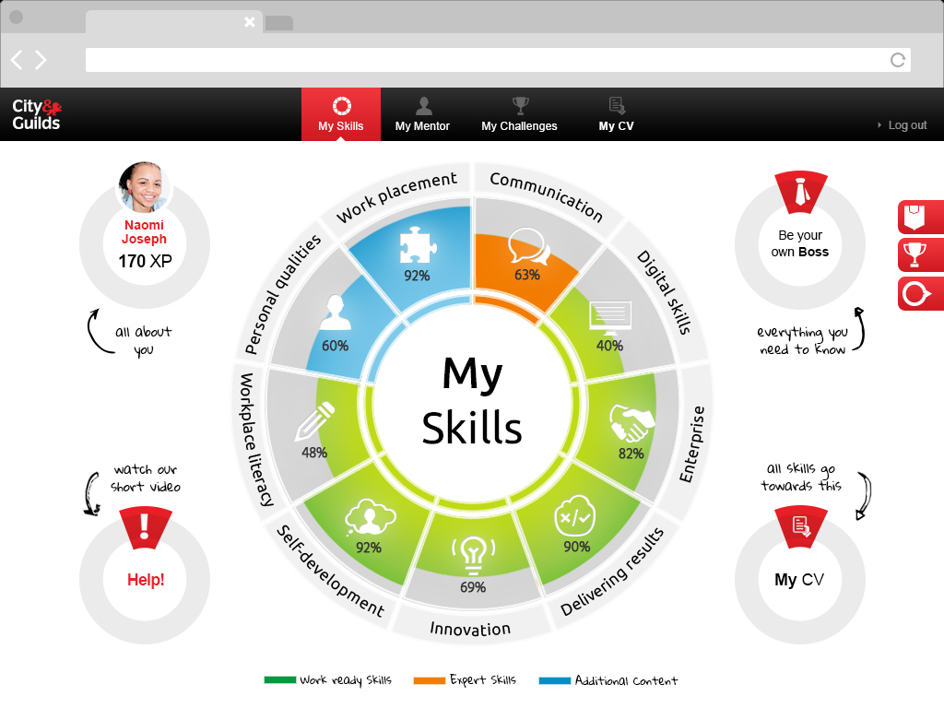
WORKPLACE SKILLS
DEVELOPING & RECOGNISING KEY ‘SOFT SKILLS’ FOR WORK AND LIFE
WORKPLACE SKILLS DEMO

Slide 53

QUESTIONS?
& ANSWERS
DISCOVER MORE AT WWW.TECHBAC.COM

