Slide 1
Know the structure of the hospitality industry
PowerPoint presentation
Unit 201: Understanding the hospitality industry

Slide 2
Introduction
It is important to understand how businesses work and the scale and types of hospitality operation; form small local restaurants to large corporate hotel chains.
It is always important to understand the different departments within a hospitality establishment and how your job role fits into this structure.

Slide 3
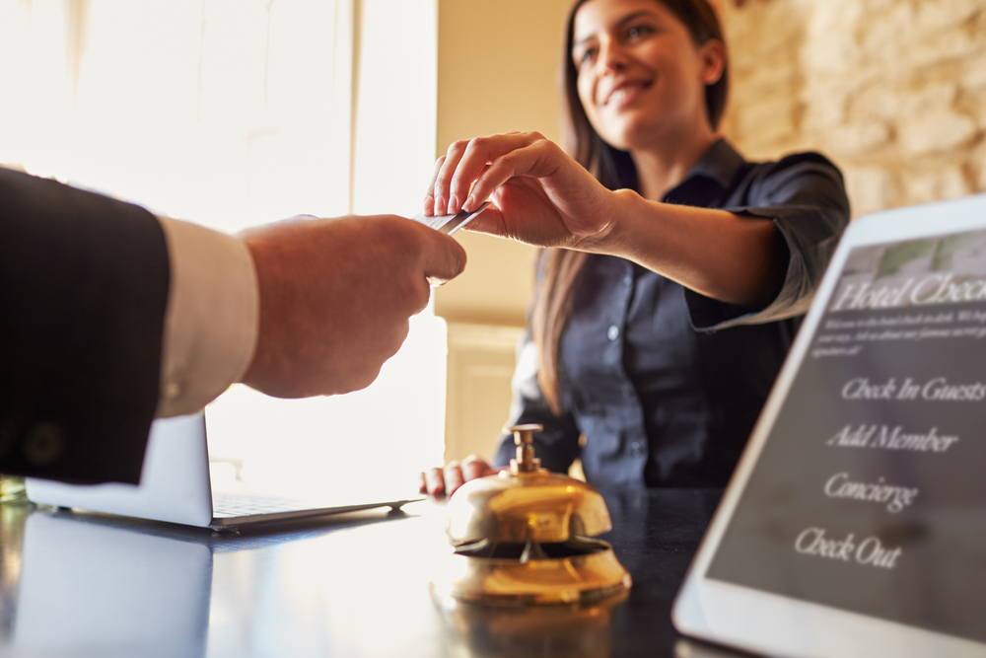
Types of hospitality establishments
Restaurants – a restaurant is a place where you can eat a meal and pay for it. In restaurants, your food is usually served to you at your table by front of house staff. Some restaurants have takeaway facilities.
Hotels – a commercial establishment providing accommodation, meals, and other guest services.
Pubs and bars – ‘pub’ is short for ‘public house’. A pub is licensed to serve alcoholic beverages. A bar is an establishment licensed to serve alcohol beverages and is named after the counter or bar on which drinks are served.

Slide 4
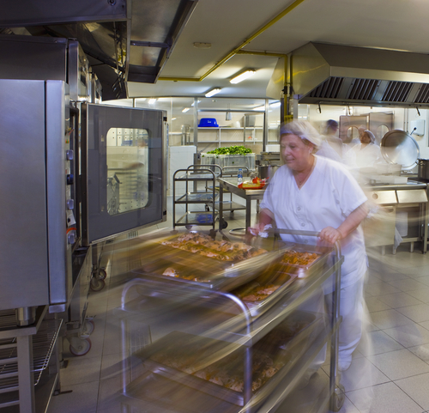
Types of hospitality establishments
Contract catering – is a catering business that is hired by a business or organisation to provide catering services every day or on a very regular basis. e.g. hospital and school catering.
Event catering – catering for events like banquets, conferences, conventions, weddings. Food may be produced on-site or transported to the event's location.
Cafes and coffee shops – are small business that sell coffee, tea, cakes, sandwiches and light meals. These are found in most towns and can be chained or independently owned.

Slide 5
Types of business operations
Multinational – a multi-national organisation has locations or facilities in multiple countries, but each location functions in its own way, essentially as its own entity.
A global company also has locations in multiple countries, but they’ve managed with a set company culture with one set of processes that facilitate a more efficient and effective organisation, for example hotel brands such as the Hilton Group.

Slide 6
Types of business operations
Sole traders – a sole trader describes any business that is owned and controlled by one person, although they may employ workers, e.g. a local hotel.
Sole traders are able to easily keep overall control of the business, because the owner has a hands-on approach to running the business and can make decisions without consulting anyone else.

Slide 7
Types of business operations
Independent – an independent business is similar to a sole trader where one or a number of people own a business. Businesses owners will have joint decisions regarding the running of the business, e.g. local restaurant, or local hotel.
Franchises – franchising is an alternative to buying into an existing business. A franchise is a joint venture between a franchisee, who buys the right from a franchisor to copy a business format, and a franchisor, who sells the right to use a business idea in a particular location, e.g. popular fast food chains such as McDonald’s, and branded coffee shops such as Starbucks or Costa.

Slide 8
Types of business operations
Partnerships – partnerships are businesses owned by two or more people. Partnerships work together and can benefit from shared expertise.
One advantage of partnerships is that there is someone to consult on business decisions.
The main disadvantage of a partnership comes from shared responsibility.

Slide 9
Types of business operations
Groups/brands – unlike a sole trader or a partnership, a group or brand may be the owners of a limited company but are not necessarily involved in running the business at each location. Often referred to as a public limited company (plc), a group is usually a large, well-known business, e.g. a chained restaurant, pub with branches in most city centres, chain hotels and chain coffee shops.
Local/independent – a local or independent business has a limited number of outlets in a local area e.g. local Indian restaurant with restaurants in neighbouring towns.
Regional – a regional business will usually operate only in their local area, county or state.
National – a national business will have a number of business and stores locally and regionally across the country, e.g. they may have restaurants in major towns and cities across the country.

Slide 10
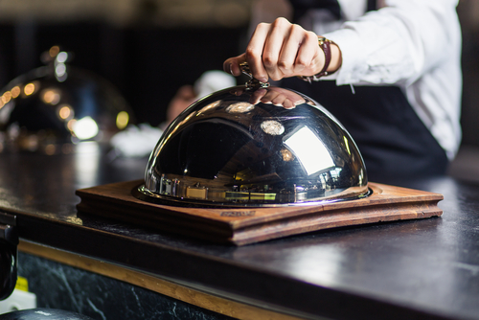
Services provided at different types of hospitality establishments
Food and beverage services
Bar services
Accommodation/guest services
Butlering
Reception services
Business services
Concierge/portering
Leisure facilities
Event management
Entertainment
Gambling.

Slide 11
Hospitality establishments: Departments
Kitchen
A professional kitchen is composed of different areas or more commonly known as sections.
A section is the area where a certain type of food is prepared. Sections help keep a kitchen running smoothly.
The number of section within the kitchen is dictated by what is on the menu.
A kitchen may have several stations with specialised equipment or just one or two areas that are designated for cooking certain menu items.

Slide 12
Hospitality establishments: Departments
Food and beverage
Commonly referred to ‘front of house’ and is composed of main different areas and roles.
This may include restaurant services, bar services and hosting guests.
The role is important to ensure that the guest interaction and experience are met.
Roles will include setting up front of house areas including laying tables, hosting guests, serving guests food and beverages, and clearing areas.

Slide 13
Hospitality establishments: Departments
Reception
The reception is the heart of a hotel, offering an array of guest focused services including restaurant bookings, reservations and concierge.
It's the first and last area guests see and interact with.
How well the front office operates can create repeat business or drive customers away.
A reception will address everything from the appearance of employee uniforms, product and service advice to making guest reservations at local venues.

Slide 14
Hospitality establishments: Departments
Housekeeping
First impressions play an important part in the overall guest experience. Guests will expect a certain level of cleanliness and service when the walk and stay in an establishment and this can help to build a good reputation for the organisation.
Housekeeping is not just cleanliness. It includes:
keeping public and guest areas neat and orderly
maintaining the safety and security of guests, visitors and employees
effective housekeeping can help control or eliminate hazards.

Slide 15
Hospitality establishments: Departments
Maintenance
This department is vitally important for any hotel and restaurant establishment and they constitute the hidden force that keeps maintained and fixing any errors that are needed.
Maintenance includes preventative maintenance and repairs to all areas, including its exterior, heating and cooling systems, plumbing, electrical systems, floors, walls and furniture.

Slide 16
Hospitality establishments: Departments
Back office (HR, accounts, reservations, management)
The front office department is the face of hospitality business, whereas the back office are not often seen interacting with guests.
Back office services will include administration roles such as account management, office skills, filling information, issuing and handling cash payments to safeguarding information.
These procedures are crucial to a hospitality business’ continued financial viability and guest confidence.

Slide 17
Any questions?

