Slide 1
Know job roles in hospitality
PowerPoint presentation
Unit 201: Understanding the hospitality industry

Slide 2
Hospitality roles
The hospitality industry is a growing sector. More and more people are working in the industry to deliver services to guests. These services are typically provided by hotels, spas, bars, restaurants and coffee shops. The job possibilities in hospitality are endless.

Slide 3
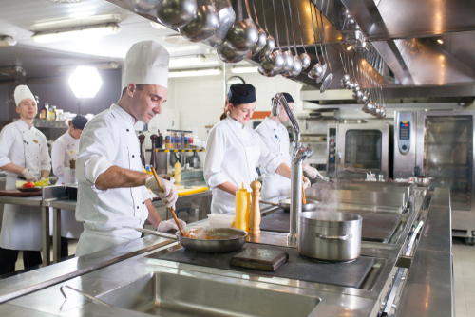
Job roles in the kitchen
A professional kitchen consists of many different job roles. These can include:
Executive chef
Head chef
Sous chef
Chef de partie
Specialist (patisserie)
Commis/Line chef
Kitchen/Catering assistant
Apprentice/Trainee
Kitchen porter
Kitchen/Catering manager.

Slide 4
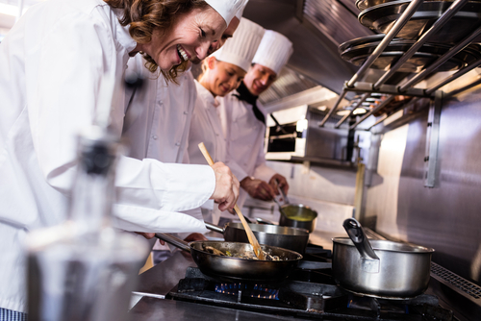
Introduction to the kitchen staff
Kitchen hierarchy (or brigade as it is also commonly known) is steeped in history and goes back many years. Auguste Escoffier (1846–1935), is one of the foremost authorities on modern French cooking and cuisine and designed the partie system that is still used in the majority of modern kitchens.
Not every kitchen and restaurant uses exactly the same titles for the different roles in their kitchen, but the most generally accepted titles for leaders in the kitchen are traced primarily to Escoffier kitchen hierarchy, so that is why they sound French.

Slide 5
Executive chef – this is the manager of the kitchen, responsible for supervision, creation of the menu, and the business side of the kitchen. An executive chef is very experienced in cooking, but their day-to-day work may involve very little hands‐on cooking.
Head chef – this is the hands‐on individual in charge of everything going on in the kitchen. Sometimes a chef de cuisine may be the individual in charge of one location of a chain, or a group of restaurants. The titles head chef, executive chef and chef de cuisine may sometimes be used interchangeably.
Sous chef – the sous chef is second in line in the kitchen. A sous chef may be in charge of the kitchen when the executive chef or chef de cuisine is absent. The sous chef may take over for any of the line cooks that may be missing.

Slide 6
Job roles in professional kitchens
Chef de partie – these chefs are in charge of a particular section of the kitchen’s service.
Specialist (patisserie) – has specialist knowledge and skills in certain areas of the kitchen such as patisserie/pastry department. Tasks include preparation of bread items, chocolate and desserts.
Commis/Line chef – a commis/line chef is a basic chef in larger kitchens who works under a chef de partie in order to learn the station's responsibilities and operation. They will have recently completed formal culinary training or still be undergoing training.

Slide 7
Job roles in professional kitchens
Kitchen/Catering assistant – duties including chopping or peeling fruits and vegetables before they are cooked. Kitchen assistants also work with meat, seafood, and poultry, doing everything from plucking the feathers from poultry, to cutting a steak or gutting a fish before the chef further prepares it.
Apprentices – apprentices are usually young people wanting to get into the hospitality industry. They perform basic tasks as they learn. An apprenticeship is aimed at learning the trade whilst equipping the chef with others skills needed to work in the industry, such as maths and English. The apprentice chefs usually work in a professional kitchen, training under a full-time chef. This has proved to be a beneficial way to learn about the industry for many aspiring chefs.

Slide 8
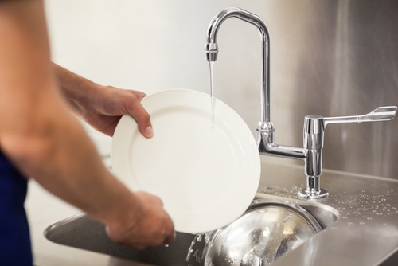
Job roles in professional kitchens
Catering manager – this role is similar to the executive chef and is usually works within the cost sector part of the industry. They may have a number of catering outlets to manage and have very little hands-on cooking. Traditionally they have worked in a catering role in the kitchen before.
Kitchen porter – often known as kitchen assistants, they are usually kitchen workers who assist with basic tasks, but have had no formal training in cooking. Tasks could include peeling potatoes or washing salad. Smaller kitchens more commonly have kitchen assistants who would be assigned a wide variety of tasks (including washing-up) in order to keep costs down.

Slide 9
Job roles in food and beverage service
Front of house food and beverage services consist of many different job roles. These can include:
Restaurant manager
Mâitre D’hotel
Sommelier
Waiter/waitress
Bar manager/Supervisor
Bar staff/Mixologist
Events manager
Conference and banqueting manager
Barista.

Slide 10
Job roles in food and beverage service
Restaurant manager – is responsible for overseeing the efficient running and profitability of restaurants and for managing the staff; including the planning and coordinating of menus. They will coordinate the operation of the restaurant during scheduled shifts and respond to guest queries and complaints.
Maître D’hotel – is the head front of house member of staff of a dining establishment/restaurant, responsible for ensuring that the connection between kitchen and front of house runs smoothly. The may meet guests as they arrive, visits tables to check on guests, and do everything they can to cater to each guest's needs.
Sommelier – a sommelier (or wine steward), is a trained and knowledgeable wine professional, who specialises in all aspects of wine service as well as wine and food pairing. Sommeliers usually practice in fine dining restaurants and hotels.

Slide 11
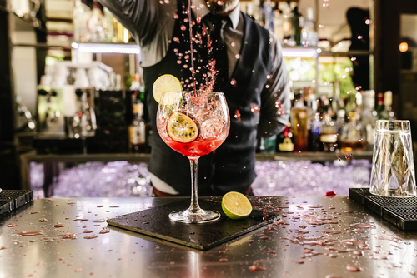
Job roles in food and beverage service
Waiter/waitress – sets up the front of house area prior to service. They meet and greet customers, organise table reservations and offer advice about menu and wine choices, as well as taking guests orders and delivering food and beverages.
Bar manager/Supervisor – primarily responsible for keeping the bar operations running with no problems. The bar manager/supervisor controls, organises, and directs bar staff. Additionally, they will check stock levels, order supplies and prepare cash drawers.
Bar staff/Mixologist – also referred to as bartenders are mainly employed to serve drinks at pubs, restaurants and other establishments. They also process payments from guests.

Slide 12
Job roles in food and beverage service
Events manager – will coordinate a variety of event activities; are responsible for the scheduling, coordinating and running events such as wedding parties and dinner and dances, and will be required to maintain quality standards and health and safety.
Conference and banqueting manager – this is a very similar role to the events manager. It is a high profile and senior role in a hotel. The banquet manager develops menus and event requirements that fit the guests’ needs and expectations.
Barista – a barista will firstly have great customer service skills and knowledge of how coffee brewing equipment operates. They produce a range of high-quality espresso-based beverages but also have the skills and knowledge to produce hot and cold beverages, such as teas and cold coffees.

Slide 13
Job roles in front of house service
Front of house services consists of many different job roles, these can include:
Front office manager
Concierge
Porter
Receptionist
Host.

Slide 14
Job roles in front of house service
Front office manager – will coordinate the operation of the hotel’s front of house operations during scheduled shifts and respond to guest queries and complaints. They will manage staff to ensure the guest needs are met. The will plan and organise accommodation and other hotel services.
Concierge – is at the heart of meeting the guest’s needs; providing information, advice, guidance and assistance to guests in all manner of things; from making dinner reservations, to reserving entertainment tickets, arranging transport and ordering food for delivery.
Porter – ensures that guests of a hotel receive services which make their stays more enjoyable. The precise duties of a hotel porter vary, depending on the hotel and the region of the world the porter works in.

Slide 15
Job roles in front of house service
Receptionist – duties include welcoming guests to the hotel, making reservations for them, taking payment, issuing room keys and attending to any other needs that are instrumental to their comfort during their stay at the hotel. This may also include booking additional services such as restaurant services.
Host – they maintain a welcoming and comfortable environment in the hotel, going above and beyond guest’s expectations. They may across different departments within the hotel, such as the restaurant and in the main hotel reception.

Slide 16
Job roles in housekeeping
Front of housekeeping services consists of many different job roles. These can include:
Executive housekeeper
Floor housekeeper
Room attendant
Public areas cleaner
Laundry attendant
Maintenance.

Slide 17
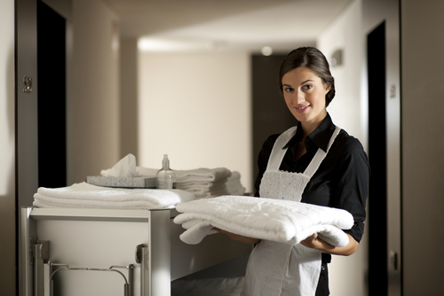
Job roles in housekeeping
Executive housekeeper – in charge of overseeing and directing the cleaning activities for a hotel. The work schedules are prepared and planned in advance by the executive housekeeper, and the executive housekeeper also handles customer service and complaints. In addition, they will carry out housekeeping audits.
Floor housekeeper – responsible for maintaining the cleanliness and the hygiene of the hotel premises. They are in charge of a team of cleaners and room attendants.
Room attendant – responsible for cleaning the room, making beds and supplying fresh towels, removing rubbish, washing bathrooms and replacing toiletries and consumables. Often, they work as a part of a team to cover all the rooms in a hotel.

Slide 18
Job roles in housekeeping
Public areas cleaner – similar to a room attendant, but focusing on public/front of house areas such as receptions, corridors, and guest toilets contained within public spaces.
Laundry attendant – responsible for ensuring that all areas of the hotel are kept properly stocked with clean linens. In addition, the role may involve collecting, cleaning and delivering guest laundry/dry cleaning.
Maintenance – carries out preventive and corrective maintenance activities on hotel areas such as rooms and equipment and tools.

Slide 19
Any questions?

