Slide 1
Understand the importance of profitability to Hospitality businesses
PowerPoint presentation
Unit 202: Understand Business Success

Slide 2
Introduction
The success of a hospitality business depends on its ability to continually earn profits.
Profit equals a company’s revenues minus expenses. Earning a profit is important to a business because profitability impacts whether a company can secure financing from a bank, attract investors to fund its operations and grow its business.
Companies cannot remain in business without turning a profit.

Slide 3
Factors affecting profitability
Increased revenue return – increasing revenue is important for business vitality, growth and employee job security. Improving the way we do things allows us to gain an edge over the competition.
Business must also demonstrate their ability to spend money the right way while building out multiple revenue-generating, guest-centric segments across their operational model.

Slide 4
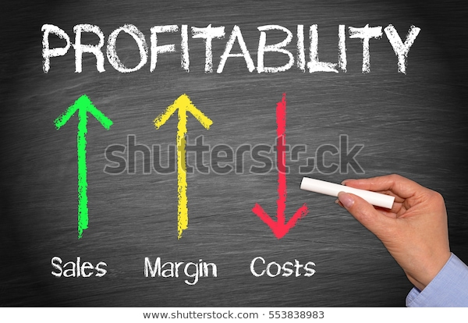
Factors affecting profitability
Revenue generating strategies
Engage during the booking process
encourage direct bookings
upselling
Engage throughout their stay
offer unique and authentic experiences
Engage after their stay
leverage customer data- feedback, promotions and personalisation.

Slide 5
Factors affecting profitability
Break even point is a key figure in operating a business; referring to the amount of revenue necessary to cover the total fixed and variable expenses incurred within a specified time period.
Although nicely labelled fixed and variable, costs sometimes fixed costs can become variable. For example staff are needed to keep a business open irrespective of how many or if any customers!
These are fixed staff costs, however on busy days more staff are required therefore staff costs become variable.

Slide 6
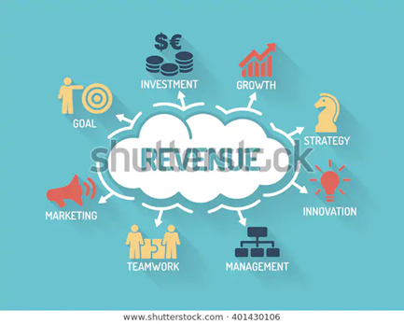
Increasing revenue
Increasing revenue – driving business profitability is not as simple as it may seem. Ensuring a guest-centric approach and meeting the guest's expectations is essential. Factors that influence increasing revenue will include:
staff training
marketing
increasing competitiveness
increasing perceived value
up-selling at every opportunity when interacting with the guest
increasing sales of branded merchandise or local partners
responding to guest requests.

Slide 7
Costs associated with a hospitality business
Fixed costs include expenses that must be paid regardless of production or sales volume. A great way to distinguish between fixed and variable costs is to ask yourself, “what expenses do I still have to pay, even if I don't get a single customer?”
Examples include:
staff or labour costs
rent
equipment costs
Utilities (gas, electricity)
internet
marketing costs.

Slide 8
Costs associated with a hospitality business
Variable costs vary in proportion to production. These costs also take into consideration anything that gets more expensive as a result of more business.
Examples include:
food and beverage stock costs
staff costs
Utilities, including electricity, gas, water, and waste management
maintenance costs
cleaning supplies
sundries
credit card processing fees.

Slide 9
Any questions?

