Slide 1
Session 12
PowerPoint presentation
Unit 202: Understand Business Success

Slide 2
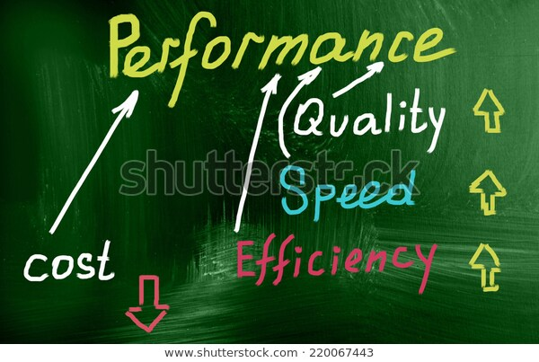
Monitoring business financial performance
Monitoring performance – one of the most important tasks successful business owners undertake is monitoring organisational and financial performance on a regular basis. Management who understand where the business currently stands from a performance standpoint as well as where it’s heading hold a huge advantage over those who choose not to.
Many businesses owners make key decisions based on gut feelings. This is an incredibly risky way to run a business.

Slide 3
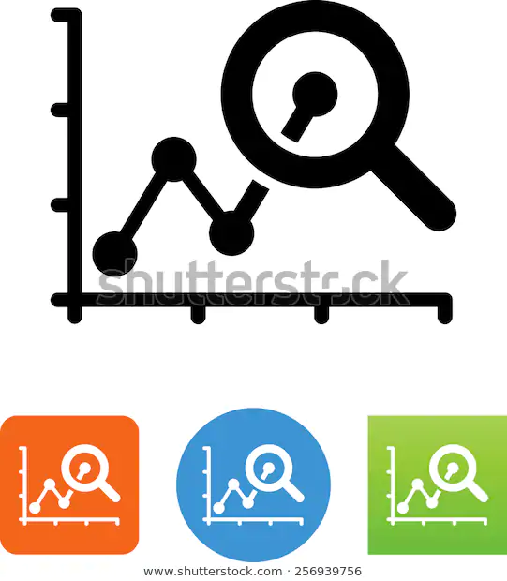
Monitoring business financial performance
Different ways of monitoring performance of a hospitality business include:
financial analysis
customer satisfaction rating
departmental performance analysis
performance reviews.

Slide 4
Monitoring business financial performance
Financial analysis – monitoring financial performance provides key insights that help you answer questions about your business, i.e.:
What are the most and least profitable areas of the business?
Is the business gaining or losing financial strength?
Am I performing in line with my objectives and business plan?
What price point maximises profits?
How much cash will the business generate over the next 12 months?
How did we perform this month compared to last month?

Slide 5
Monitoring business financial performance
Customer satisfaction – guest satisfaction is key to any hospitality business and is a great indicator of how well your business is performing.
Using guest satisfaction to dictate your business will allow you to take a long-term approach which will pay off in the end.
When you look at customer satisfaction and quantify the results, there is the opportunity to make changes that will have a large impact on a business.

Slide 6
Monitoring business financial performance
Types of feedback:
Verbal or face to face feedback – this is important for dealing with complaints or issues. It offers an opportunity to change a guest experience for the better.
Guest surveys – good for regular surveying and keeping track of responses.
Online reviews – an invaluable resource with the ability for guest personalisation.

Slide 7
Monitoring business financial performance
Department performance analysis – managing a successful hospitality business has to be one of the most challenging jobs around, due to the sheer volume of responsibilities required.
Key performance indicators (KPIs) are measures which every business should use on the regular basis. They are a simple value that demonstrates how effectively a business is achieving its objectives they can be used to create benchmark metrics against industry standards and financial predictions.
Setting KPI’s for a department or staff member is an effective way of monitoring performance, examples include:

Slide 8
Monitoring business financial performance
Types of KPIs used in hospitality departments:
average daily rates (ADR)
revenue per available room (RevPAR)
occupancy rate
average spends for food and beverage
cost of sales
gross profit margins.

Slide 9
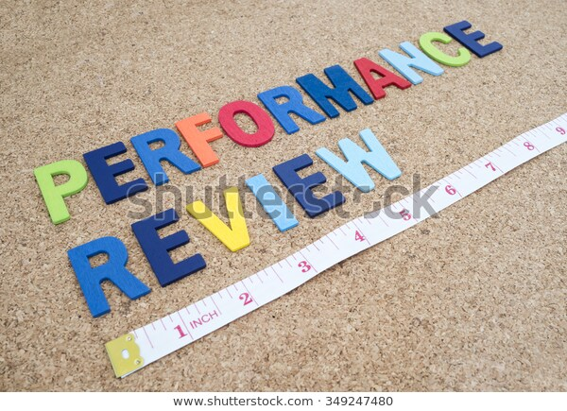
Monitoring business financial performance
Performance reviews – our people are our greatest asset.
A performance review is an evaluation process that promotes communication and useful feedback about job performance. It can facilitate better team working relationships to provide a historical record of performance and contribute to professional development.

Slide 10
Monitoring business financial performance
For an organisation performance reviews give the opportunity to build strength and capabilities. They can:
assess suitability to fill roles within the organisation
identify where skills and capabilities might need a boost
understand where further development support is required to help achieve organisational goals.

Slide 11
Monitoring business financial performance
For a manager performance reviews give the opportunity to guide, support and develop a team. They provide:
an opportunity to be clear about the objectives and expectations of a business and set goals or KPIs
feedback from the staff member
insight to the staff member’s career aspirations and plan for staff development.

Slide 12
Monitoring business financial performance
For members of staff performance reviews give the opportunity to build a manager/employee relationship and open up dialogue and understanding. They give a chance to:
discuss career development and growth aspirations
suggest how to make improvements within the team
learn about the aspirations and goals of the organisation and how you fit in
share feedback on the manager’s performance.

Slide 13
Any questions?

