Slide 1
Know how technology contributes to business success
PowerPoint presentation
Unit 202: Understand Business Success

Slide 2
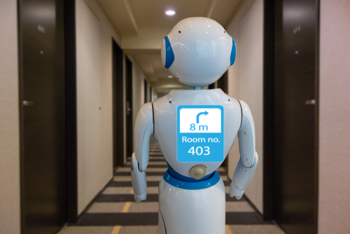
Introduction
Technology is advancing at a faster pace than ever before, and this is changing both the expectations of guests and the way in which the hospitality industry conducts its business.
Some of the trends in industry are leading to great improvements and savings for hospitality businesses, while some are changing how hotel developers plan their buildings, infrastructure, management structure and staffing requirements.

Slide 3

Technologies used in the hospitality business
Information and Communication Technology (ICT) has affected society and its surroundings in many ways.
Most hotels in the world use ICT to ease their operations tasks, such as taking reservation, room management, telecommunication, and guest accounting.
Accurate data can be used to forecast business activity, productivity and financial positioning.

Slide 4
Technologies used in the hospitality business
Software/apps – software and apps allow hospitality business owners or managers to streamline their administrative tasks while cutting costs and increasing bookings at the same time.
The software system isn’t just important for the day-to-day operations of a hotel, but it also plays a vital role in the overall guest experience.

Slide 5
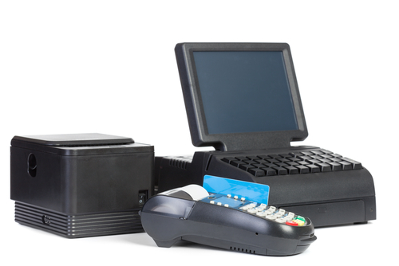
Technologies used in the hospitality business
Electronic point of sales (EPOS) – guests and customers are now accustomed to a personalised service that is smoother and more efficient than ever before, thanks to better customer data and faster payment systems that eliminate the laborious processes of the past.

Slide 6
Technologies used in the hospitality business
Competitive advantage
Businesses looking for that competitive edge are using the new technologies within the EPOS system, not only for payment transactions but for enhancing the guest experience by making it personal. Contactless payments speed up the payment process, while charging to room accounts, loyalty or rewards systems and clever detailed customer data better inform the business and its future offering.

Slide 7
Technologies used in the hospitality business
Resource management tools and equipment – important tools for success in this business.
Property management system (PMS) – content management systems for websites and social media channels .
Customer relations manager (CRM) – being able to offer personalised experiences requires comprehensive guest profiles.
If you want to surprise a guest with their favourite coffee, you need to know what their favourite coffee is.
Customer relationship managers allow you to keep track of valuable information about your guests as well as manage email communication, send newsletters, and facilitate guest surveys.

Slide 8
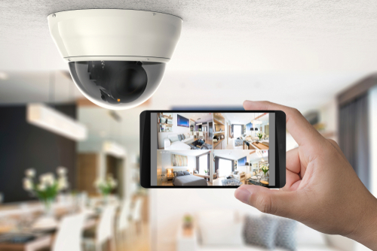
Technologies used in the hospitality business
CCTV – closed-circuit television cameras are widely used in the hospitality industry. CCTV has the ability to capture events that take place around the clock in the hotel surroundings.
CCYV provides extra security to both employees and guests.

Slide 9
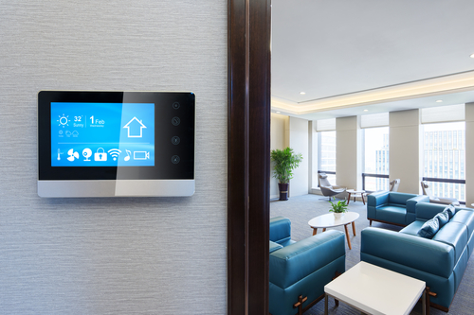
Technologies used in the hospitality business
Room booking systems – part of the PMS systems used within a hospitality business, a booking engine allow guests to make online commission-free direct bookings; a way to optimise a businesses sales strategy and maximise profit.
Digital monitoring of equipment – from operations to guest experience to marketing, smart hotel technology offers a variety of cost savings and revenue opportunities. This is enabling hotel owners to reach new levels of profitability.
Smart thermostats and occupancy sensors can monitor and respond to fluctuations in occupancy.

Slide 10
Technologies used in the hospitality business
The internet of things (IoT)
IoT has allowed for innovation in the workplace, such as continuous temperature monitoring sensors which ensure more accurate time and temperature controls in restaurant kitchens. This directly improves food safety and reduces food spoilage.
Real-time monitoring and reporting of electronic points of sales, and better ordering systems contributes to a better guest experience.

Slide 11
Technologies used in the hospitality business
Wi-Fi – hotel guests who travel with devices such as phones, tablets and computers no longer see Wi-Fi as a perk, but as a must-have when they check in at a hotel.
Guests expect to be able to connect to the internet seamlessly and without too many interruptions. This has led hotels to invest in better, faster Wi-Fi infrastructure so that people can do business and use their technology devices with ease when they book their stay.

Slide 12
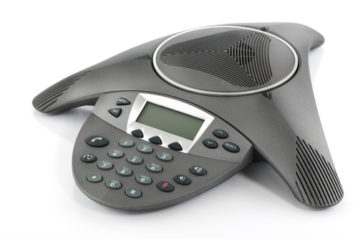
Technologies used in the hospitality business
Digital conference facilities – high density Wi-Fi is required for conferences and meetings. Hotels also need to be able to offer access to audio-visual (AV) and digital facilities for conferences.
While the amount of AV and digital equipment that goes into a typical conference room is fairly minimal, staging companies are often hired for various projects in order to equip the facility as required.

Slide 13

Technologies used in the hospitality business
Smart room keys – keyless systems such as programmable keycards are the norm. However, hotels will increasingly install smart room access systems that allow guests to unlock their doors by simply swiping their phones across a keyless pad on the door. Fingerprint-activated room entry systems and retina scanning devices are already here, with retina scanning more accurate and secure than fingerprint scans.

Slide 14
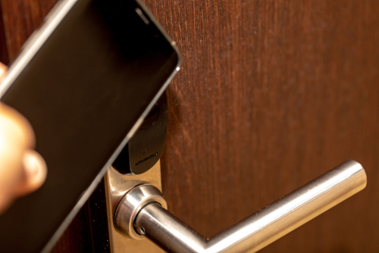
Technologies used in the hospitality business
Integrated, seamless experiences – technology doesn’t mean that customer experience can only happen online and through devices, check-ins and online comments.
All of these experiences need to be part of an integrated, dynamic system so that the guests’ experiences are at the forefront of the marketing and operational team’s mind.
If a guest leaves a comment about their stay when they check-out of the hotel, for example, the right people need to reply and acknowledge this type of communication.

Slide 15
Technology contributing to success
Technology is :
saving time and money
making processes more efficient
tracking financial data
real-time information
supporting marketing strategies
contributing to better guest service
contributing to better guest experiences
allowing businesses to offer guest tailored service and offers
improving communication.

Slide 16
Any questions?

