Slide 1
Know how technology contributes to business success
PowerPoint presentation
Unit 202: Understand Business Success

Slide 2
Responsibilities a hospitality business has to manage digital information
Legal and ethical responsibilities associated with digital information and data restrict the access and use of personal and confidential information.
Hospitality businesses have a duty of care to guests to protect and manage sensitive information.

Slide 3
Responsibilities a hospitality business has to manage digital information
All information should be treated with the utmost respect and security, responsibilities include:
managing personal and guest information with confidentiality
restricting access of information to those authorised to view it
complying with data protection legislation
using information for the purposes it was gathered for.

Slide 4

Responsibilities a hospitality business has to manage digital information
Types of sensitive information:
personal data
financial data/bank account details
date of birth
passport details or copies
confidential information.

Slide 5
Responsibilities a hospitality business has to manage digital information
How can data breaches happen?:
insider threats – staff selling data to third parties
human error – speaking too loudly at a reception desk/repeating a credit card number too loudly
data breaches
cyber attack
criminal activity – point of sales/cloning.

Slide 6
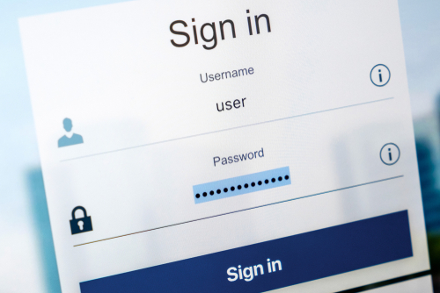
Responsibilities a hospitality business has to manage digital information
Methods to keeping information safe:
staff training
firewalls
network monitoring
anti-malware security
using password protected log in
limiting access to those who need it
locking up securely – don’t leave information lying around or showing on a screen
only keeping information for as long as it is needed
disposing of information in an appropriate way (shred/delete).

Slide 7

Consequences of inappropriate use of digital communication technology
Consequences include:
non-compliance of data legislation
legal action
loss of data or data breaches
misuse of important, financial or business sensitive data
bad publicity
loss of reputation
loss of customer confidence
brand damage.

Slide 8
Any questions?

