Slide 1
Know how legislation and regulations affects hospitality businesses
PowerPoint presentation
Unit 202: Understand business success

Slide 2
The purpose of key legislation and regulation within the hospitality sector
Company law – sometimes referred to as corporate law, governs the rights, relations and the conduct of companies, organisations or businesses.
Company law allows a purpose beyond profit towards a focus on good governance.
Environmental health and food safety – ensures a high level of protection for consumers whilst also taking into account the protection of animal health and welfare, plant health and the environment. Legislation and regulation differs between jurisdictions and countries however it is essential that local regulation is adhered to.

Slide 3
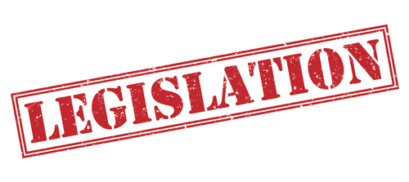
The purpose of key legislation and regulation within the hospitality sector
Employment law – regulates the relationship between employers and employees.
It governs what employers can expect from employees, what employers can ask employees to do, and employees' rights at work.

Slide 4
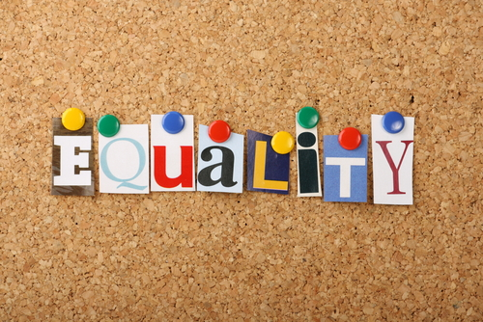
The purpose of key legislation and regulation within the hospitality sector
Equality law – equality and non-discrimination are part of the foundations of the rule of law (UN). Built on the premise that all people, institutions and entities, public and private, including the state itself, are accountable to just, fair and equitable laws. Manifested in:
equality and human rights
labour laws: employment rights
equality acts: non-discrimination
protection from harassment acts
trade union and labour relations

Slide 5
The purpose of key legislation and regulation within the hospitality sector
Licensing – business registration, permits and licenses allow the business to operate whilst respecting the rules and regulations stipulated by the commercial legislation.
Often associated with collection of taxes and fees they also serve to protect the public and implement standards, examples of these registration, permits and licenses include:
company registration
tax registration
environmental Health registration
alcohol/liquor licensing.

Slide 6
The purpose of key legislation and regulation within the hospitality sector
Data protection – controls the way information is handled and stored. A set of principles that businesses have to adhere to in order to keep someone's data accurate, safe, secure and lawful.
These principles ensure data is:
only used in specifically stated ways
accessed by those authorised to do so
securely stored to protect personal or confidential information
not stored for longer than necessary.

Slide 7
Any questions?

