Slide 1
Know how legislation and regulations affects hospitality businesses
PowerPoint presentation
Unit 202: Understand business success

Slide 2
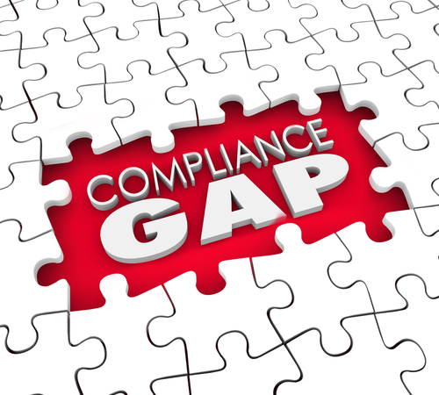
What is meant by non-compliance
Non-compliance means to be defiant or resistant to authority
Examples of non-compliance:
not following direction
not following guidelines
not reporting when required to
not following the law or regulation

Slide 3
Reasons for non compliance
Reasons for non-compliance:
poor business practice and standards
lack of knowledge
lack of training
poor supervision.

Slide 4
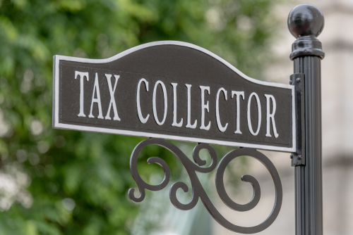
Identify who can enforce the legislation and regulations within the Hospitality industry
Depending on what type of legislation or regulation it can be enforced by different authorities such as:
government national or local
revenue officials
food and safety authorities
health and safety executives
fire safety officers
law enforcement officers.

Slide 5
Identify the positive implications of legislation and regulation
Positive implications include:
legal compliance
safer environment
better guest experience
fair and equal opportunities for both customers and staff
increased reputation
best practice.

Slide 6
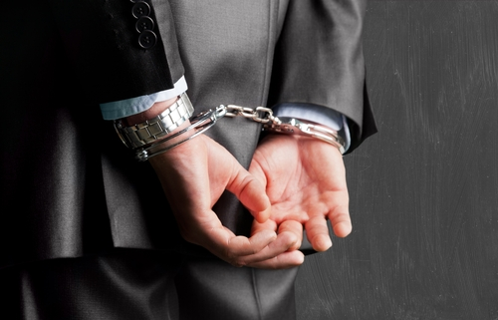
Identify the negative implications of legislation and regulation
Negative implications include:
health and safety issues
customer complaints
employee disputes
legal action
fines
loss of reputation
risk of closure.

Slide 7
Any questions?

