Slide 1
Know the health and safety requirements of hospitality organisations
PowerPoint presentation
Unit 202: Understand business success

Slide 2
Introduction
No matter how big or small a business you need to manage safety. A business is legally responsible for the safety of employees and any other person that may be affected by work activities.
Accidents and ill-health cost businesses money; in terms of lost time, lost skills, insurance premium hikes, legal proceedings, etc.
The benefits of effective health and safety management to businesses are very significant. There is clear evidence that effective health and safety management contributes directly to overall business success.

Slide 3
What is a risk?
The possibility of loss, injury, or other adverse or unwelcome circumstance; a chance or situation involving such a possibility.
An uncertain event or condition that, if it occurs, has an effect on a business, guest or employee.

Slide 4
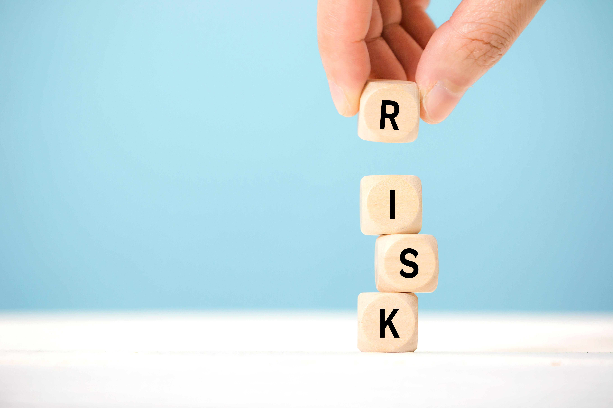
What is the difference between a risk and hazard?
A risk is the chance, high or low, that any hazard will actually cause somebody harm.
A hazard is something that can cause harm, e.g. electricity, chemicals, working up a ladder, noise, a keyboard, a bully at work, stress, etc.

Slide 5
Legal responsibilities for employers with regard to health and safety guidance
Safety statement
This represents a commitment to employees’ safety and health. It should state how the employer will ensure their safety and health and state the resources necessary to maintain and review safety and health laws and standards.
The safety statement must be made available to staff, and anyone else, showing that hazards have been identified and the risks assessed and eliminated or controlled.

Slide 6
Legal responsibilities for employers with regard to health and safety guidance
The safety statement should influence all work activities, including:
the selection of competent people, equipment and materials
the way work is done
how goods and services are designed and provided.
It is essential to write down the safety statement and put in place the arrangements needed to implement and monitor it.

Slide 7
What is risk assessment?
Risk assessment is a term used to describe the overall process or method of:
Identifying hazards and risk factors that have the potential to cause harm (hazard identification).
Determining appropriate ways to eliminate the hazard, or control the risk when the hazard cannot be eliminated (risk control).
Risk assessment is simply looking closely at what in your place of work or about your work activities could cause harm to your employees and visitors to your workplace (e.g. customers, suppliers, sales representatives etc.) and determining the control measures you can implement to minimise the risk.

Slide 8
Legal responsibilities for employers with regard to health and safety guidance
How to do a risk assessment: Three basic steps
Step 1: Identify hazards
Start by looking at and identifying hazards in your workplace. A hazard is anything that can cause harm to you or your employees.
“Where can people come to harm?”
Take a good look at your workplace and the work that you are doing there. What you are looking for are the situations where people can be harmed (e.g. hazards such as vehicles, machinery, manual handling etc.).
Look at how you get around your workplace: Is there safe access? Look at how you carry out the work: How could you be harmed?

Slide 9
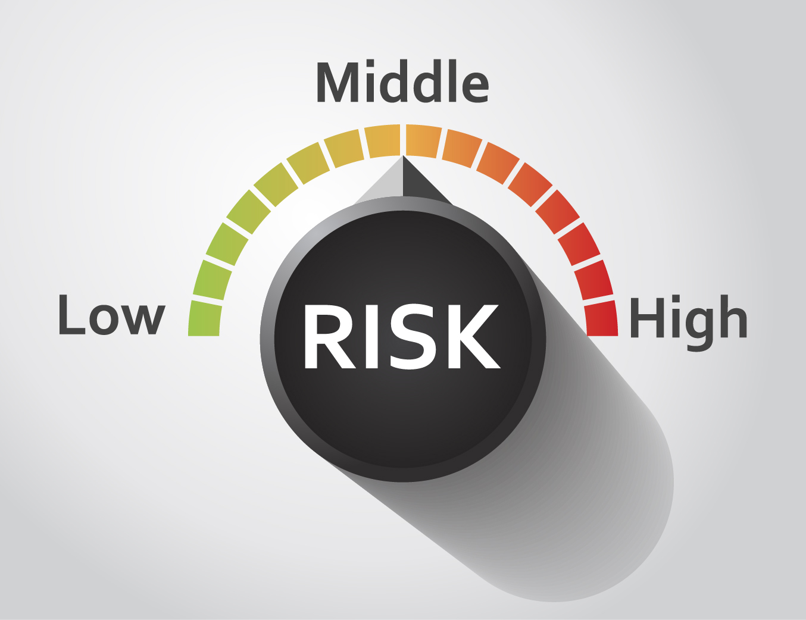
Legal responsibilities for employers with regard to health and safety guidance
Step 2: Determine the level of risk
Next look at the level of risk. Some hazards will be high risk, e.g. working at height. Other hazards will be a lower risk, because the harm may be less severe.
“What is the chance people will be harmed and how serious could the injury be?”
Decide who could be harmed and how and give consideration to vulnerable groups (e.g. young people, the elderly, pregnant employees, shift workers, etc).

Slide 10
Legal responsibilities for employers with regard to health and safety guidance
Step 3: Put in controls and inform
Decide what you are going to do to make the task or activity safer for you, your employees and other people around you. Implement the controls and then tell your employees!
Your control measures are the most significant part of the risk assessment, as they set out the steps that must be followed to protect people. Some control measures may already be in place.
You will need to decide if additional measures are needed. Risk assessment will help you prioritise the high risk hazards first.

Slide 11
Legal responsibilities for employers with regard to health and safety guidance
Employer’s duties include:
Managing and conducting all work activities so as to ensure, as far as reasonably practicable, the safety, health and welfare of people at work
Designing, providing and maintaining a safe place of work that has safe access and egress, and uses plant and equipment that is safe and without risk to health
Providing information, instruction, training and supervision regarding safety and health to employees
Providing and maintaining welfare facilities for employees at the workplace
Preventing risks to other people at the place of work including, for example, visitors, customers, suppliers and sales representatives
Having plans in place for emergencies.

Slide 12
Legal responsibilities for employees with regard to health and safety guidance
Employees, including those employed on a part-time or temporary basis, also have duties.
Employee duties include:
Complying with relevant laws and protect their own safety and health, as well as the safety and health of anyone who may be affected by their acts or omissions at work
Ensuring that they are not under the influence of any intoxicant to the extent that they could be a danger to themselves or others while at work
Cooperating with their employer with regard to safety, health and welfare at work
Using in the correct manner any item provided for protection
Participating in safety and health training offered by their employer
Reporting any dangerous situations, practices or defects that might endanger a person’s safety, health or welfare
Not engaging in any improper conduct that could endanger their safety or health or that of anyone else.

Slide 13
Any questions?

