Slide 1
Health and safety practices
PowerPoint presentation
Unit 202: Understand business success

Slide 2
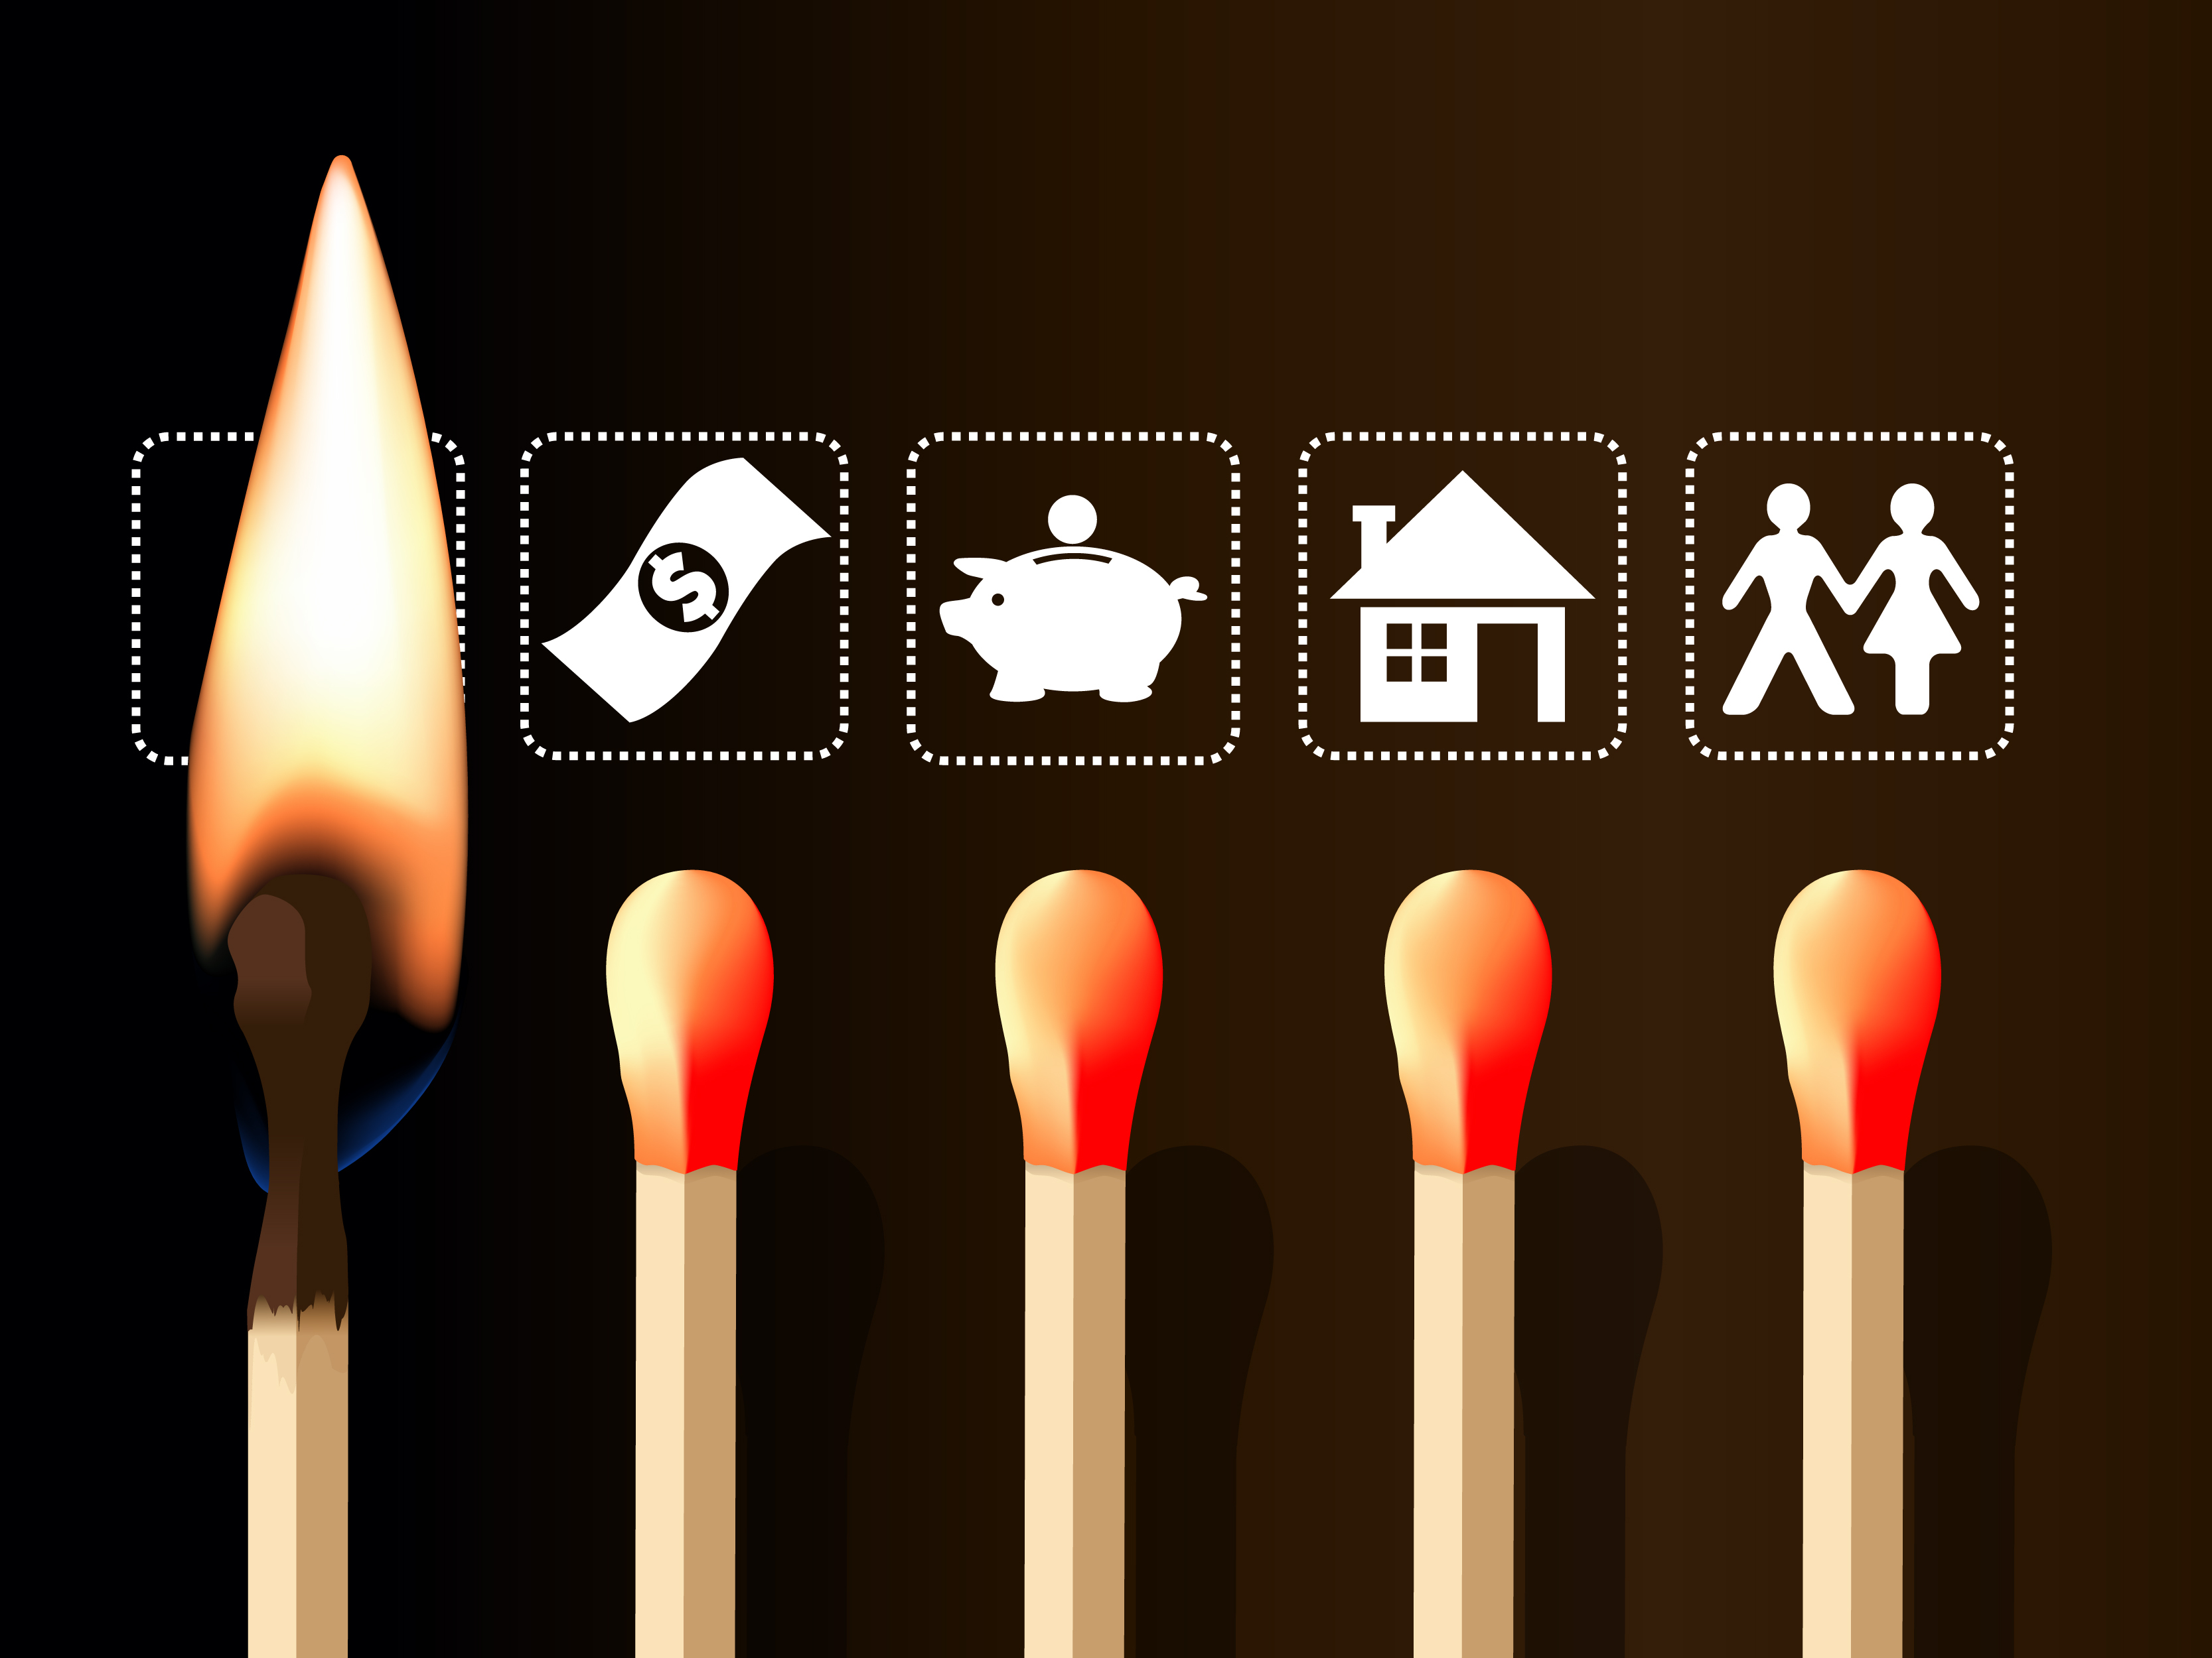
Introduction
A poor health and safety culture can be disastrous for hospitality business, guests, and employees, so it’s important to invest time and money to get it right.
As well as causing life-threatening injuries, added stress and loss of business time and money, legal action can lead to sanctions such as fines, imprisonment and disqualification.

Slide 3
Consequences of not applying good health and safety practices
accidents
illnesses
stress
death
damaged reputation
increased sick leave and staff turnover
prosecution
compensation claims
legal costs.

Slide 4
Consequences of not applying good health and safety practices
A failure to apply adequate health and safety procedures can result in serious injuries or fatalities.
A work-related illness or injury can not only put an employee out of work for a while and impact their quality of life but has the potential to affect your guests too.
It may also damage your business’s productivity, finances, and reputation – all of which can be difficult to recover from.

Slide 5
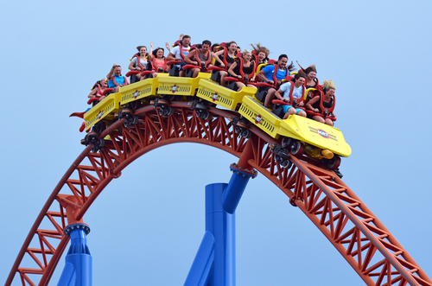
Case study: Serious consequences
A failure to install adequate health and safety procedures can result in serious injuries or fatalities. A work-related illness or injury can not only put an employee out of work for a while and impact their quality of life; it may also damage your business’s productivity, finances, and reputation – all of which can be difficult to recover from.
In the summer of 2015, the Smiler roller coaster at Alton Towers crashed, resulting in life-altering injuries for four riders. An investigation found that there were no faults on the track, on the cars, or on the system that was designed to keep the cars separate while the ride was running.

Slide 6
Case study: Serious consequences
Merlin Attractions were fined £5 million.
The crash resulted in two teenagers having to undergo amputations following the crash, with several others also injured. This was all a result of Merlin neglecting to make health and safety duties a higher priority.
The Smiler incident has acted as a reminder for the entire industry that safety is exceptionally critical. Alton Towers have since made technical improvements to the Smiler roller coaster and have improved their safety systems.
Nick Varney, chief executive of Merlin Entertainments, said that “it is something we will never forget and it is something we are utterly determined will never be repeated.”

Slide 7
Any questions?

Slide 8
Session 8
PowerPoint presentation
Unit 202: Understand Business Success

Slide 9
Risks to guest health and safety within the hospitality industry
Guest health and safety is an important consideration for hospitality businesses, it’s important to risk assess all activities within the business from fire safety, elevator failure, security threats like terrorism to unattended luggage or suspect devices.
Planning for emergencies such a standard operating procedures, staff training, as well as staff vigilance ensures that guest health and safety is prioritised.

Slide 10
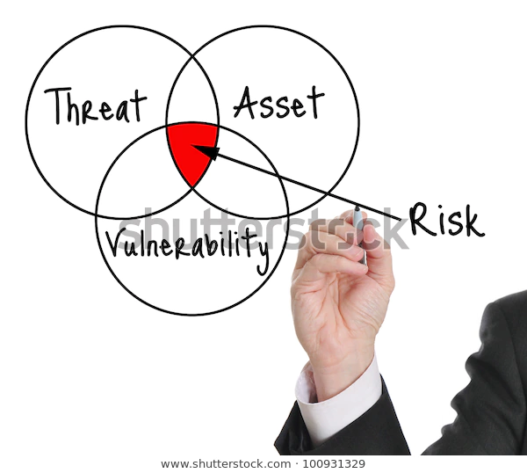
Risks to guest health and safety within the hospitality industry
Security risks- fire evacuation, major incidents, natural disasters, self harm and acts of terrorism.
Emergency and Disaster Response Planning includes special plans made for evacuations relating to guest (e.g. disabled or elderly guests located on lower floors).
“Staff shouldn't be caught out in emergencies without knowing the correct procedure to keep themselves and guests safe.”

Slide 11
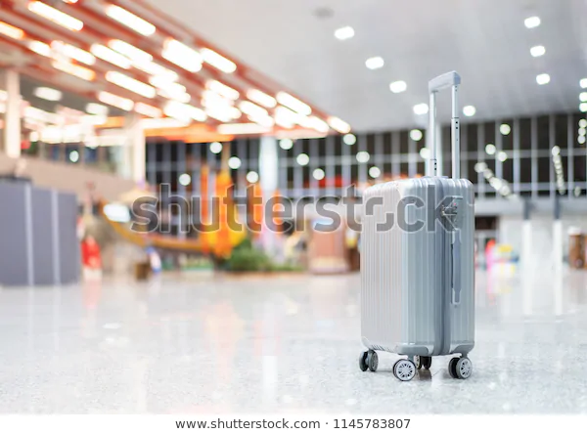
Risks to guest health and safety within the hospitality industry
Unattended luggage – not only being a potential trip hazard the risk of luggage being lost, stolen or damaged and the negative impact on guest happiness that ensues, staff must be vigilant to the ever-present threat of terrorism and potential disruption and impact on day to day business.

Slide 12
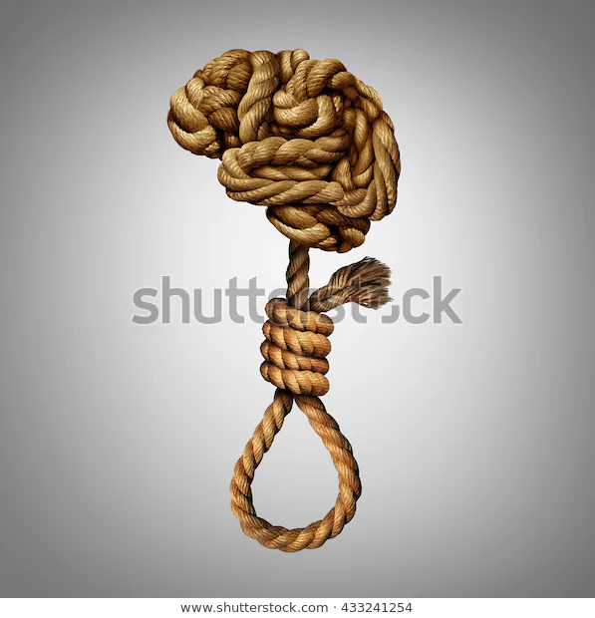
Risks to guest health and safety within the hospitality industry
Self harm - the impact of sudden deaths and attempted suicides on all who come into contact with them should not be underestimated. Employees who have close or regular contact with guests should be made aware of the behaviours that could indicate a potential suicide.
It is not just guests who may exhibit mental health problems.
Managers and staff need to be aware of mental health issues amongst their own teams.

Slide 13
Risks to guest health and safety within the hospitality industry
The following guest behaviours that could indicate a potential suicide:
Books in alone yet lives locally
Has visible signs of self-harm
Shows signs of excessive alcohol or drug use
Does not have any luggage
May spend extravagantly in a short space of time
Does not leave his or her room for an evening meal and does not order room service
Does not appear for breakfast and does not check out in the morning

Slide 14
Any questions?

Slide 15
Session 9
PowerPoint presentation
Unit 202: Understand Business Success

Slide 16
Procedures to be followed when a major incident is reported
Major incidents- many hotels have developed policies and procedures to address major incidents or sudden death on their premises.
As with all policies, managers, duty managers and supervisors should be trained in the policy, which should be communicated to line staff and incorporated into the employee handbook.
One designated contact should be responsible for managing an incident: securing the site until police arrive, interacting with emergency services; caring for affected staff, guests and witnesses; documenting the incident and responding to media enquiries.

Slide 17
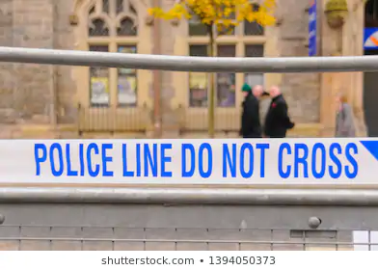
Major incidents
Awareness is the responsibility of all hospitality staff, in an increasingly risk averse society major incidents may never happen, planning for the unexpected is essential for our safety and that of the guest:
Major incidents:
Acts of terrorism
Criminal acts
Violence
Fire or explosion
Unexpected mechanical failure ie, trapped elevator

Slide 18
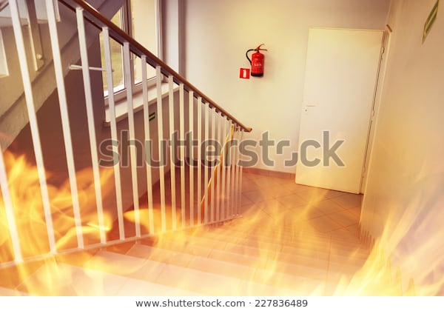
Procedures to be followed when a major incident is reported
Fire & Explosion- aren’t necessarily the most common types of workplace accidents, but when they do occur, they can be exceptionally dangerous – even deadly.
Even if employees and guests escape harm or injury, the consequences can be extremely expensive for businesses – not just because of the damage to property, stock and loss of jobs but also potentially in terms of litigation if the employer is found to be at fault.

Slide 19
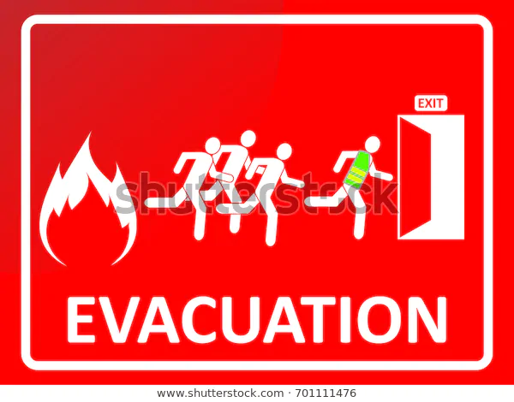
Procedures to be followed when a major incident is reported
Strategic planning fire safety by implementing the following steps ensures a safer environment for both guest and staff
Plan fire routes
Carry out a fire risk assessment
Appoint fire wardens
Train staff
Install detection and alarm systems
Arrange maintenance and repairs
Plan fire evacuation strategy
Provide information to guests

Slide 20
Any questions?

