Slide 1
Risks
PowerPoint presentation
Unit 202: Understand business success

Slide 2
Risks to guest health and safety within the hospitality industry
Guest health and safety is an important consideration for hospitality businesses, it’s important to risk assess all activities within the business, from fire safety, elevator failure, security threats like terrorism to unattended luggage or suspect devices.
Planning for emergencies such a standard operating procedures, staff training, and staff vigilance ensures that guest health and safety is prioritised.

Slide 3
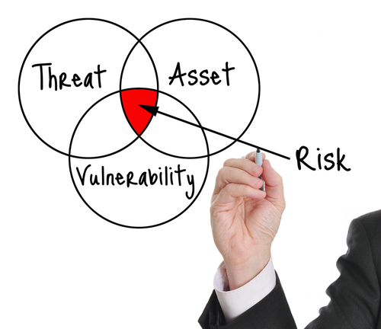
Risks to guest health and safety within the hospitality industry
Security risks: Fire evacuation, major incidents, natural disasters, self harm and acts of terrorism.
Emergency and disaster response planning includes special plans made for evacuations relating to guest (e.g. disabled or elderly guests located on lower floors).
Staff shouldn't be caught out in emergencies without knowing the correct procedure to keep themselves and guests safe.

Slide 4
Risks to guest health and safety within the hospitality industry
Unattended luggage: Not only being a potential trip hazard, the risk of luggage being lost, stolen or damaged and the negative impact on guest happiness that ensues is a risk. Staff must be vigilant to the ever-present threat of terrorism and potential disruption and impact on day- to-day business.

Slide 5
Risks to guest health and safety within the hospitality industry
Self harm: The impact of sudden deaths and attempted suicides on all who come into contact with them should not be underestimated. Employees who have close or regular contact with guests should be made aware of the behaviours that could indicate a potential suicide.
It is not just guests who may exhibit mental health problems.
Managers and staff need to be aware of mental health issues amongst their own teams.

Slide 6
Risks to guest health and safety within the hospitality industry
The following guest behaviours could indicate a potential suicide:
books in alone yet lives locally
has visible signs of self-harm
shows signs of excessive alcohol or drug use
does not have any luggage
may spend extravagantly in a short space of time
does not leave his or her room for an evening meal and does not order room service
does not appear for breakfast and does not check out in the morning.

Slide 7
Any questions?

Slide 8
Session 9
PowerPoint presentation
Unit 202: Understand Business Success

Slide 9
Procedures to be followed when a major incident is reported
Major incidents- many hotels have developed policies and procedures to address major incidents or sudden death on their premises.
As with all policies, managers, duty managers and supervisors should be trained in the policy, which should be communicated to line staff and incorporated into the employee handbook.
One designated contact should be responsible for managing an incident: securing the site until police arrive, interacting with emergency services; caring for affected staff, guests and witnesses; documenting the incident and responding to media enquiries.

Slide 10
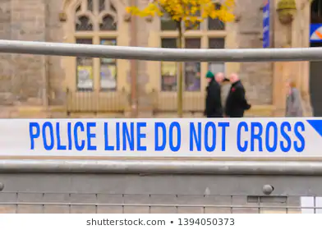
Major incidents
Awareness is the responsibility of all hospitality staff, in an increasingly risk averse society major incidents may never happen, planning for the unexpected is essential for our safety and that of the guest:
Major incidents:
Acts of terrorism
Criminal acts
Violence
Fire or explosion
Unexpected mechanical failure ie, trapped elevator

Slide 11
Procedures to be followed when a major incident is reported
Fire & Explosion- aren’t necessarily the most common types of workplace accidents, but when they do occur, they can be exceptionally dangerous – even deadly.
Even if employees and guests escape harm or injury, the consequences can be extremely expensive for businesses – not just because of the damage to property, stock and loss of jobs but also potentially in terms of litigation if the employer is found to be at fault.

Slide 12
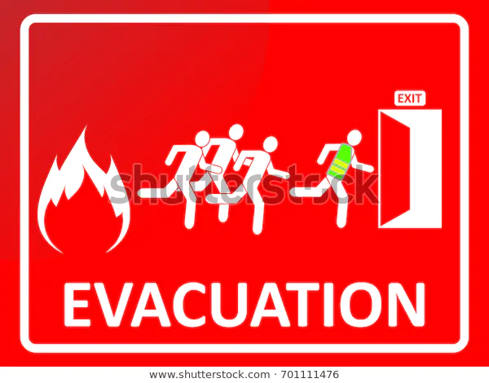
Procedures to be followed when a major incident is reported
Strategic planning fire safety by implementing the following steps ensures a safer environment for both guest and staff
Plan fire routes
Carry out a fire risk assessment
Appoint fire wardens
Train staff
Install detection and alarm systems
Arrange maintenance and repairs
Plan fire evacuation strategy
Provide information to guests

Slide 13
Any questions?

