Slide 1
Major incidents
PowerPoint presentation
Unit 202: Understand business success

Slide 2
Procedures to be followed when a major incident is reported
Major incidents: Many hotels have developed policies and procedures to address major incidents or sudden death on their premises.
As with all policies, managers, duty managers and supervisors should be trained. Policies should be communicated to line staff and incorporated into the employee handbook.
One designated contact should be responsible for managing an incident: Securing the site until police arrive, interacting with emergency services; caring for affected staff, guests and witnesses; documenting the incident and responding to media enquiries.

Slide 3
Major incidents
Awareness is the responsibility of all hospitality staff. In an increasingly risk averse society, major incidents may never happen. Planning for the unexpected is essential for our safety and that of the guest.
Major incidents:
acts of terrorism
criminal acts
violence
unexpected mechanical failure i.e. trapped elevator.

Slide 4
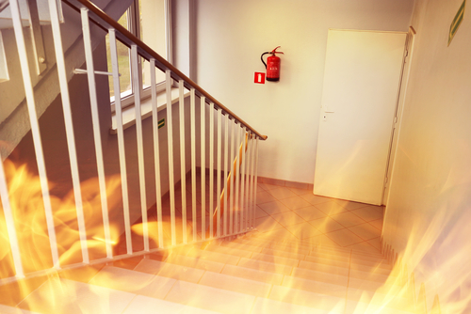
Procedures to be followed when a major incident is reported
Fire and explosion aren’t necessarily the most common types of workplace accidents, but when they do occur, they can be exceptionally dangerous – even deadly.
Even if employees and guests escape harm or injury, the consequences can be extremely expensive for businesses – not just because of the damage to property, stock and loss of jobs but also potentially in terms of litigation if the employer is found to be at fault.

Slide 5
Procedures to be followed when a major incident is reported
Planning fire safety by implementing the following steps ensures a safer environment for both guest and staff:
plan fire routes
carry out a fire risk assessment
appoint fire wardens
train staff
install detection and alarm systems
arrange maintenance and repairs
plan fire evacuation strategy
provide information to guests.

Slide 6
Any questions?

