Slide 1
Know how effective communication is used to benefit a hospitality establishment
PowerPoint presentation
Unit 203: Provide guest service

Slide 2
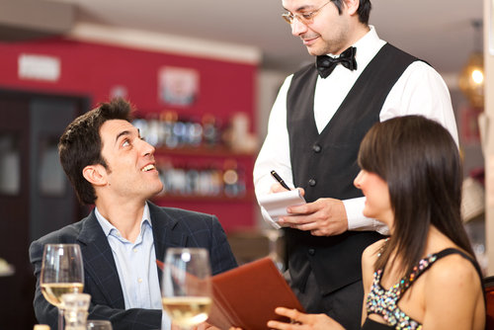
Introduction
Guests of the hospitality industry are increasingly looking for high levels of service. Whether in a fast food take away, a 5* hotel or hostel they expect the staff they meet to ensure their experience is positive.
In such a competitive industry, businesses need to find ways in which they stand out from their competitors.
If their staff do not know what makes positive guest service, they are unlikely to meet the needs of their guests

Slide 3
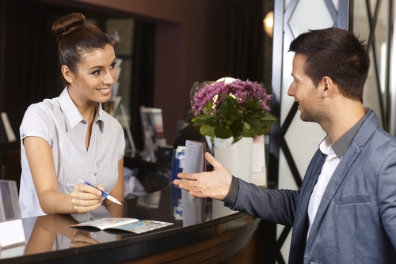
Methods of communication when dealing with guests
A business that provides customer service relies on good first impressions.
When a guest enters the establishment, the guest makes judgments about the business based on the appearance, grooming, posture, and courtesy of the staff, as well as the appearance of the business.

Slide 4

Methods of communication when dealing with guests
These factors communicate a message to the guests about the business and its attitude to guests.
First impressions can colour the guest’s perception of the entire dining experience. Once the perception is formed, even if it is faulty, it is very hard to change.
You only get one chance for a good first impression

Slide 5
Methods of communication when dealing with guests
Face to face communication is the distinction of being able to see the other party or parties in a conversation.
It allows for a better exchange of information since both speaker and listener are able to see and interpret body language and facial expressions/
.

Slide 6

Methods of communication when dealing with guests
Non-verbal communication includes such things as tone of voice, voice quality, making eye contact with the person to whom you are talking, paying attention when somebody else talks, body position, distance from the person, and body movement.
It is easy to say one thing but to communicate the opposite with your non-verbal communication. When the non-verbal part of your communication is in conflict with the verbal message, others tend to trust the non-verbal message.

Slide 7
Methods of communication when dealing with guests
Effective listening – you can listen about four times as fast as you can speak. It is easy to listen to your own thoughts at the same time as listening to somebody else speak. It is also easy to listen to only your own thoughts while somebody else is speaking.
To be an active listener, you must deliberately resist this tendency to let your mind wander. Not only will you remember more of what the speaker is saying, but the speaker will feel that you are listening.

Slide 8
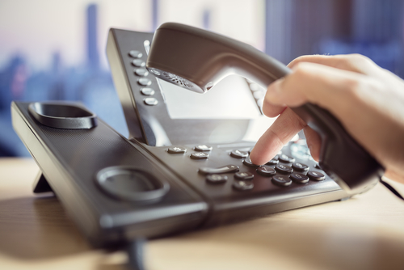
Methods of communication when dealing with guests
Over the telephone – communicating on the telephone can be more difficult than speaking in person because many of the non-verbal cues are missing. When dealing with guests and other outsiders, it is particularly important to create a good first impression of your business. This first impression is created almost solely by your voice.
Therefore, working on telephone communication skills is a sensible investment of a businesses time.

Slide 9

Methods of communication when dealing with guests
In writing – we encounter written communication through letters, memos, reports, job applications and resumes, marketing literature, notices on staff noticeboards boards, employee handbooks, promotional signs, meal orders, membership application forms, float balance sheets.
Electronic communication in the form of the internet and email as well as text messaging have become important methods of communication in the workplace.

Slide 10

Methods of communication when dealing with guests
Electronic/email – communication in the form of the internet and email as well as text messaging have become important methods of communication in the workplace.

Slide 11
Methods of communication when dealing with guests
Think about the importance of ensuring that accurate records are kept for function enquiries, table bookings, membership enquiries, phone messages, and courtesy bus bookings.
Think also about digital communication such as ringing up orders correctly on the POS/tills, emails and internet usage.
No matter what type of activity the most important thing is ACCURACY! Don’t rush! Get it right!

Slide 12
Any questions?

