Slide 1
Know how effective communication is used to benefit a hospitality establishment
PowerPoint presentation
Unit 203: Provide guest service

Slide 2
Benefits of effective communication
No matter where you sit, team leader or teammate, effective communication is everyone’s responsibility.
It is a lot more than just communicating; it involves knowing your audience, building trust and encouraging involvement.
Effective communication takes work but, if you get it right, the team will be more productive and less stressed.

Slide 3
Benefits of effective communication
Team building – when teams effectively communicate, information flows freely from side to side and top to bottom. Team members feel empowered to act because they understand how their work impacts other efforts and how it contributes to the team’s goals.
Employee morale – when a team communicates effectively, team members trust that they are getting the whole picture and can focus on their work. They feel comfortable that, if something comes up, they will be informed and will know who to turn to for help.

Slide 4
Benefits of effective communication
Increased customer satisfaction – when a team communicates well with each other, they will communicate well with the customer.
A customer who knows they can count on you, even when there are problems, will be far less willing to take their business elsewhere.

Slide 5
Benefits of effective communication
Increased productivity – when team members know their roles, the roles of others and what leadership expects, they can concentrate more on work and less on the workplace.
Team leaders gain a clear picture of their resources and can balance workloads to get the most out of their team, other benefits of effective communication include:
better understanding
increased sales/happy customers
fewer complaints
numbers of compliments
repeat business/brand loyalty
reduced staff turnover
job satisfaction and staff motivation.

Slide 6
How to overcome the barriers to effective communication
Day-to-day functioning of any business relies on clear, effective communication. When employees aren’t on the same page more mistakes get made.
When more mistakes get made, employees feel less effective in their role and lose motivation, in turn negatively affecting and impacting the guest experience.
Communicate only what is needed – too much information can make it very difficult to listen with full attention.
Try to focus on the relevant information, and the central points that are needed.
Use simple and clear words and the use of ambiguous words and jargons should be avoided.

Slide 7
How to overcome the barriers to effective communication
Avoid slang – in written and verbal instructions will go a long way towards keeping your team on the same page.
Slang differs significantly across generations and cultures. It can even vary wildly from region to region, even among those that share a culture or age group.
Slang can cause confusion, but it can also be a source of alienation and frustration. Confusion, frustration, and a generally disconnected team is a recipe for disaster.

Slide 8
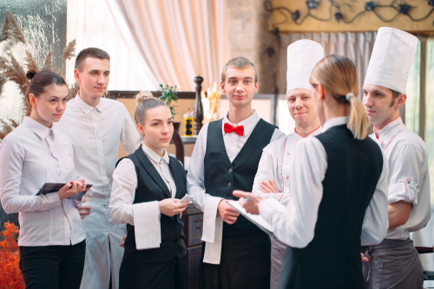
How to overcome the barriers to effective communication
Be aware of cultural differences – you need to be extremely aware of inter-cultural communication issues.
For example, not everyone in your company might speak English well, they may have a different religious belief or cultural upbringing.
To overcome this language barrier, keep messages simple and to the point so everyone can understand them.

Slide 9
How to overcome the barriers to effective communication
Stay open minded – to communicate effectively, you need to be open-minded and willing to ask and answer questions that may seem frustrating or frivolous.
Never put someone off just because you don’t feel like answering them.

Slide 10
Any questions?

