Slide 1
Know the effect of customer service on hospitality establishments
PowerPoint presentation
Unit 203: Provide guest service

Slide 2

Introduction
Understanding the importance of good customer service practices for both internal and external customers within a hospitality business is essential to business success.
Service excellence starts with excellent internal customer service. Remembering happy employees will be more likely to treat customers with respect.
Even employees who do not have direct contact with customers can impact the image of the company through their interactions outside the company, their treatment of other employees, and their loyalty to the business.

Slide 3
Types of customers in the hospitality industry
Customer service must be a total business effort. It just can't be the front line who deals with the outside customers, the ones that buy our products and services.
The front line needs the support of everyone within the organisation.
Looking after the internal customers builds the platform for better external customer service.
Creating a cultural harmony between all levels of staff, based on mutual respect, communication and clear goals enables a business team to succeed.

Slide 4
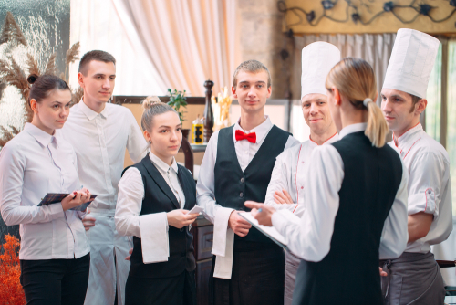
Types of customers in the hospitality industry
Internal customers are those who work for the business.
They are are colleagues, peers, supervisors and managers, who work in the same business as partners in getting the jobs done.
team members and staff
supervisors
managers

Slide 5
Types of customers in the hospitality industry
External customers use a business’s product or services but are not part of the organisation. In hospitality, for example, an external customer is an individual who enters your business (guest) and pays for a product or service provided.
Examples of different categories of external customers within hospitality include:
existing guests
new guests
potential guests.

Slide 6
Principles of customer service
Hospitality businesses strive for service excellence, creating that competitive edge. Truly focusing upon your guest needs and expectations is not as easy as it sounds, without the support and commitment of your internal customers, i.e. your employees.
Focusing on the internal customer requires a business to, get all employees actively involved in the service excellence effort, including:
clearly defined roles and responsibilities
setting and implementation of standards of performance
ideas and suggestions from the team
staff training and support.

Slide 7
Principles of customer service
Focusing on the external customer requires a business to define and communicate a commitment to achieving service excellence so that guests and employees know what the business is trying to achieve. Followed by translating that commitment into action through a range of activities including:
getting closer to your guest, know what their needs and expectations are
designing products and services in response to those needs/expectations
consistently delivering those products or services
measuring how the business is doing by insight and feedback
improving or reacting to feedback, ensuring customer excellence.

Slide 8
Principles of customer service
Focusing on the standards of performance with a view to achieving consistency requires a business to:
identify contact points and interaction opportunities
devise standards of performance (SOPs) to guide how service should be delivered across all the identified interactions
train and coach employees on how to deliver those SOPs
devise mechanisms to continuously improve

Slide 9

Principles of customer service
Characteristics of these principles are:
welcoming, friendly, and courteous
knowledgeable
efficient
well-timed
flexible attitudes
consistent
communicating effectively
building trust and confidence
exceeding expectations.

Slide 10
Factors that affect good customer service
Excellent customer service is vitally important in all businesses. However, guest expectations are often difficult to gauge. Influencing factor to consider when analysing guest expectations and reasons for choosing a product or service are:
price point
value for money
reputation
brand
past experiences
recommendations
media influences
cultural influences
faith-based influences.

Slide 11
The effect of good customer service on stakeholders
The employee – internal customer service provides a better environment to work in, better relationships with other members of staff, better communication and reduced levels of stress, which ultimately leads to better job satisfaction
The business – customer satisfaction can provide hospitality businesses with major competitive advantages, which can directly lead to increase in profitability and growth.
The guest experience is one of the most important factors affecting positive customer behaviour such as loyalty and personal recommendations.

Slide 12
Any questions?

