Slide 1
Understand how guest issues are resolved by hospitality establishments
PowerPoint presentation
Unit 203: Provide guest service

Slide 2
Introduction
Taking care of the guest is the heart of the hospitality business. Doing so means understanding and anticipating what the guest needs and then knowing how to meet and exceed those needs as well as dealing with issues that may in day to day business.
Evaluating guest satisfaction is an essential tool for informing business of what is working and what is not! It provides useful information towards meeting guest satisfaction and driving business success.

Slide 3
Guest expectations
In the hospitality industry, it’s all about customer satisfaction and happiness in order to boost loyalty. Guest experience is crucial to the success of your hotel, so you need to provide the right amenities and overall service if you’re going to have your guests return. Although personal to each guest in general expectations will include:
  personalised experience
  high quality and competent customer service
  friendly courteous service
  clear, honest communication
  consistency
  informed or advised
  efficiency, timing and speed.

Slide 4

Guest expectations
Value for money
Value is what ultimately drives every purchaser’s decision: The belief that what you are gaining yields a greater return than what you are investing.
If a consumer finds value, they will likely return to make a similar purchase in the future.

Slide 5

Guest expectations
Product quality and presentation – characteristics and activities of a successful hospitality businesses are proper presentation i.e. décor, display, heating, lighting, linen, glass, cutlery, cleanliness, etc., and constant improvement of qualitative services, which exceeds the expectations of customers in every way.
A continued challenge to the business is keeping current guests loyal with the service or product they like whilst attracting new customers looking for something different.
Hygiene – guests demand and expect high standards of hygiene, not only for food preparation and service, but also a clean bed, a spotless toilet and bathroom and a high level of general cleanliness in their room and public areas.

Slide 6
Guest expectations
Health and safety – health and safety is an important consideration for any workplace. Guest expectations include:
safe environment free from obvious risk
safe food and drink
personal safety is prioritised.
Luxury factor – an offer of a five-star experience that guests will thoroughly enjoy and never forget. They expect to find things designed to improve their experience. The property needs to be outstanding, inviting, immaculate and give you that personalised service you expect at a luxury resort.

Slide 7

Types of guest issues
Common difficulties
noisy neighbours
uncomfortable beds or pillows
rooms too hot
no hot water
stolen or lost property
difficulties with settling accounts.
Dissatisfaction with service and products – implicit expectations reflect established norms of performance. Expectations are established by the business in general, other companies, industries, and even cultures often a guest’s dissatisfaction is fuelled by a comparison (compared to another hotel or restaurant).

Slide 8
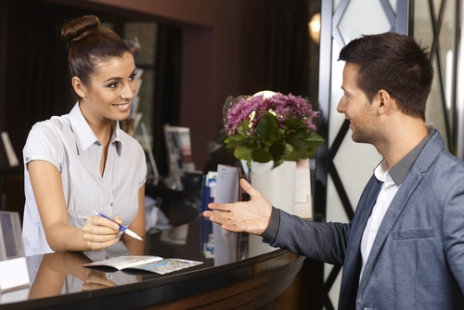
Types of guest issues
Guest requests – management, sometimes known as, guest experience management, is an important part of hotel management because it underpins guest service.
Guests can request services, information or amenities in person, over the phone, by email, mobile app, or social media.
Text messaging or other messaging services also add complexity and challenges for the staff at the end of these messages.

Slide 9
Types of guest issues
Guest requests – unless prioritised, this has a potential to disappoint, creating a strategic risk for hospitality businesses.
Guests can complain about their experience in real-time and across many digital platforms. These include TripAdvisor, Google, Yelp, and other hotel reviews which typically focus on the guest’s experience in-stay.
The impact of reviews can also have a significant impact on revenue.

Slide 10
Types of guest issues
Difficult guests – seemingly impossible to please.
Intoxicated guests – many hospitality businesses are licensed to sell alcohol, responsible service of alcohol if not legislated for is expected, for the safety of staff and guests alike.
Hospitality organisational policy should address the risks associated and have standard operating procedures to support staff in managing those guests who have had too much to drink.

Slide 11
Types of guest issues
Medical incidents – handling even a minor medical emergency can be stressful however maintaining and calm collected attitude will ensure that the guest gets the right care as quickly as possible, from slips, trips and falls to the most serious of issues like heart attacks and even death.
Well trained and prepared staff following standard operation procedures will ensure the guest health and wellbeing is prioritised.

Slide 12
Any questions?

