Slide 1
Understand how guest issues are resolved by hospitality establishments
PowerPoint presentation
Unit 203: Provide guest service

Slide 2
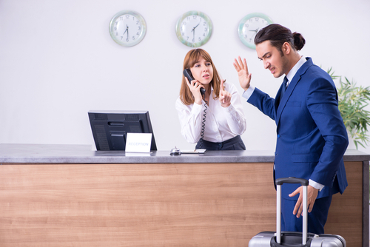
Dealing with guest issues
When expressing a complaint, the guest may be quite angry. Front line members of staff should not make promises that exceed their authority. Honesty is the best policy when dealing with guest complaints. If a problem cannot be solved, staff should admit this to the guest early on.
Front office staff should be advised that some guests complain as part of their nature. The staff should develop an approach for dealing with such guests. Hospitality businesses generally have complaint handling procedures, however in the absence of such a procedure it is advised to:

Slide 3
Dealing with guest issues
Listen with concern and empathy, stay calm. Don't argue with the guest.
Isolate the guest if possible, so that other guests won't overhear.
Be aware of the guest's self-esteem, show a personal interest in the problem, try to use the guest’s name frequently.
Give the guest your undivided attention, concentrate on the problem, not on placing blame. Do NOT Insult the guest.
Take notes. Writing down the key facts saves time if someone else must get involved. Guests also tend to slow down when they see the staff member trying to write down the issue.
Tell the guest what the best can be done, offer choices. Don't promise the impossible, and don't exceed your authority.
Set an approximate time for completion of corrective actions. Be specific, but do not underestimate the amount of time it will take to resolve the problem.
Monitor the progress of the corrective action.
Follow up. Even if the complaint was resolved by someone else, contact the guest to ensure that the problem was resolved satisfactory.
Common difficulties
Dissatisfaction with service and products
Guest requests

Slide 4
Dealing with guest issues
Intoxicated guests – staying calm is crucial.
Don’t argue with the drunk guest, don’t call them out on being drunk, and don’t embarrass them in front of other guests or employees.
Pretend that you don’t notice that this person is drunk and handle him or her as you would any other guest. Invite the individual to an area away from other guests where you can talk.
Politely, but firmly, encourage the guest to go back to his or her room no matter what more alcohol should be served to the guest.
While handling an intoxicated guest, have security personnel available nearby to intervene if needed.

Slide 5
Dealing with guest issues
Major incidents – hospitality businesses should have an emergency plan and team trained in responding to major incidents, fire evacuation and medical emergencies. Often that team is led by a manager with clear roles and responsibilities shared throughout the team.

Slide 6
Dealing with guest issues
Medical incidents – a staff member discovering a sick or distressed guest should inform the front desk, reception or manager. Based on the guest’s symptoms or conditions, either first aid should be applied and/ or professional medical help should be called, such as a doctor or ambulance. The guest should be made comfortable but not moved until professional help arrives.
In the event of a deceased guest, nothing should be moved or touched. The room should be sealed or secured and you should await further instruction from the authorities or police.

Slide 7
Benefits of dealing with issues effectively
The employee – is often negatively impacted by the experience when dealing with issues. However, this stress can be reduced by having the confidence and skills (supported by training, strategies and operating procedures) designed to cope when dealing with guest issues.
The business – when a guest is satisfied, they’ll come back. Obviously, this means more revenue for the company – after all, why would they go somewhere else when they had a great experience at the last place? However, many guests leave without complaining or giving the business a chance to fix an issue. Not only do they not return but potential advise many more not to.

Slide 8
Benefits of dealing with issues effectively
The guest – can be your most powerful marketing tool, or your biggest detractor. If your guests have a good experience, they are going to return more frequently and share the positive news on social media, as well as recommend your business or brand to their friends and family members.
If they have a negative experience, they are going to express their views through online reviews and go the extra mile to make sure people know about what happened. It makes business sense to deal with guest issues for continued business success.

Slide 9
Methods of evaluating guest satisfaction
Using guest feedback to make future decisions – guest feedback and relevant data can guide future decisions within the business. When you monitor your guest feedback and respond to it accordingly, it’s important that you take note of what improvements you could make in the future based on those responses.
You also can use booking data and marketing data to finalise decisions for upgrading amenities, creating events, designing promotions and more.
Not only will this help towards making the best decisions and using resources wisely, but it will show the past, present and future guests that a business genuinely values their input.

Slide 10
Methods of evaluating guest satisfaction
More often than not used by larger organisations, customer relationship management (CRM) is a technology that allows businesses both large and small to organise, automate, and synchronize every facet of customer interaction. CRM system examples include marketing, sales, customer service, and support. Smaller businesses continue to rely on the following methods to inform a business of their customer satisfaction levels:
guest questionnaires
verbal feedback
letters
emails
telephone calls
comments on social media sites and influencers
comments on websites and travel blogs
reviews on travel booking engines
team briefing/meetings.

Slide 11
Any questions?

