Slide 1
Know the principles of sustainability in the hospitality industry
PowerPoint presentation
Unit 204: Awareness of sustainability in the hospitality industry

Slide 2
Introduction
The hospitality industry has historically had a dramatic environmental impact through energy and water consumption, use of consumables and the production of waste.
Establishments such as hotels consume energy for lighting, fuel and other power needs. Water is used for bathrooms, food and beverage operations, and laundry, as well as other general operations.
The hospitality industry now promote their sustainability credentials as part of the offer to their guests.
Working in the hospitality industry you need to understand the issues relating to the use of resources, their impact, sustainable sources and how sustainability may affect businesses.

Slide 3
Introduction
Sustainability of resources and food sources is fast becoming an important part of the hospitality industry.
Guests are now more knowledgeable and understand that the earth can only supply so much resource for consumption before it runs out or causes damage to the environment. Sustainability can only be achieved with improved practices within the supply chain and a better understanding within the hospitality industry.

Slide 4
Sustainability in the hospitality industry
So what is sustainability in the hospitality industry?
In simple words, sustainability means that natural ecosystems can continue to support life and provide resources to meet the needs of the present and future generations.

Slide 5
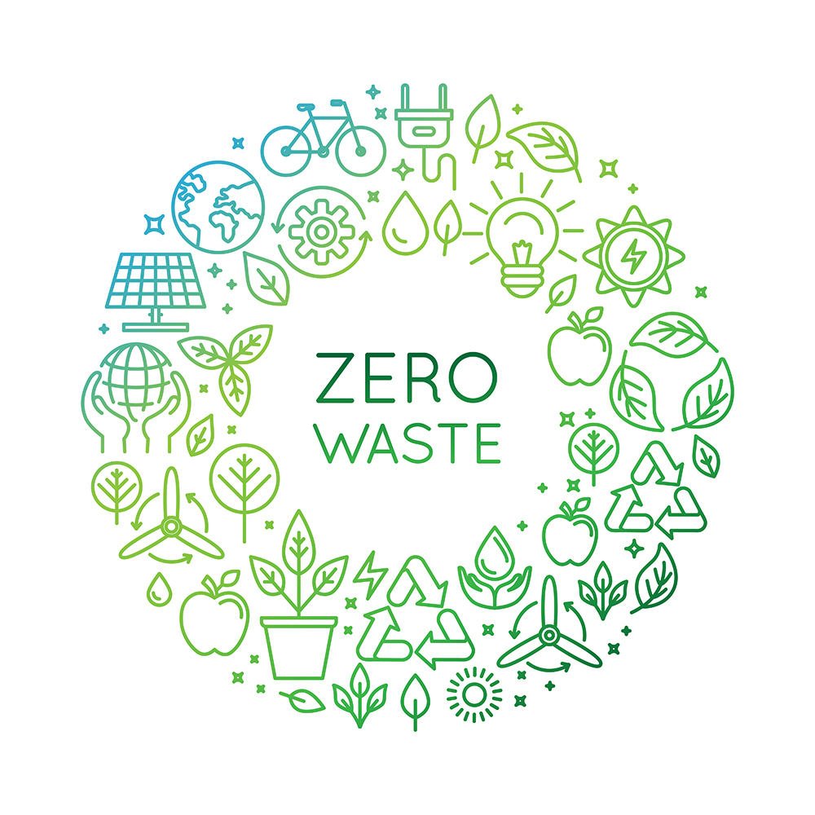
Sustainable practices in the hospitality industry
The hospitality industry is faced with a number of concerns when it comes to managing their waste, which results in high costs and most of their materials being sent to landfill.
Waste reduction – as a guest-facing sector, the hospitality industry provides excellent opportunities to generate engagement with guests and support the reduction of waste. One of the biggest steps is minimising waste by eliminating the use of single-use items, such as using paper instead of plastic straws for drinks.
Waste reuse/recycle – providing recycling bins in easily accessible places will allow guests to recycle. Other simple steps include asking guests to reuse towels in hotel bathrooms.

Slide 6
Sustainable practices used in the hospitality industry
Energy usage best practices
Energy efficiency can be improved a number of ways. The biggest savings and costs are typically in three major areas:
heating and air conditioning
hot water
lights.
Energy usage impacts all organisations and departments in the hospitality industry. This includes the usage of electricity and gas. Simple energy saving activities include the installation of lights which are only active when the room card is inserted, and using low wattage and LED lights.
Implementing a building management system (BEMS) to control and monitor heating, ventilation and air conditioning can reduce total energy costs.

Slide 7
Sustainable practices used in the hospitality industry
Water reduction
Many establishments and hotels have a lot of water waste from guest showers, swimming pools and laundry. In restaurants, water is used for dishes and cleaning and often the machines are not efficient at saving water.
Many hotels have removed baths and have only showers with low-flow showerheads, or heat-recovery shower systems to capture and reuse energy through the boilers. In some large hotels, in-house water treatment facilities are used to treat waste water and turn it back into clean water. Chemicals are also used to treat water systems and clean facilities.

Slide 8
Sustainable practices used in the hospitality industry
Food commodities sourcing
Consumer pressure to provide locally produced food supply is on the demand and the term ‘farm to fork’ is commonly used throughout the industry.
As consumers become more knowledgeable they demand to know the provenance of food, ethical production methods and the sustainability of products. Within the professional kitchen it is essential that the chef can confirm the provenance of the supply of food and the ethical methods employed.

Slide 9
Sustainable practices used in the hospitality industry
Food commodities sourcing
This can be achieved by sourcing from sustainable initiatives within the supply chain such as fair trade. This means that the producer receives a guaranteed and fair price for their product, regardless of the price on the world market. This means their quality of life should improve, as well as the long-term prospects for workers.
Environmentally friendly activities/operations
Sustainable initiatives also including laws about not over-fishing certain fish species, and the use of farmed fish rather than wild fish. Others are purchasing seasonal products that are local, are fair trade, have recyclable packaging and reduce the impact of transportation.

Slide 10
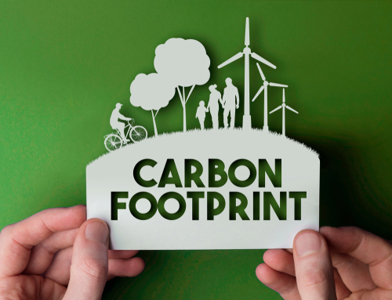
Carbon footprint
What is the term carbon footprint?
The carbon footprint refers to the amount of carbon dioxide released into the atmosphere as a result of the organisation’s activities.
Carbon dioxide is a gas that’s present naturally in the earth’s atmosphere. As a greenhouse gas, it plays a crucial role in heating the earth by absorbing energy from the sun and redirecting it back towards the earth's surface.
However, an increase of carbon dioxide gas can have a toxic effect on human and animal life. Moreover, a build-up of carbon dioxide in the atmosphere can also lead to climate change.

Slide 11
Supply of sustainable food – carbon footprint
The supply of sustainable food is affected by many different issues. The most common concern is the carbon footprint (emissions). These may include:
Transporting food and other resources around and storing it, which generates emissions. However, this activity also has the potential to make the food industry more efficient and cost-effective by providing food where and when it is required.
The costs involved in shipping produce to meet consumer expectations of year-round supply.
Consumer pressure to provide locally produced food supply and reduce ‘food miles’.
Weather and changes in farming methods – changes in weather patterns has increased the number of droughts and flooding worldwide. This leads to farms having to generate a large proportion of emissions from food production, as a result of processes including deforestation, fertiliser production and use, and livestock management.

Slide 12
Reducing the carbon footprint
There are many ways in which hospitality organisations can reduce their carbon footprint, such as:
sourcing local produced commodities
practising sustainable purchasing
effective waste management
training and educating staff and guests
monitoring energy consumption.

Slide 13
Any questions?

