Slide 1
Know how to implement sustainable practices in the hospitality industry
PowerPoint presentation
Unit 204: Awareness of sustainability in the hospitality industry

Slide 2
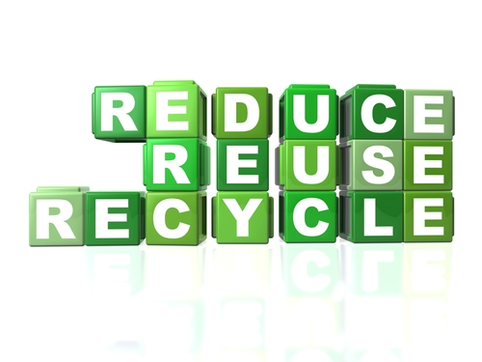
Introduction
Hotels, restaurants or pubs have some unavoidable waste streams, ranging from food waste to rubbish left behind by hotel guests and other customers.
We generate millions of tonnes of waste every year in the UK. This is a poor use of resources and costs businesses and households money. It also causes environmental damage – for example, waste sent to landfill produces methane, a powerful greenhouse gas.
Recycling waste can:
lower waste management costs
save space and reduce clutter
improve the businesses environmental credentials
reduce the businesses impact on the environment.

Slide 3
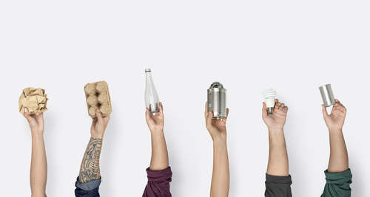
What can you recycle?
Waste materials that you can recycle include:
paper
certain plastics
food
metals
glass
liquids
hazardous.

Slide 4
Different types of recyclable materials
Paper and cardboard
Paper and cardboard are commonly used in the hospitality industry as packaging. Paper is a valuable recyclable material but only when it is clean.
If you scrunch paper and it doesn't spring back, then it can be recycled.
Recycling process
Remove any plastic wrapping attached to the paper and cardboard. This can be recycled separately.
The paper and cardboard is taken to a recycling plant where it is separated into types and grades.
The separated paper and cardboard is then washed with soapy water to remove inks, plastic film, staples and glue. The mixture is put into a large holder where it is mixed with water to create ‘slurry’.
By adding different materials to the slurry, different paper products can be created, such as cardboard, packaging and other paper.
The slurry is spread using large rollers into large sheets and the paper and cardboard is left to dry and then is ready for use.

Slide 5
Different types of recyclable materials
Plastics
Plastics are commonly used in the hospitality industry. Plastic is a valuable recyclable material but only when it is clean. Plastics include shampoo bottles, fizzy drink bottles, etc.
The majority of plastic is non-biodegradable. Approximately 8 million metric tonnes of waste plastic enters the earth's ocean every year.
Recycling process
Empty and rinse plastics. Left over foods or liquids can contaminate other recyclables. Squash plastic to save space.
The plastic is taken to a recycling plant where it is separated and sorted into types and grades.
Plastic is ground down into chips and pellets after sorting is complete.
The chips and pellets are washed in a bath before being dried and then melted. Once melted, the material is formed into pellets to be used in other plastic materials.

Slide 6
Different types of recyclable materials
Metals
Metals can be classified as ferrous or non-ferrous. Non-ferrous are commonly used in the hospitality industry and include aluminium cans and tins.
They are a valuable recyclable material but only when they are clean, so it is important to ensure that there is no residue liquid or foods left before recycling.
Recycling process
Metals are collected and taken to a treatment plant.
In the treatment plant the metal is sorted in to different types and cleaned ready for reprocessing.
The metal then goes through a re-melt process and turns into molten metal. This removes the coatings and inks that may be present on the metals.
Metals are formed into specific shapes such as bars that can be easily used for the production of various products, such as cans and tins.

Slide 7
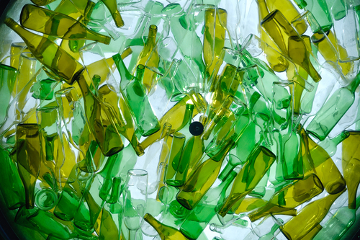
Different types of recyclable materials
Glass
Glass is commonly used in the hospitality industry. It is a valuable returnable packaging. However, some organisations are going glass free in the kitchen to prevent accidental contamination.
Recycling process
Empty and rinse glass. Leftover foods or liquids can contaminate other recyclables.
Glass is taken from the bin to a glass treatment plant.
The glass is sorted by colour and washed to remove any impurities.
The glass is then crushed and melted, then moulded into new products such as bottles and jars – it is even used in bricks.

Slide 8
Different types of recyclable materials
Food
Most waste food ends up in landfill sites where it rots and releases methane, a damaging greenhouse gas.
Avoiding throwing out food that could have been eaten will save the business money and help reduce greenhouse gas emissions. However, some food waste is inevitable.
Recycling process
Waste food can be composted. This involves mixing food waste with garden waste, shredding it and then composting it in an enclosed system for around 2–4 weeks.
Food waste can also be treated using a method called anaerobic digestion. This uses microorganisms to break down food waste, giving off methane, which is collected and converted into biogas and used to generate electricity.

Slide 9
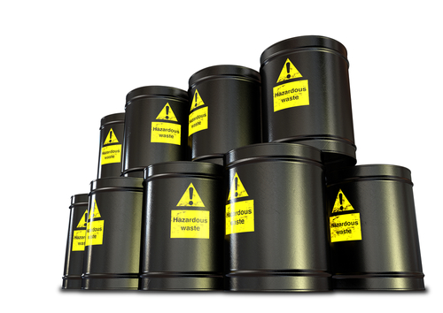
Different types of recyclable materials
Hazardous
Hazardous waste comes in many shapes and forms: it can be liquids, solids, contained gases or sludge, and it is often poured down sinks or added to the regular waste stream; for example, pouring cleaning and disinfecting products and oils down the sink, which contributes to the pollution of our land and water.
Other hazardous waste can come in the form of solid items, such as batteries and light bulbs.
All hospitality organisations are legally responsible for the safe and correct disposal of hazardous waste. Not following proper procedures and regulations can result in not only damages to the environment but also significant fines.
Organisations should arrange to have hazardous waste removed by waste removal companies.

Slide 10
Different types of recyclable materials
Non-recyclable
Non-recyclable materials are usually disposed of at landfill sites. The waste is usually buried and covered with organic material such as earth. Waste sent to landfills can take many years to break down and can pollute the ground and produce harmful gases such as methane.
Non-recyclable materials may include items that need to be disposed in a certain manner to protect the environment and comply with waste regulations. This may include items such as:
batteries
paints
electrical equipment.

Slide 11
Any questions?

