Slide 1
Know how to implement sustainable practices in the hospitality industry
PowerPoint presentation
Unit 204: Awareness of sustainability in the hospitality industry

Slide 2
Activities which can be implemented to reduce waste
Stock rotation – use the ‘FIFO’ rule: First in, first out, when storing food and other items which have a shelf-life. This ensures that newer stock is routinely placed behind older stock, and the older stock will always be used up first before it has chance to go to waste.
Menu planning – wastage of food in the hospitality industry is a significant problem. The cost of food waste isn’t just the cost of buying the food, it also includes the costs of storing the food, preparing it, cooking, serving and disposing of it. Positive activities to reduce waste include:
Cross-utilising ingredients so that more than one menu item uses each ingredient.
Buying small quantities of short shelf-life items, or utilising ingredients with a longer shelf-life.
Making sure staff are trained on how to reduce spoilage and kitchen waste.

Slide 3
Activities which can be implemented to reduce waste
Re-use system – this is heavily used in hotels for towel and bed linen in which guests comply with a ‘hang up and reuse’ system. The hotel then saves on the labour cost of restocking and washing extra towels and bed linen. Re-using towels and not changing bed linen every day really does save significant amounts of water and energy.
Contemporary plastic key cards are made from PVC based plastic which is part of a highly toxic manufacturing process. Many hotels are shifting to card options made from paper, wood and bioplastic, or enabling room entry via guest smartphones.

Slide 4
Activities which can be implemented to reduce waste
Leftover food – make use of it somewhere else. For example, vegetable peelings and animal bones can be used to make stocks and soups, while day-old bread can be made into croutons or breadcrumbs.
List all the different ways you could use left over foods.

Slide 5
Activities which can be implemented to reduce waste
Reduction in disposables items – single-use items or disposable items are products and packaging that we throw out after only one use. These items are used for only minutes but their impact on our environment can last thousands of years. Disposable items may include plastic straws, plastic cutlery, water bottles, coffee cups, takeaway packaging and individual wrappers. These can all end up in landfill or contaminating recycling streams.
There are many sustainable alternatives to single-use items. Switching to sustainable items can make a big difference for the environment. For example, for customers at coffee shops, cafes and restaurants, business should consider buying condiments in bulk and switching to reusable containers, such as glass bottles or ramekins.

Slide 6
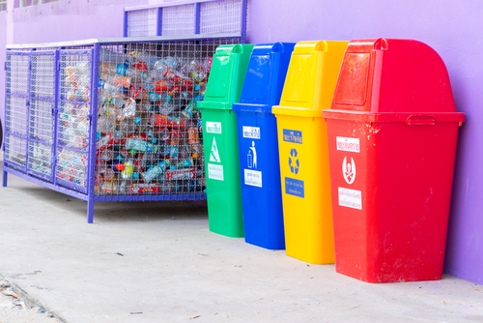
Activities which can be implemented to reduce waste
Separating waste streams – wherever you work in the hospitality industry, there will be a policy and system for sorting out different types of waste that result from providing services to your guests.
Placing items into the wrong waste streams might put the organisation at risk of breaching the law or pose a risk to waste handlers.
Most waste streams follow a colour-coded system with different-coloured bags and containers for different kinds of waste.

Slide 7
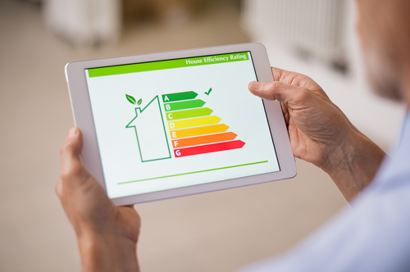
Activities which can be implemented to reduce waste
Energy monitoring and management – energy usage should be monitored and managed. Energy management is the process of collecting information about where, when, how, and why energy is being used within an organisation, so it can increase efficiency, reduce costs and improve sustainability.
How do you monitor energy in your household, school or work?

Slide 8
Activities which can be implemented to reduce waste
An energy management system (EMS) for the hospitality industry allows managers to monitor individual guest rooms and track actual energy usage in different departments.
Like energy-management systems that monitor, track and optimise energy consumption, predictive energy maintenance systems enables hospitality business to use sensor data to identify wasteful or overuse trends and can alert maintenance staff.

Slide 9
Activities which can be implemented to reduce waste
Reviewing of processes – reducing waste by improving systems and processes is one areas that offer the biggest opportunities for waste reduction in the hospitality industry. Business should look at their existing processes and identify areas where waste is a problem and change processes that reduce excess waste.
Smart procurement – managers should consider using minimal suppliers and where possible getting suppliers to be able to supply a number of your required products in one delivery. Hospitality organisations should see how the supplies that are purchased turn up and ask the questions:
are the suppliers using returnable packaging?
can you return containers with every new order?
can the supplier supply reusable bags or resealable containers?

Slide 10
Any questions?

