Slide 1
Work as part of a team
PowerPoint presentation
Unit 205: Professional workplace standards

Slide 2
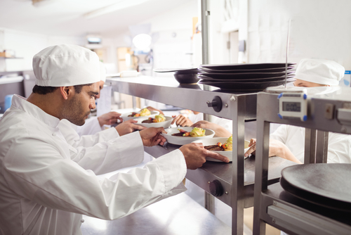
Introduction
Teams invariably outperform individuals if they are working effectively. When groups come together to solve a problem, they come up with more creative and flexible solutions than could individuals.
In a hospitality business, excellent products and services is always a team effort. If the meal is not well prepared or if the service is poor, the customer may not enjoy the dining experience. All members of the team have a role in making the customers experience memorable.

Slide 3
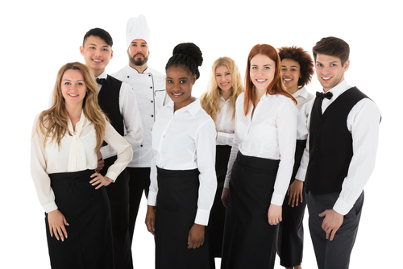
Collaborative approach
A collaborative team is a group of individuals who share common beliefs and work towards common goals. Collaborative team members spend time discussing and planning what they hope to accomplish as a team and set team and individual goals for reaching that vision.
Team member collaboration:
buddy systems
team meetings
Inter-departmental collaboration:
reception and accommodation
kitchen and restaurant
restaurant and bar

Slide 4
Good practice dealing with colleagues
Working with other team members whom you have a great work relationship with can make work fun. When morale is high, it leads to better productivity, which leads to better results.
Apply appropriate communication techniques – an ability to communicate effectively with supervisors, colleagues, and staff is essential, no matter what industry you work in. Convey a clear and concise message, whilst showing respect, empathy and friendliness as well as the right non-verbal cues.
Follow organisational procedures – the goal of every procedure is to provide the employee with a clear and easily understood plan of action required to carry out or implement a policy. It will also help eliminate common misunderstandings by identifying job responsibilities and establishing who should do what.

Slide 5
Good practice dealing with colleagues
Apply common courtesies – maintaining a common courtesies culture within the workplace leads to a more productive and enjoyable workplace. Good manners are the foundation of positive relations with management and colleagues.
Respect your colleagues – use their names when talking to them, valuing their opinion and having an open mind will ensure a positive culture within the hospitality business.
Respond in a timely manner – prioritising responding to colleague's request or queries shows that we value them, by getting back to them as quickly as possible not only builds a relationship but can contribute to better service for the business and guest.

Slide 6
Good practice dealing with colleagues
Support product knowledge and give advice when asked – sharing product knowledge or skill when asked by a colleague improves workplace productivity, standards and creates a collaborative environment where colleagues support each other to better the guests experience.
Meet colleague’s expectations – in modern business landscapes, employees expect to be treated with respect, to trust and be trusted by the people they work with, to feel job secure, and to have opportunities to use their skills and abilities in a safe workplace.
Check back in with a colleague – can demonstrate they are valued, by following up on a concern or answer, to see how they got on or do they need any further assistance creates a better relationship and understanding.

Slide 7
Any questions?

