Slide 1
Importance of food safety
PowerPoint presentation
Unit 207: Food safety

Slide 2
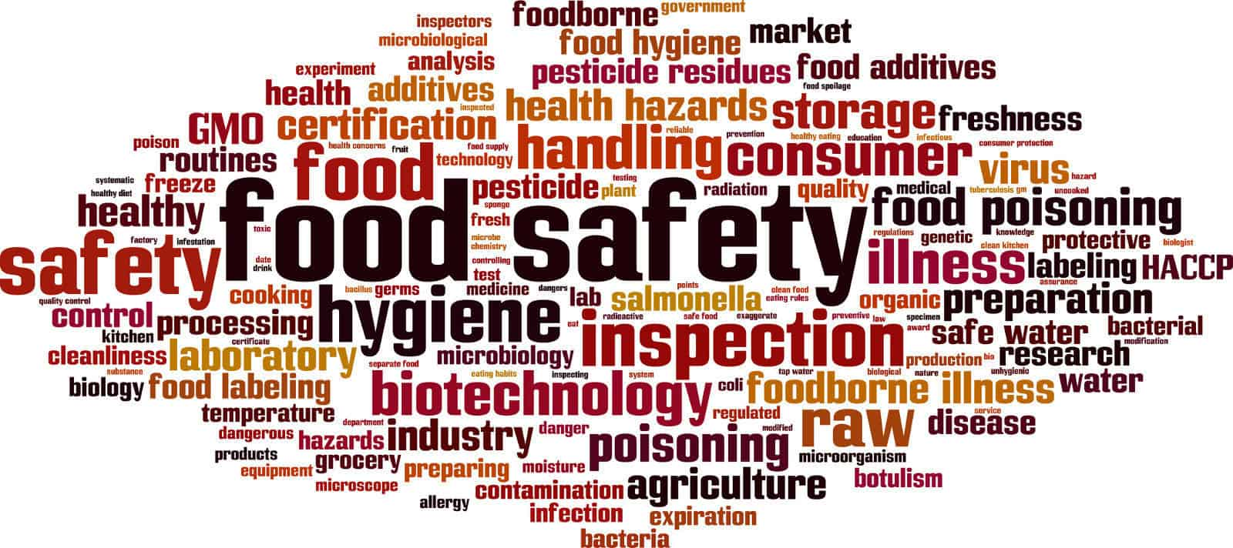
Definition of food safety
The handling, preparing and storing food in a way to reduce the risk of individuals becoming sick from foodborne illness.

Slide 3
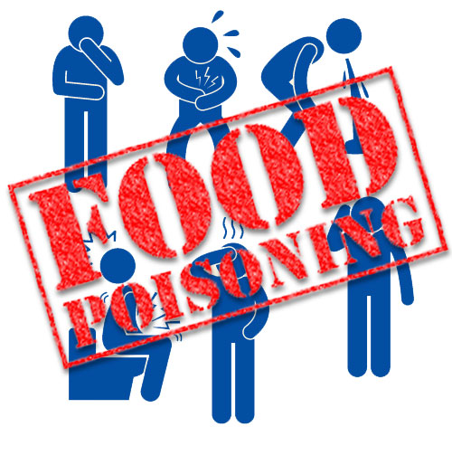
Definition of Food Poisoning
An illness caused by eating contaminated food and infectious organisms such as bacteria and toxins.

Slide 4
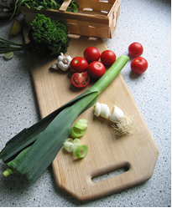
HACCP
Hazard analysis and critical control points is a well -known and used food safety management system.
It can be used effectively in all sizes and types of food business
Its main aim is to focus attention on CCP’s in the food business operation to ensure that situations do not occur which could make the food unsafe to eat
Each step in the food production process must be analysed to identify points at which something could go wrong and then procedures must be put in place accordingly.

Slide 5
Hazard awareness
A hazard is anything that may cause harm to people who eat the food.
Consider the list of hazards listed and explain what risk they pose:
Hazard | Risk
Dirty hands
Food handler sneezing
Outdoor clothing
Septic facial spots
Food handler wearing jewellery
Dirty serving utensils
A bowl of cooked rice left in a warm kitchen
Chipped mixing bowl

Slide 6
7 principles of HACCP
Conduct a hazard analysis
Identify critical control points (CCP)
Establish critical limits for each CCP
Establish CCP monitoring requirements
Establish corrective actions
Establish record keeping procedures
Establish procedures for ensuring HACCP system is working as intended

Slide 7
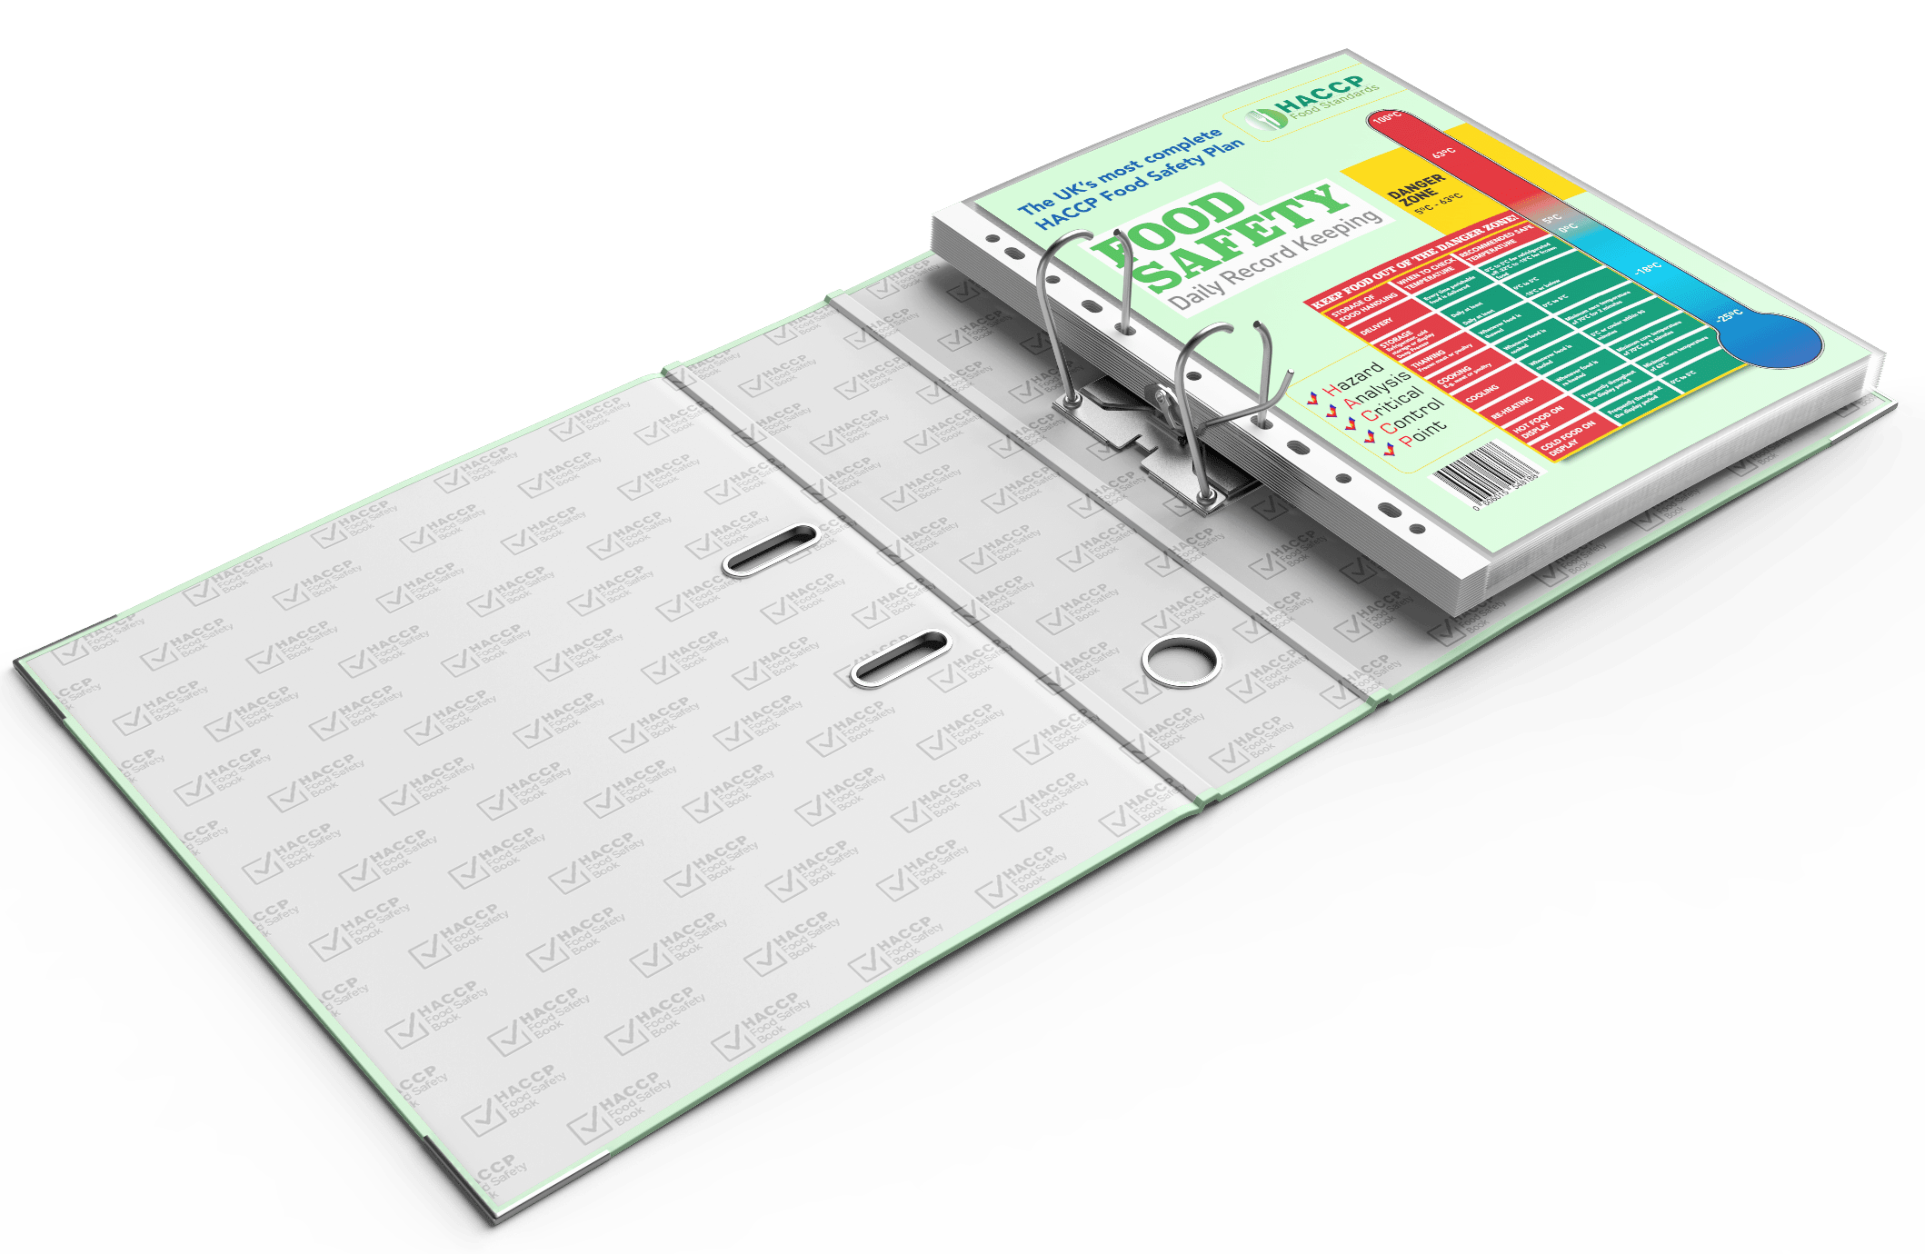
Food safety records used in a food safety management system
Fitness to work records
Training records
Pest control records
Temperature records
Refrigerator/freezer temperature records
Cleaning records
Stock rotation records
Audit records

Slide 8
Any questions?

