Slide 1
Personal hygiene
PowerPoint presentation
Unit 207: Food safety

Slide 2
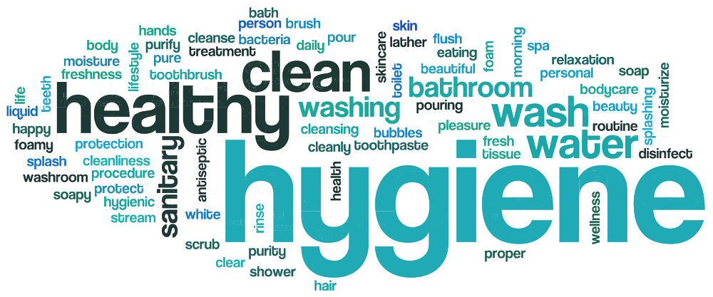
Personal hygiene
It is the responsibility of all food handlers to maintain a high level of personal hygiene
Many bacteria live on or in the body and can be transferred by using our hands to contaminate utensils, surfaces and food.

Slide 3
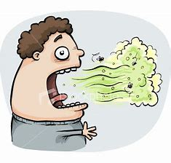
Personal hygiene continued
Poor personal hygiene practices
eating/chewing
spitting
nail biting
scratching
smoking
infrequent bathing/showering
infrequent cleaning of work area
touching parts of the body
tasting using fingers
wetting finger to turn pages.
.

Slide 4
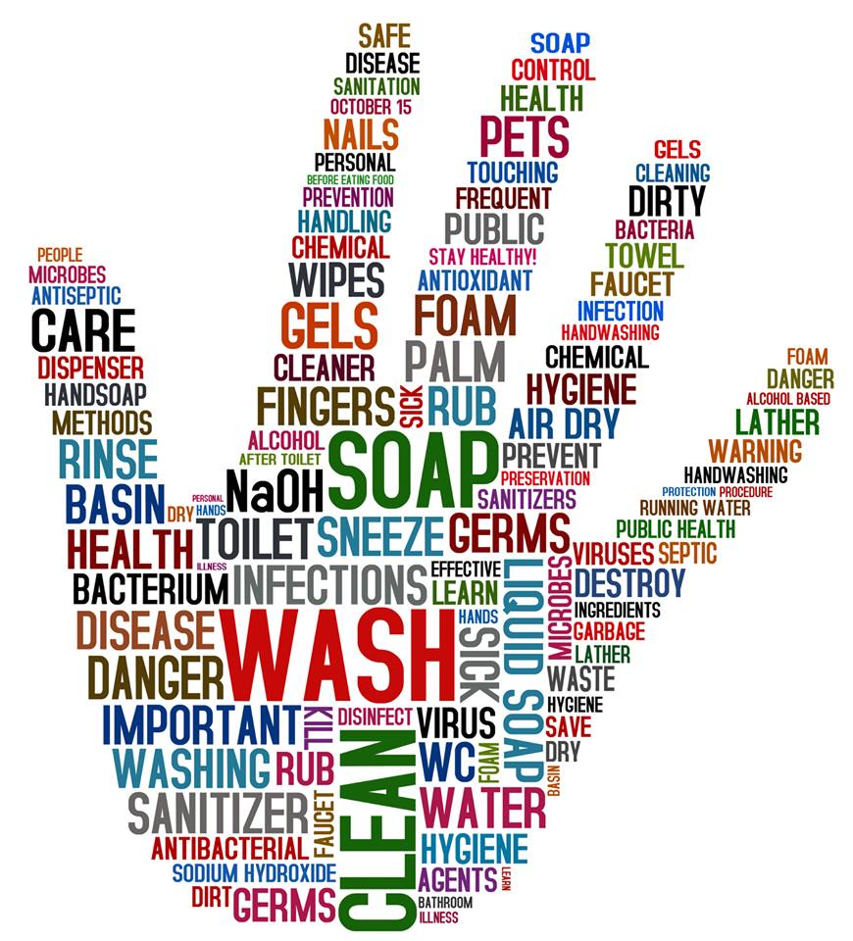
Personal hygiene continued
Hand washing should be carried out:
before entering a food preparation area and touching food
after eating
after going to the toilet
after handling raw meat, shellfish, poultry, eggs or vegetables
after coughing or sneezing into your hand or handkerchief
after touching your face or hands
after handling rubbish
after completing cleaning tasks
after handling money
after smoking.
.

Slide 5
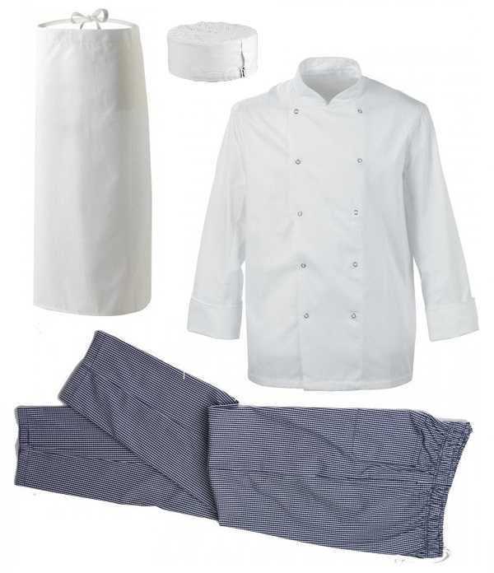
Personal hygiene continued
Clothes
Clothes must always be freshly laundered
Appropriate protective clothing must be worn including, head covering and sensible footwear.
Features of protective clothing:
no external pocket
press studs or velcro rather than buttons
able to cover own clothes
durable
easy to clean
light in colour
long sleeves
.

Slide 6
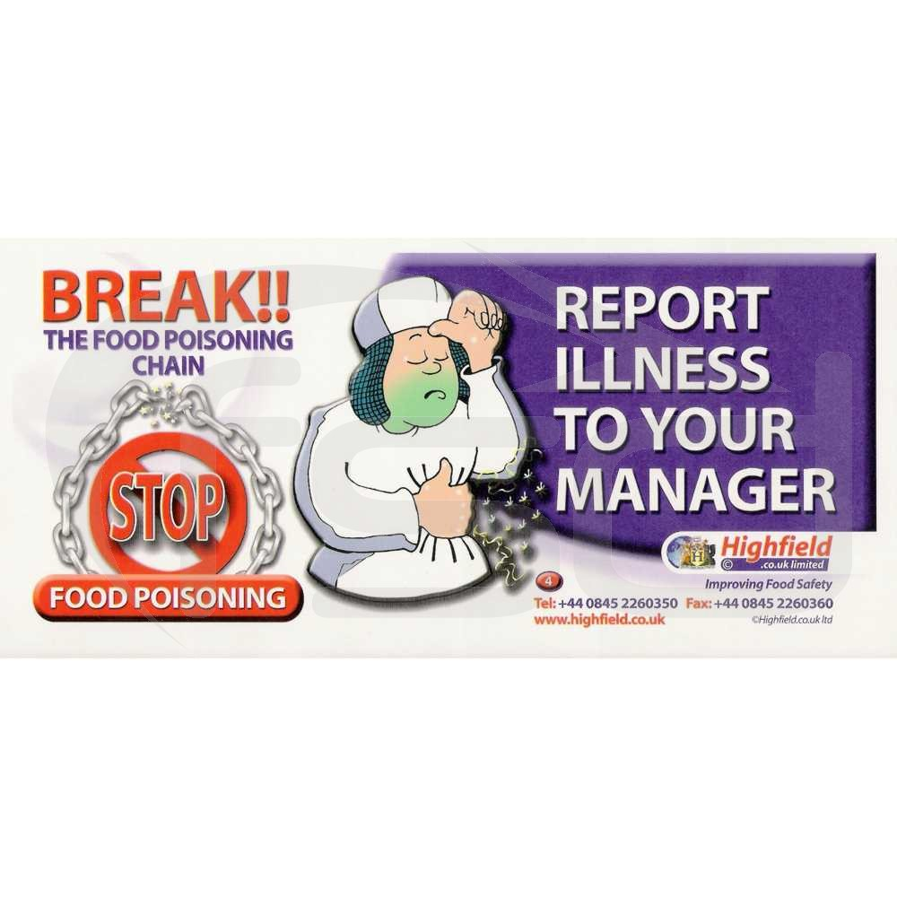
Personal hygiene continued
Illness
If you are unwell it is your responsibility as a food handler to report to your supervisor as some illnesses may prevent you from working.
Reportable illnesses and infections:
diarrhoea
vomiting
colds
sore throats
congested eyes
skin infections
stomach upset
suspected food poisoning.
.

Slide 7
Personal hygiene continued
There are two categories of carriers:
Healthy carrier
A person who harbours, and may pass on, harmful bacteria but are fit and well
They may not show signs of illness.
Convalescent carriers
People recovering from salmonella food poisoning may be carrier for a number of months.
.

Slide 8
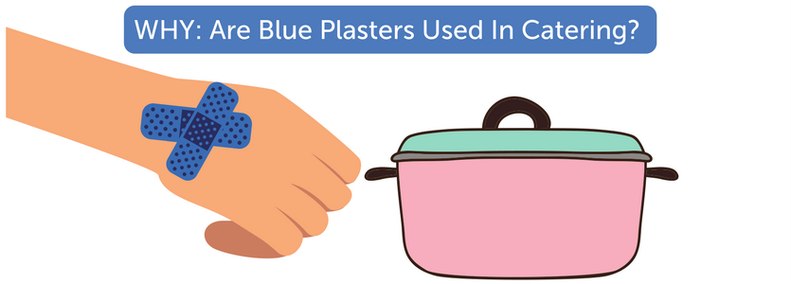
Features of plasters
There are three key features of plasters that can be used by food handlers:
Non-food coloured – usually blue so it can be easily seen if they come off
Waterproof – as the food handler will be immersing hands in water, it protects the wound
Metal strip – so it can be detected with a metal detector if it comes off during food production.
.

Slide 9
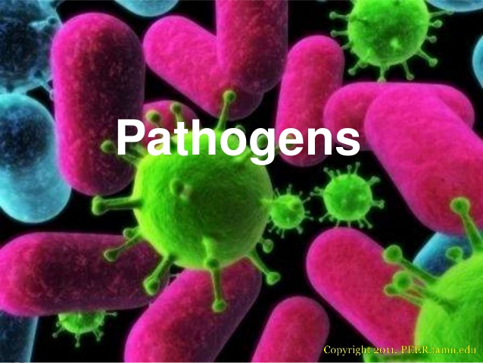
Sources of pathogenic bacteria
Pathogenic bacteria are bacteria that pose a serious health risk and cause disease.
Sources in human beings:
hands
hair
nose
mouth
ears
throat
septic cuts
spots and boils.

Slide 10
Any questions?

