Slide 1
Keeping working area clean and hygienic
PowerPoint presentation
Unit 207: Food safety

Slide 2
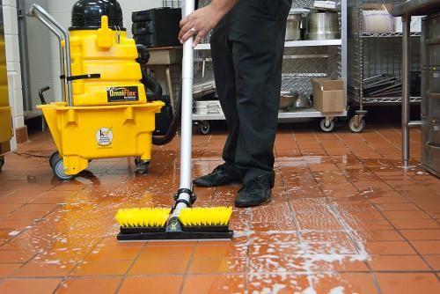
Cleaning the work area
Cleaning is key to maintaining hygiene standards in food preparation and service areas.
It is the responsibility of all food handler to follow cleaning schedules that outline:
step-by-step procedures to be followed
the correct equipment and chemicals for each task
how often each cleaning task should be carried out.

Slide 3
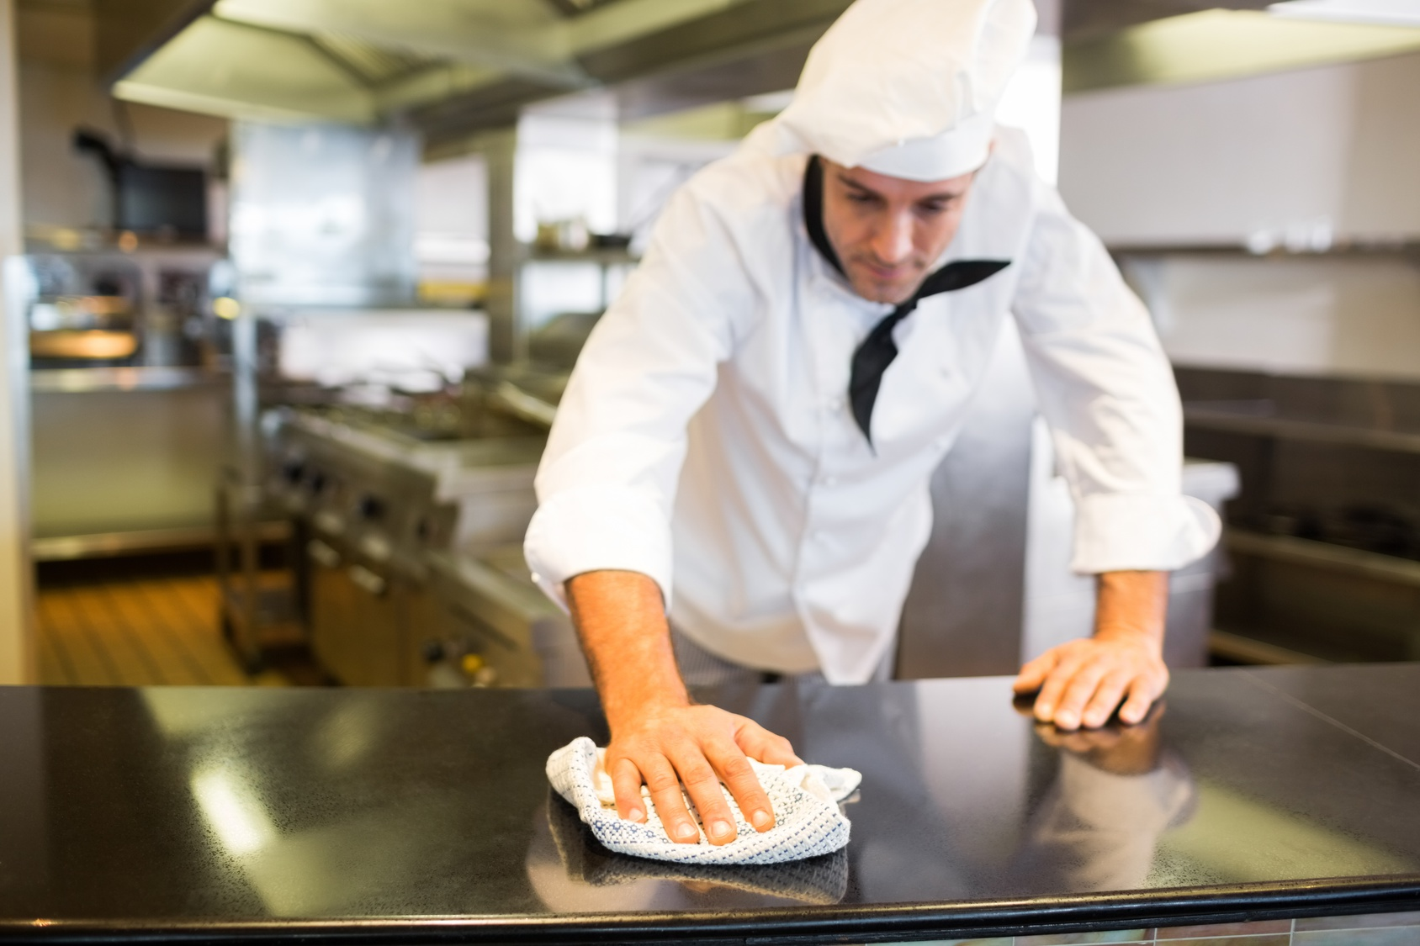
Cleaning practices
Cleaning practices are the methods used to maintain standards of cleanliness and hygiene.
This will include:
working tidily
removing waste
cleaning down worktops
sanitising work areas
emptying bins
sweeping floor areas
Vacuuming.

Slide 4
Six stages of cleaning
Pre-clean
Main clean
Rinse
Disinfect
Rinse
Dry

Slide 5
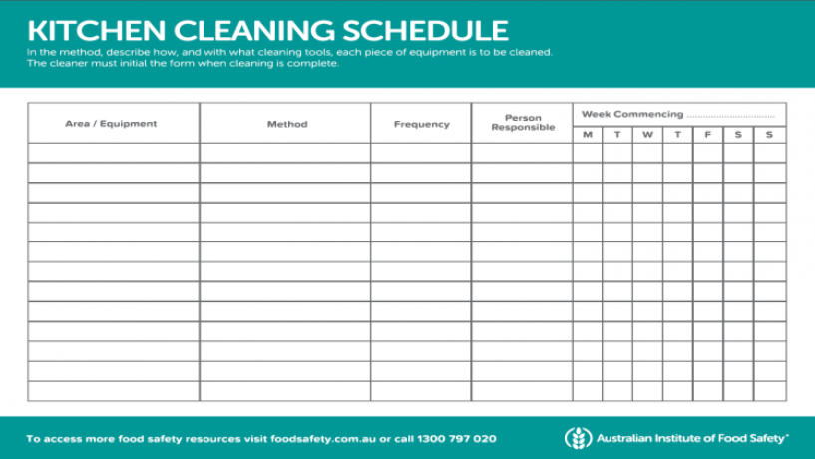
Cleaning schedules
Information included in a cleaning schedule
Who is responsible?
What needs to be cleaned?
When or how often it needs to be cleaned?
How it should be cleaned?
What safety measures are required or considered?

Slide 6
Cleaning schedules: Frequency
Consider when each of the following should be cleaned and if it should be cleaned in place (CIP) or out of place (COP)
Equipment | After each use | Daily | Deep clean weekly | CIP | COP
Grill
Oven
Handwash basin
Refrigerator
Work benches
Hot cupboard
Veg prep sink
Dishwasher

Slide 7
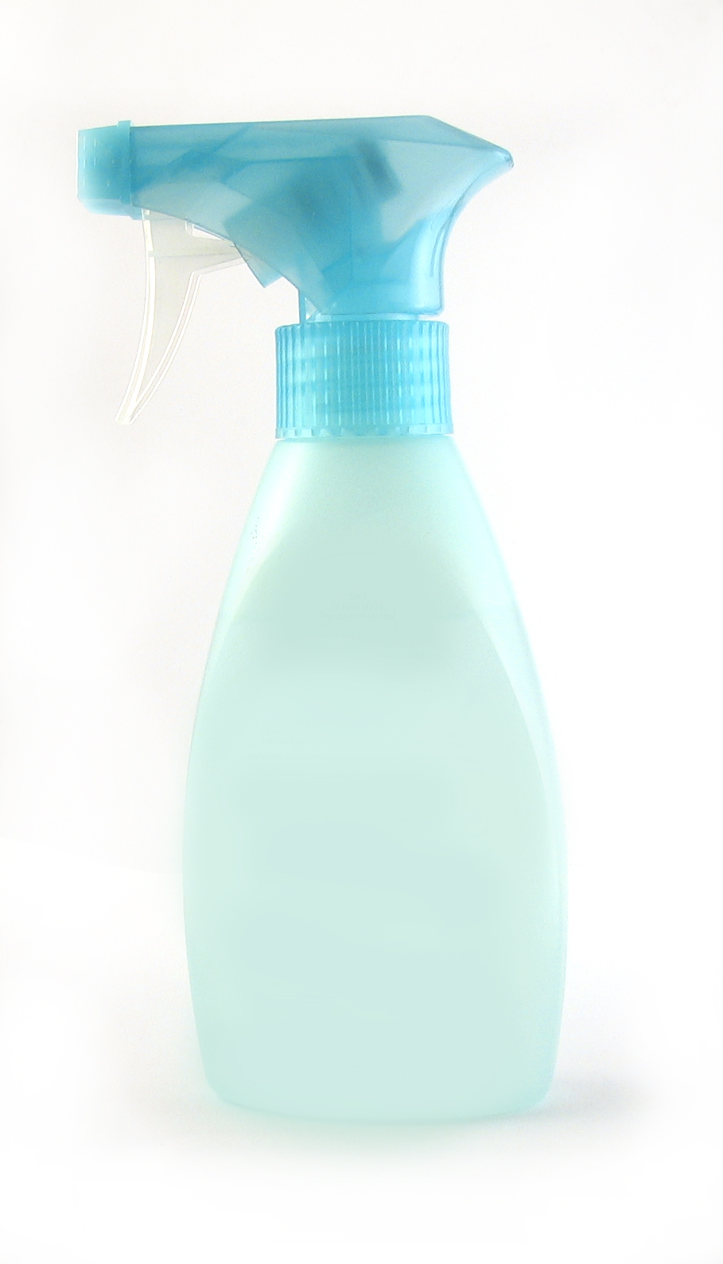
Cleaning chemicals
Chemicals should be used when cleaning food production areas to ensure standards of hygiene are maintained.
In most cases the chemical is added to water to dilute it to the correct strength needed to clean effectively.
Rules to follow when using cleaning chemicals:
Follow manufacturer’s instructions
Wear recommended PPE
Store chemicals away from food in a cool area
Always label containers if decanting
Never mix chemicals
Dilute/mix as required to ensure the effectiveness of cleaning
Contact times must be followed to ensure it cleans effectively.

Slide 8
Cleaning chemicals
Types of chemicals
Detergents – used to dissolve grease, help to remove food debris from surfaces and equipment. They do not kill bacteria.
Disinfectants – designed to destroy bacteria or reduce them to a safe level. They do not remove grease or dirt so must be used after a surface has been cleaned. May be strong smelling so care must be taken in food areas.
Sanitiser – combine the effects of detergents and disinfectant to remove grease and dirt whilst disinfecting at the same time.
Disinfection can also be carried out by heat as an effective way to kill bacteria, if using hot water it should be over 82°C.

Slide 9
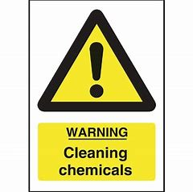
Cleaning chemical risk assessment
A risk assessment must be carried out on all chemicals used in the work place to prevent harm to health.
This will involve:
finding out the health hazards
deciding how to prevent harm to health
providing control measures to reduce harm to health
making sure controls are used – personal protective equipment
keeping all controls measures in good order
providing information, instruction and training to staff.

Slide 10
Cleaning chemical safety
When using chemicals it is important that personal protective equipment is supplied to reduce risks to staff.
Examples of PPE:
gloves/gauntlets
goggles
eye protectors
face shields/masks
Staff must also be made aware of the risks of:
mixing chemicals
decanting chemicals
using unlabeled containers.

Slide 11
Waste management
A kitchen and restaurant will generate a wide range of waste, including:
food
packaging
glass
paper
oils
plastics.
Bins are needed in food preparation areas that enable waste to be separated for disposal. They are also needed in an outside space.
Bins must have well fitting lids, foot operated bins are best practice, must not be allowed to overflow, emptied and cleaned regularly.

Slide 12
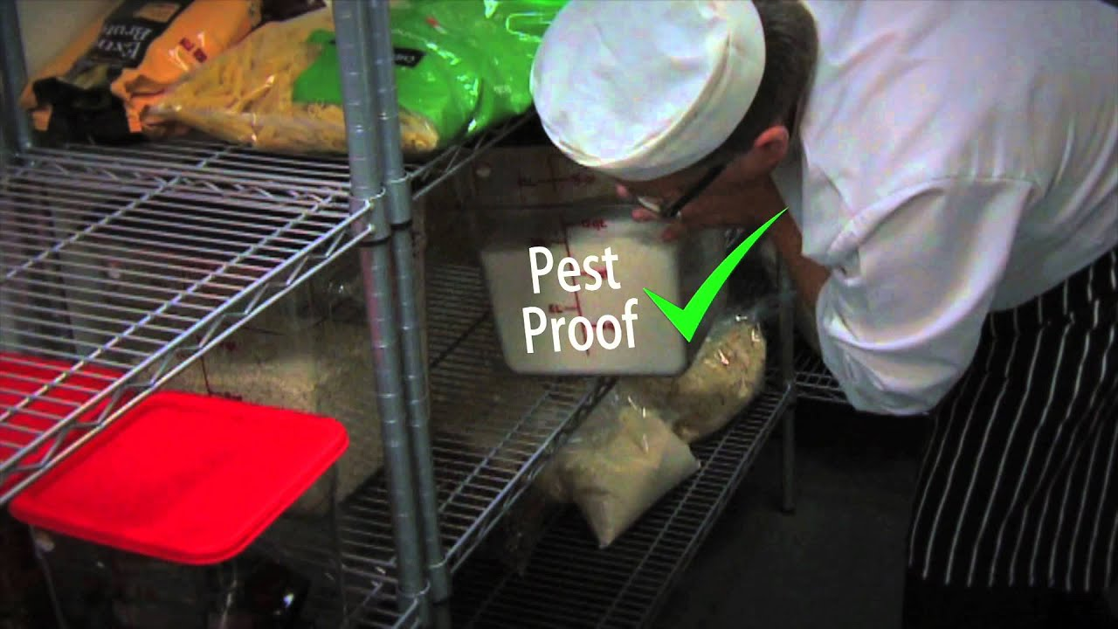
Common food pests
Rearrange the jumbled letters to find common food pests:
RCOOCAKHL
YFL
OMEUS
RDBSI
SPWAS
ARTS
NTSA

Slide 13
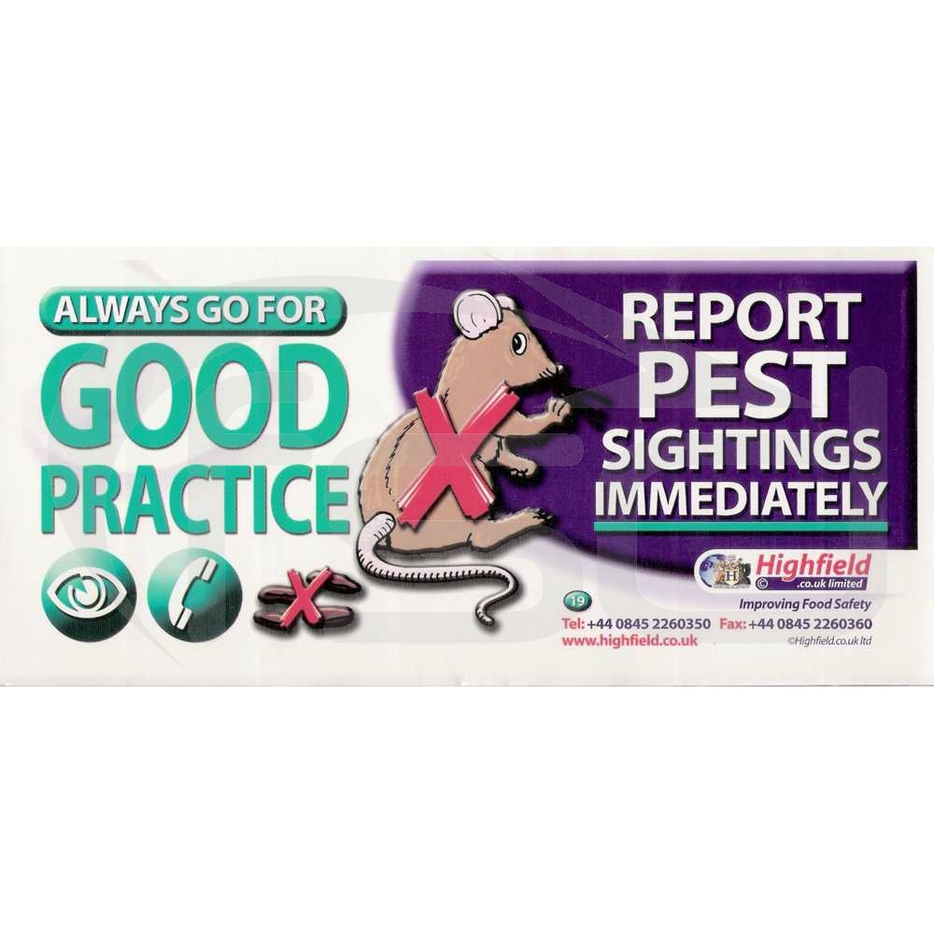
Signs of pest infestation
droppings
smell
smear marks
pupae cases
larvae
damage/gnawed
food spillages

Slide 14
Methods of pest control
Most food pests enter food areas to search out food, warmth and shelter:
check pests do not arrive in deliveries
use fly screens at window and doors
keep doors and windows closed
carry out regular checks to find possible entry routes
keep tightly fitting lids on bins at all times
install kick plates / bristle strips to prevent entry
clean as you go, following cleaning schedule
use a pest control contractor to install bait boxes
keep external waste areas clean and tidy.

Slide 15
Bin Rules
Remember the BIN rules:
E _ _ _ _ B _ _ _ R _ _ _ L _ _ _ Y Throughout the D _ _
W _ _ _ Y _ _ _ H _ _ _ S A _ _ _ _ E _ _ _ _ _ _ _ Bins
Dis _ _ _ _ _ _ all bins D _ _ _ _
Where should outside bins and waste skips be positioned?
Why should external bins have well fitting lids?
What can you do to the bin area after a refuse collection?

Slide 16
Any questions?

