Slide 1
Food storage
PowerPoint presentation
Unit 207: Food safety

Slide 2
Food storage
Most businesses have to store food even if it is only for a short time.
Correct storage helps to:
Prevent illness linked to foods
Preserves the food’s taste, appearance and nutritional value
Provides adequate supplies when they are needed
Avoids spoilage and wasted food
Keeps to the budget
Keeps within the law and avoids prosecution for selling unfit food.

Slide 3
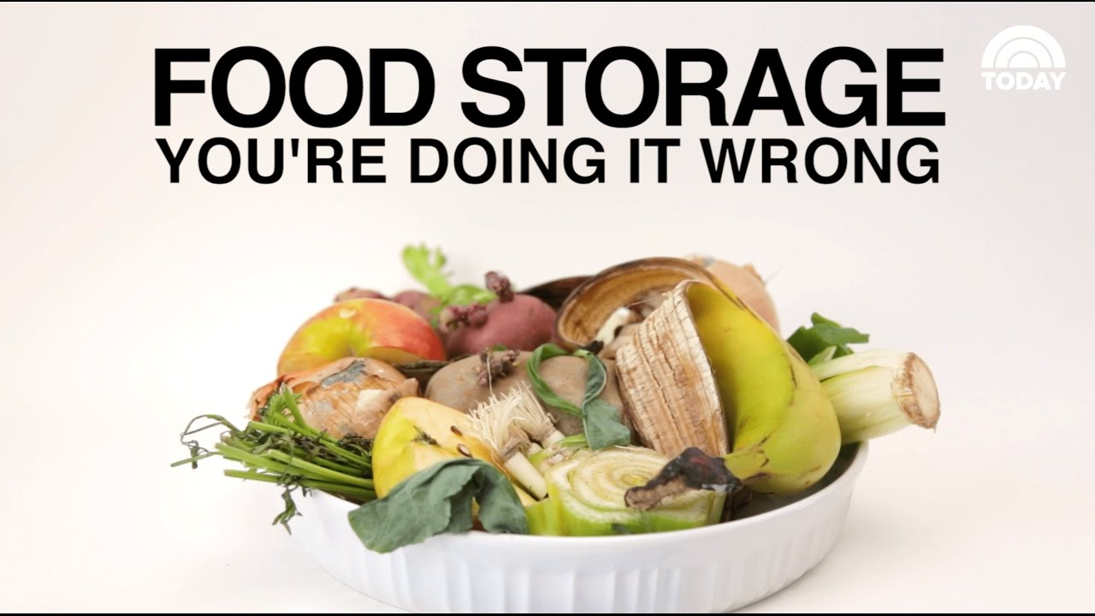
Checks for storing food small group activity
Working in small groups and thinking about when you are working in the kitchen, produce a mind map of the checks that should be carried out on the following types of foods:
deliveries of frozen items
deliveries of dry goods
deliveries of fresh meat
deliveries of fresh fish
deliveries of fresh vegetables and fruit
cooked items to be used the following day.

Slide 4
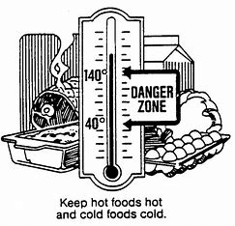
Checks when storing food
food temperature
storage area conditions are correct
damage to packaging
dates
quality
signs of pest infestation
temperature probe is working properly
raw and cooked foods stored separately.

Slide 5
Types of storage
Dry goods store
long- and short-term storage of canned and bottled foods, grains, spices, tea, coffee
Refrigerators and cold stores
high risk and perishable foods for short periods
Chiller cabinets
for displaying food for very short periods
Freezers
for longer term storage of frozen items.

Slide 6
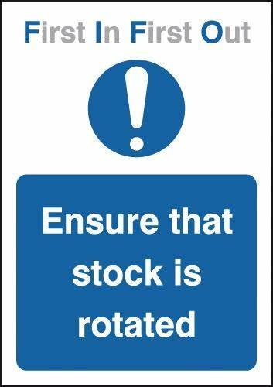
Stock rotation
Stock should be rotated to ensure that old stock is used before new stock, also know as FIFO (first in, first out).
The following systems should also be used to aid stock rotation:
day dots
date system
labelling.

Slide 7
Types of food contamination
Food can be contaminated in a number of ways and are classified as:
Chemical
pesticides, fertilizers, cleaning chemicals.
Physical
soil or dirt on veg, hair, fingernails, plasters, buttons from food handlers, packaging, string, paint fragments, screws from buildings and equipment, pests, flies, ants.
Microbiological
pathogenic bacteria, spoilage bacteria, viruses.
Allergenic
nuts, dairy, flour, shellfish, etc.

Slide 8
Ways of reducing cross contamination
good personal hygiene practices
cleaning and disinfecting of work area
keeping foods covered and separated
separately zoned areas for raw and cooked foods
colour coded systems
thorough cooking
safe storage practices
linear workflow
appropriate training.

Slide 9
Any questions?

