Slide 1
Food safety risks
PowerPoint presentation
Unit 207: Food safety

Slide 2
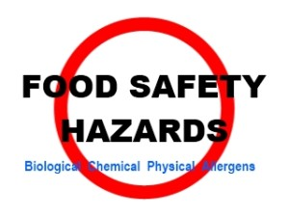
Biological hazards
Biological hazards are the main cause of food poisoning and most cases of illness are caused by bacteria.
Pathogen – an organism that causes illness/disease
Spoilage – the process of causing damage, spoilage bacteria causes food to perish.
Conditions bacteria require to multiply
warmth
food
moisture
Time.

Slide 3
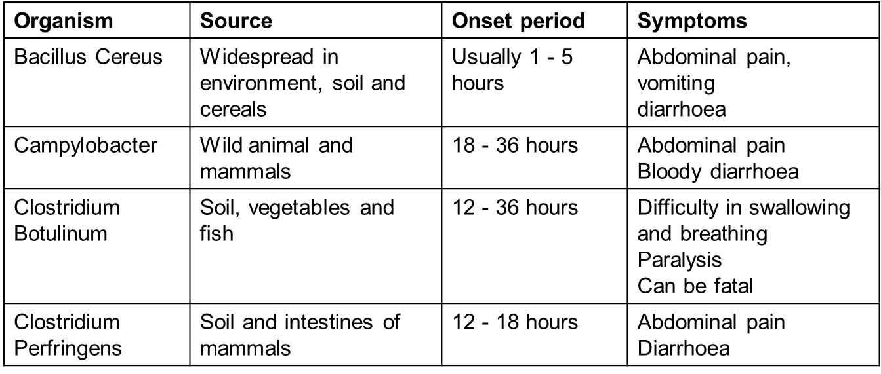
Food poisoning bacteria
The chart below provides information on sources of food poisoning
.
bacteria describing both the symptoms and onset times

Slide 4
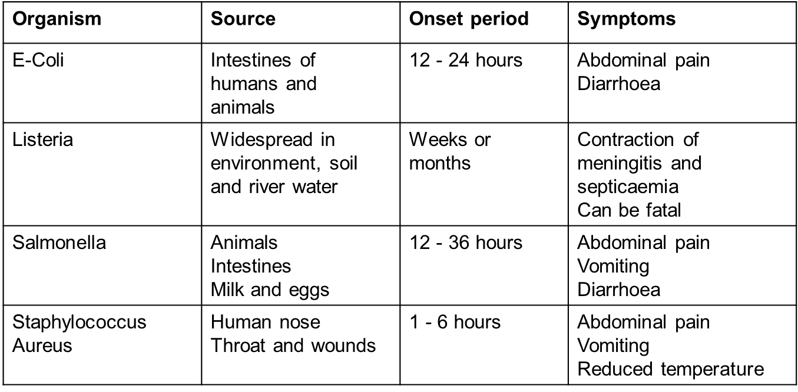
Food poisoning bacteria continued

Slide 5
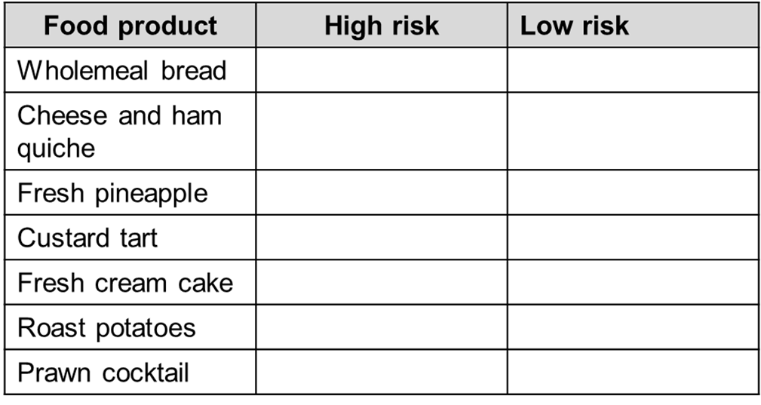
High – low risk foods
High risk foods are those most likely to be involved in food poisoning cases. Identify from the list below whish foods are high risk or low risk.

Slide 6
Procedures for food safety
The diagram below shows the recommended work flow in a kitchen from delivery to service
Use the boxes on the right to list the correct hygienic work procedures at each stage.

Slide 7
Allergens
Some people are particularly sensitive to certain foods and as a result of this have an allergic reaction.
Allergic reactions to food result in the immune system reacting as if the body were under attack.
Food allergies affect a small group of people with symptoms that are life threatening.
Symptoms can include:
tingling diarrhoea
swelling cramps
breathing difficulties anaphylactic shock
vomiting

Slide 8
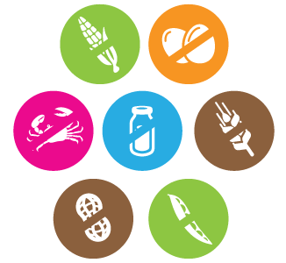
List of Allergens
The identified allergens are:
cereals containing gluten sesame seeds
crustaceans sulphur dioxide
eggs lupin
fish molluscs.
peanuts
soybeans
milk
nuts
celery
mustard

Slide 9
Allergen identification activity
Using a range of recipes and menus available in your centre, complete an allergen chart stating the ingredient where the allergen is found.
You may use the template in Handout 7 or a version supplied by your centre.
Compare the allergens you have identified with your peers to produce a definitive list of the allergens for each recipe/menu.

Slide 10
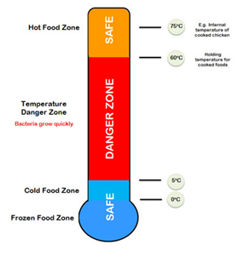
Time and temperature
Time and temperature are key to controlling the conditions bacteria require to multiply to levels that cause food poisoning.
Every possible step must be taken to destroy pathogenic micro-organisms before food is eaten.
Key terms
core temperature
danger zone
hot holding
cold holding
re-heating.

Slide 11
Any questions?

