Slide 1
Roles and opportunities in a professional kitchen
PowerPoint presentation
Unit 301: Developing opportunities for progression in the culinary industry

Slide 2
Partie system
Traditionally, the kitchen is broken into different sections, or parties, to speed up service times and share the preparation steps.
The benefits of the partie system:
more dishes can be produced
organisation is easier
production is streamlined
aids accountability
specialises preparation and cooking of foods.

Slide 3
Partie system continued
Depending on the size of the establishment, the arrangement could be as simple as:
cold section preparing all cold menu items, including cold starters, buffets and salads
hot section preparing items, such as meat and seafood, as well as the accompaniments
dessert section preparing all dessert items and special items for buffets, e.g. fruit for breakfast buffet.
Depending on the menu, kitchen design and complexities of dishes, the number of staff in the kitchen can vary.
The business has to be conscious of the number of staff employed to control labour costs

Slide 4
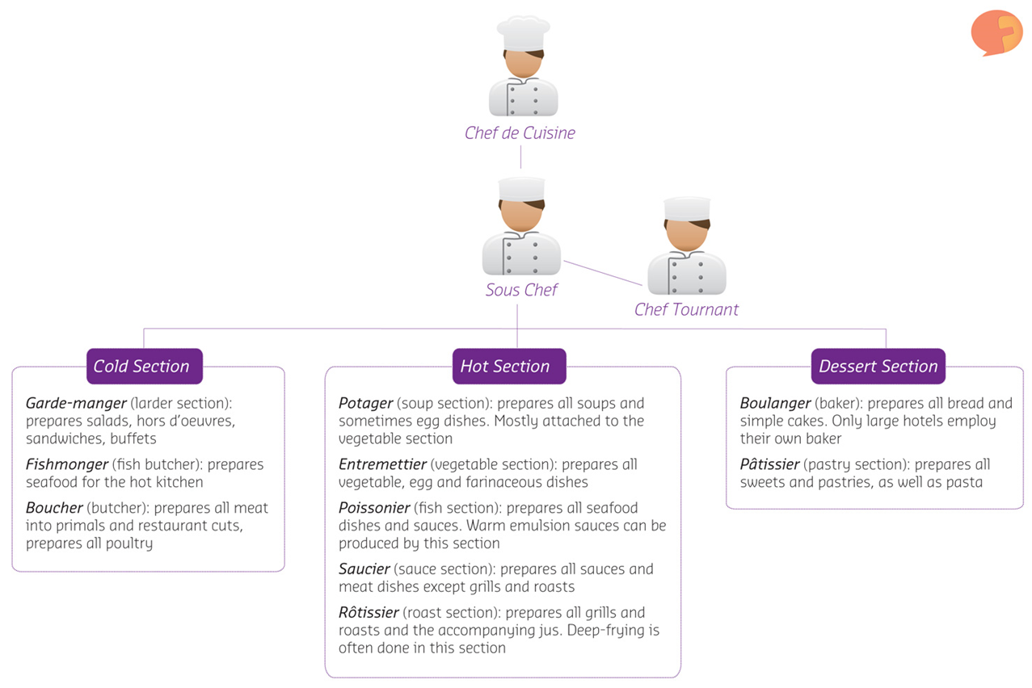
Classical Partie system sections

Slide 5
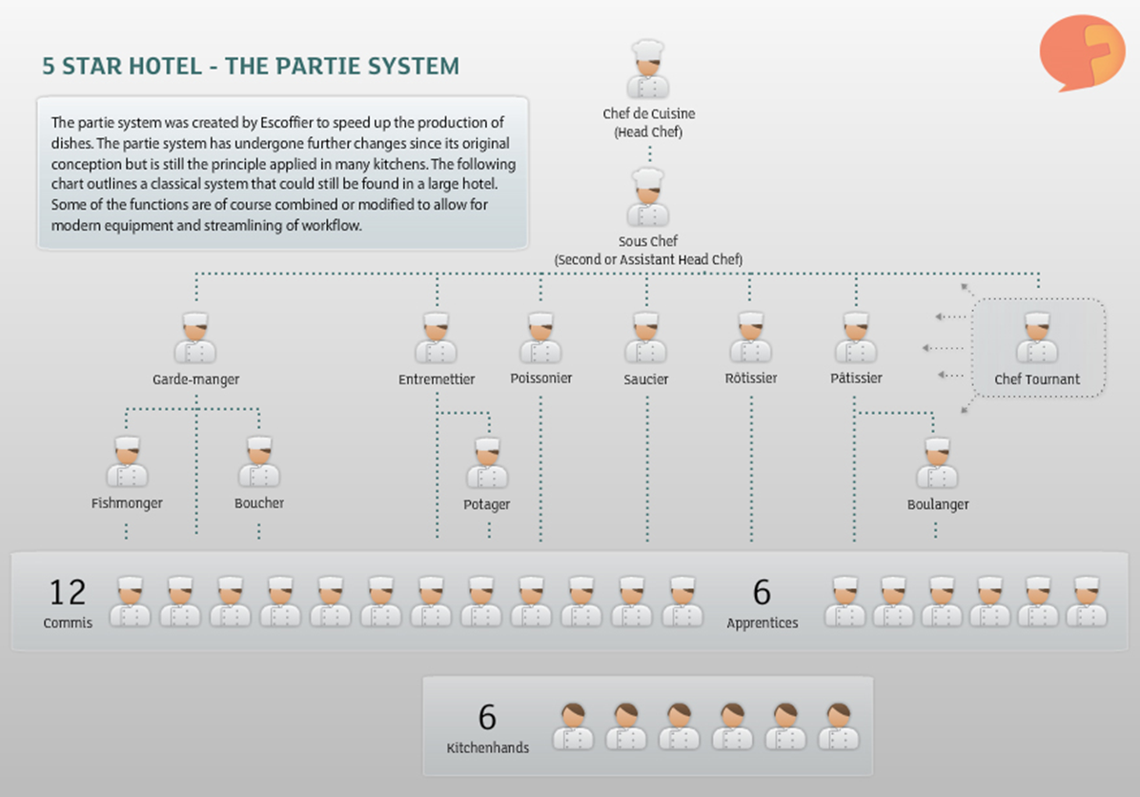
Classical Partie system large establishment

Slide 6
Progression routes
In a professional kitchen there are opportunities to progress both:
vertically
horizontally
A progression route could be:
Trainee / apprentice
Team member / operative
Supervisor
Front line manager
Department manager
Senior manager

Slide 7
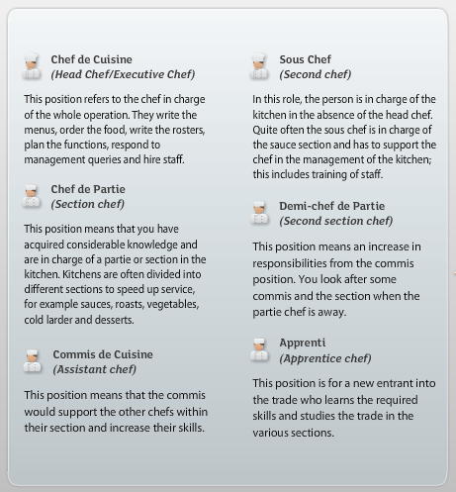
Staff responsibilities
Creating job roles and clear responsibilities prevents confusion and allows for the establishments to have clear guidelines and tasks.
These responsibilities vary from establishment to establishment, but the overarching rule is that the amount of responsibilities increase with the degree of management and the number of people supervised.

Slide 8
Any questions?

