Slide 1
Completing own professional development
PowerPoint presentation
Unit 301: Developing opportunities for progression in the culinaryn industry

Slide 2
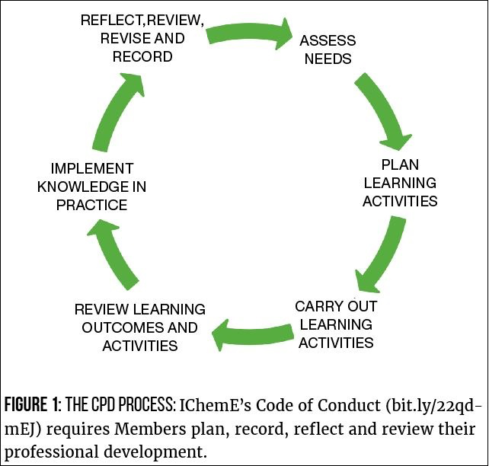
Continuous professional development cycle

Slide 3
Completing own professional development
Procedures for developing own knowledge and skills:
Complete a SWOT analysis
Complete training needs analysis
Complete a development plan
Complete an action plan
Undertake personal development activities
Evaluate development performance
Update development plan/action plans.

Slide 4
Evaluating performance
Be honest
Be realistic
Identify performance measures
Seek feedback from peers/line managers/customers
Identify areas for development
Review SMART targets.

Slide 5
Any questions?

