Slide 1
Monitor own section to deliver service standards
PowerPoint presentation
Unit 302: Supervise and monitor own section

Slide 2
Monitoring
A supervisor within the professional kitchen environment should understand the importance of the monitoring process in relation to:
performance management
quality control
company standards
health and safety
food safety
waste control
budgets
stock control.

Slide 3
Impact of not monitoring the team effectively
Team do not perform to required standards
Training needs are not identified
Menu items are not produced to the required standards
Increase in customer complaints
Loss of revenue/business
Increased number of accidents
Breaches in health and safety – penalties/fines
Food poisoning, loss of reputation
Increased waste, impacting on profits
Budgets not met, loss of revenue due to increased costs
Out of date stock, higher level of stock, increased costs.

Slide 4
Monitoring preparation procedures
A chef de partie needs to ensure the section is prepared by:
ensuring all ingredients are available
ensuring standardised recipes are available
ensuring equipment and utensils are available and working
ensuring staff are present and allocated tasks to complete
ensuring health and safety check have been completed
ensuring food safety records are completed.

Slide 5
Corrective Actions
As a supervisor, it is essential to understand what can be done about challenges identified when preparing a section.
Staff – staff problems can be alleviated by discussing issues. When asking staff to work on a day off, consider their welfare, the use of temporary staff and, as a last resort, reducing the workload.
Commodities – if more commodities are required use your supplier network, approach business colleagues, buy from local suppliers, or change the menu. If commodities are poor consider your procurement plan.
Other resources – if required, these can be obtained from local suppliers or even online. However, you may be limited in what you can achieve, due to time constraints. This includes power, equipment and water.

Slide 6
Service preparations
The chef de partie is responsible for ensuring service deadlines are met by:
Providing information that is correct and current, including: Allergen information Number of portions
Ensuring mis en place is complete: Have cook-to-order items ready Keep hot holding items at correct temperature Have garnishes available
Ensuring service dishes and plates are at hand: Hot and cold plates
Ensuring equipment is in working order: Equipment checks completed Contingencies in place
Ensure technology is working
Ensure the team are prepared, ready and briefed for service.

Slide 7
Methods used to confirm section is ready
Team briefing
Visual checks completed
Completion of records
Completion of checklists
Verbal confirmations.

Slide 8
Supervisory skills
A chef de partie will require a number of skills to be an effective supervisor in the kitchen, including:
leadership
communication
time management
conflict handling
problem solving
planning and organisation
managing resources
approachability
technical skills
delegation.

Slide 9
Activities to be supervised to meet standards
Receiving food orders - relaying instructions to the team - interpreting orders to the team - ensuring orders are understood correctly
Responding appropriately to food orders - confirming orders have been understood - confirming timings for delivering the order - confirming any special requests
Cooking menu items to meet organisations standards - ensuring recipe specifications/SOPs are being followed - ensuring menu items are cooked to correct temperature/required degree
Communicating during food production and service - keeping the service team informed of any delays - ensuring the team are communicating any problems/delays so they can be addressed

Slide 10
Activities to be supervised continued
Producing food to meet organisation standards - quality of menu items - menu items meet customer requirements - reputation of the organisation if maintained
Plating and presenting menu items to meet organisations standards - correct garnishes are used - served according to specifications – correct plates - correct potion size served - correct accompaniments served.

Slide 11
Monitoring a section
As well as ensuring that menu items are prepared, cooked and served to meet organisation standards, a chef de partie will be monitoring other aspects of the section, including:
How the whole section is performing to identify any team work strengths/weaknesses
Individual team members performance to identify training needs/areas for development
Food safety compliance and due diligence to maintain reputation
Personal hygiene standards for the whole team
‘Clean as you go’ policy being adhered to
Correct procedures being followed to minimise waste and control costs
Energy management to avoid waste and promote sustainability policies.

Slide 12
Documentation used to support the monitoring process
The chef de partie will use a range of documentation when monitoring the team which will also demonstrate due diligence, including:
temperature records
stock records
accident reports
equipment fault reports
cleaning schedules
risk assessments
wastage records
food delivery records
staff schedules/rota.

Slide 13
Team feedback
As well as briefing the team before service it is important for the chef de partie to de-brief the team and provide feedback at the end of service.
Feedback should:
allow for two-way communications
be given at an appropriate time
include praise on performance
address any problems/issues that occurred
be specific and accurate using facts to support comments
end on a positive note.

Slide 14
Purpose of team feedback
The aim of feedback is to improve performance. It should focus on improvement using a positive approach and not be critical or offensive.
Purpose:
To improve self/team awareness
To enhance self esteem
To raise morale
To encourage the team/individuals to want to learn
To offer reassurance
To motivate the team
To improve individual/team performance.

Slide 15
Techniques for giving feedback
Feedback sandwich - start and end with a positive and discuss areas for improvement in the middle
Stop, start, continue - what the team feel they should stop doing - what the team feel they should start doing - what the team wish to continue doing.

Slide 16
Reviewing process
A supervisor within the professional kitchen environment should understand the importance of the reviewing process in relation to:
Goals
Targets – team and individual
Budgets
Resources
KPIs
Menu specifications.

Slide 17
Evaluating process
It is important for a chef de partie to reflect on both the teams performance and their own and part of that process will be to evaluate the monitoring process.
Process:
Planning
Implementation – formative and process
Completion – summative, outcome and impact evaluation
Dissemination and reporting.
As part of the evaluation, the chef de partie will need to look at the whole process; from planning through to the actual outcomes and how monitoring the activities have played a part.

Slide 18
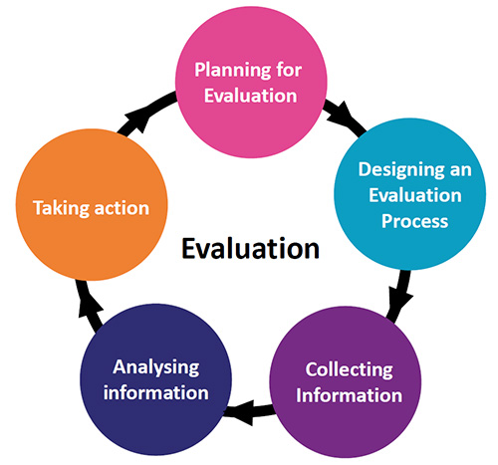
Evaluating the monitoring process
Areas to be evaluated:
The section performance – individual/team roles
Customer comments/feedback – positive/negative
Compliance with policies and procedures – evidence
Achievement of goal/targets.
For each of the areas the chef de partie
should consider:
What went well
What improvements could be made.

Slide 19
Any questions?

