Slide 1
Manage pressure by solving problems in own section
PowerPoint presentation
Unit 302: Supervise and monitor own section

Slide 2
Procedures for reducing pressure
By having the skills to solve problems, the chef de partie will be able to manage pressures in the workplace.
Procedures for managing pressure will include:
Sourcing up-to-date information
Planning for service
Ensuring staffing levels are sufficient for the workload
Training the team to meet operational needs and equipping them with the skills required
Identifying potential issues and possible solutions before they arise
Communicating the plan to the team with clear objectives and goals
Supporting teamwork for effective delivery of service.

Slide 3
Types of pressure
Pressures can be:
Personal Organisational - lack of organisational skills - staff turnover - mood swings - competition - tiredness - financial issues - lack of confidence - legislation compliance - workload - sales - targets / KPI’s - customer feedback - conflicts within the team - physical resource costs - meeting expectations / standards - business reputation - memory or concentration problems - skills shortages

Slide 4
Problem solving
Problems should be seen as opportunities
It is important for a chef de partie to have the confidence to deal with problems.
Having a good process to use when approaching problems will enable them to be solved quickly and effectively.
Without a good process solutions may be ineffective, resulting in nothing being done and painful consequences.
Problem solving is important to the chef de partie, the team and the organisation, to ensure control is maintained.

Slide 5
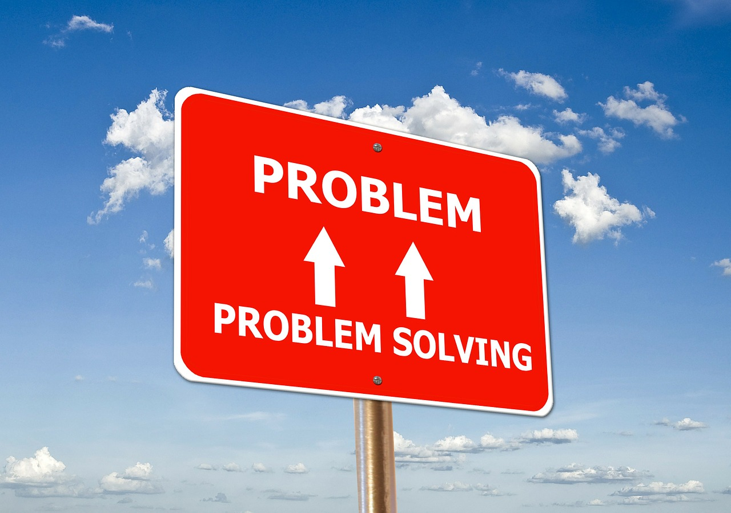
Types of problems
Examples of problems that may arise in a kitchen include:
staffing issues
skills shortages
food delivery issues
poor quality ingredients
equipment failure
hygiene risks
accidents
customer complaints
organisational standards not being met
information not being received/passed on.

Slide 6
Problem solving techniques
Keep calm
Ask questions – pre-problem solving stage
Zoom out from the content to explore the overall context
Brainstorming to get a range of ideas on how to resolve the problem
Wear different hats to view the problem from different perspectives
‘5 whys’ technique to uncover the root of the problem
Failure mode and effects analysis to prevent potential issues
Leave room for imagination.

Slide 7
4 steps to solving problems
Define the problem - differentiate fact from opinion
Generate alternative solutions - use active listening to establish ideas from others
Evaluate and select an alternative - what are the plus and minus of each
Implement and follow up on the solution.

Slide 8
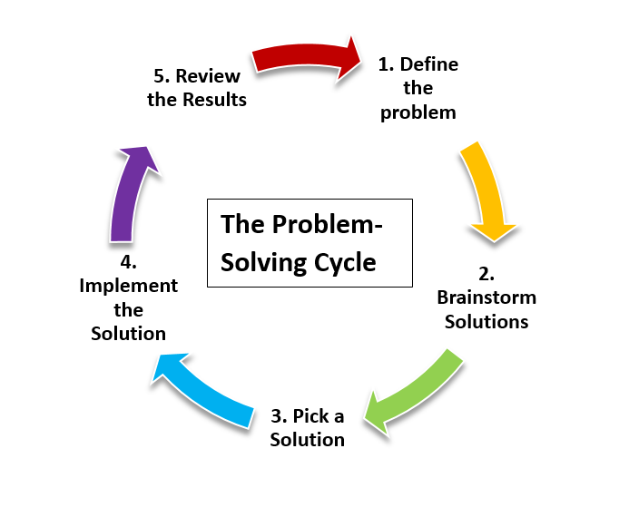
Skills required for solving problems
In order for a chef de partie to be effective at problem solving, the following skills will be needed:
Creativity - problems are usually solved intuitively or systematically
Research skills
Teamwork
Emotional intelligence
Risk management
Decision making.

Slide 9
Any questions?

