Slide 1
Legislations
PowerPoint presentation
Unit 303: Contribute to business success

Slide 2
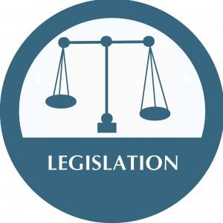
Legislation
Legislation is law which has been set by a governing body.
Legislation can have many purposes:
  to regulate
  to authorise
  to outlaw
  to provide
  to sanction
  to grant
  to declare
  to restrict.

Slide 3
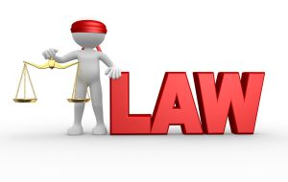
Legislations
A chef de partie will need to understand the legislative requirements of the following when running of a section in the kitchen:
  Employment
  Equality
  Disciplinary
  Health and safety
  Food safety
  Service of alcohol
  Waste disposal management
  Chemical handling and disposal.

Slide 4

Legislative compliance
Compliance means conforming to a rule. This could be:
a law
a regulation
a specification
a policy
a standard.
A business will endeavor to demonstrate regulatory compliance to show they are aware of and take steps to comply with laws, policies and regulations

Slide 5
Legislative compliance
It is important for a business to demonstrate compliance with legislations to avoid penalties being incurred and reputation being affected. This can be achieved by:
  implementing organisational policies
  demonstrating organisational commitment
  planning for accident prevention
  carrying out risk assessments
  assigning responsibilities
  implementing safe working practices
  implementing standard operating procedures (SOP)
  measuring, auditing and reviewing individual/team/business performance.

Slide 6
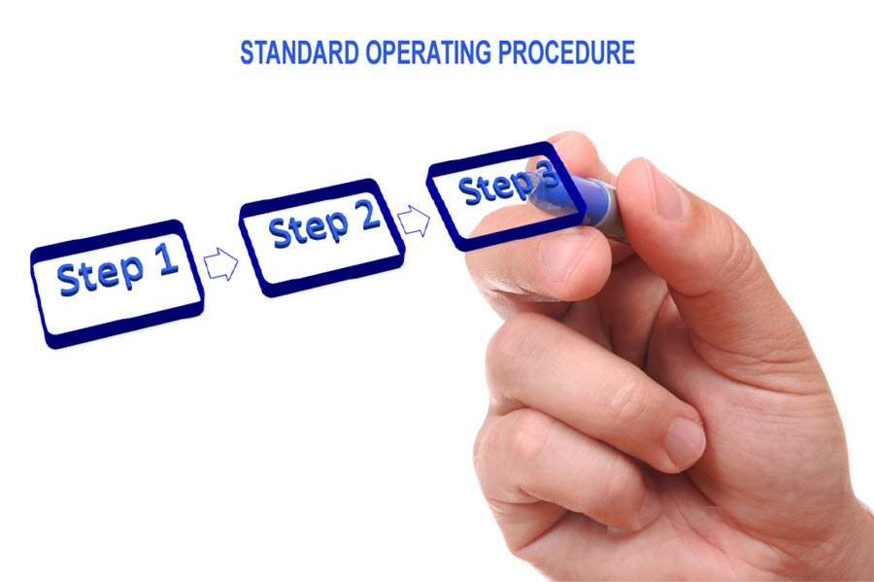
Standardising operation procedures
Operational procedures are step by step instructions compiled to help staff complete tasks to the organisations standards.
Often known as standardised operating procedures (SOPs). SOPs aim to achieve:
efficiency
quality output
uniformity of performance
compliance with industry regulations/
legislations
reduction in miscommunications/
mis-interpretation.

Slide 7
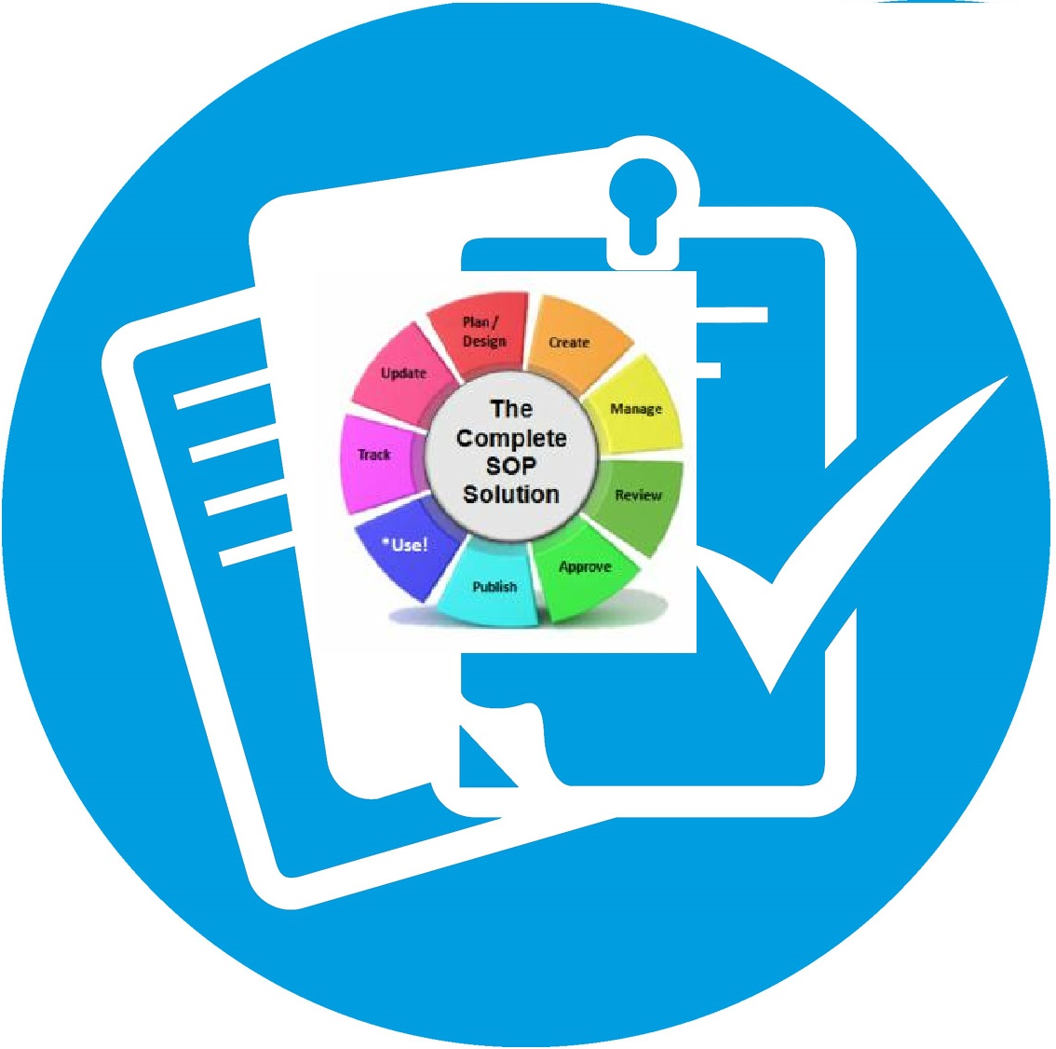
Standardising operation procedures continued
Methods used to maintain standardised operational procedures:
  Organisational policies
  Staff training
  SOPs
  Risk assessment audits
  Compliance audits.

Slide 8
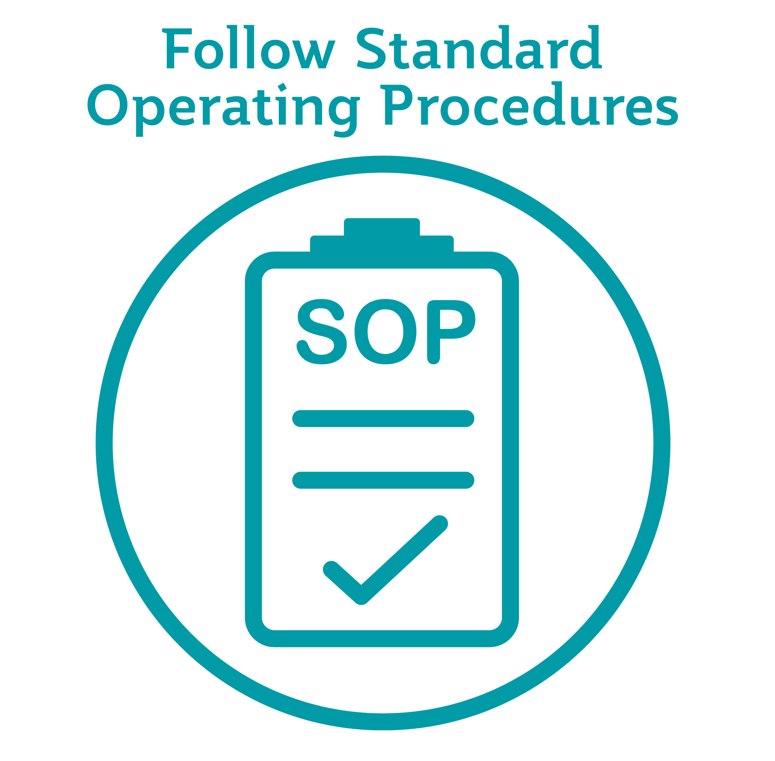
Communicating Standardised operation procedures
Operating procedures can be communicated to the kitchen team in a number of ways, including:
  during induction
  through in-staff handbooks
  through newsletters
  by email
  on staff notice boards
  SOP manuals
  posters
  internal social media platforms.

Slide 9

Benefits of complying with legislation
There are a number of benefits for a business complying with legislation, including:
  Protection for the organisation
  protection for employees
  promoting corporate responsibility
  reducing risk to the business
  reducing risk associated with food safety
  reducing risk associated with non-compliance
  better informed employees with regard to employment rights.

Slide 10
Legislative compliance in own section
When running a section a chef de partie is responsible for:
  employee rights
  kitchen design
  temperature controls
  food safety management system
  safe use of equipment
  supervision of the team
  training of the team.

Slide 11
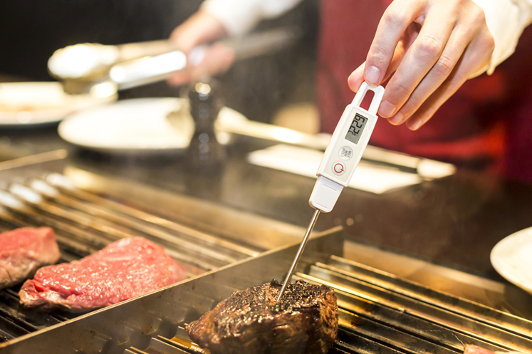
Monitoring food safety
Food safety is paramount in a kitchen but it is easy for the team to become lax or for staff to forget correct processes.
Implementation and monitoring of the correct processes and procedures with a clear revision cycle is important to maintain high standards.
From personal, to equipment and food hygiene, the formation of clear guidelines and policies make it easier to verify compliance against the set standards.

Slide 12
Key role of a chef de partie in monitoring food safety
  Supervising:
  - food preparation and cooking procedures
  - hygiene standards
  - working practices
  - cleaning procedures
  - stock control.
  Monitoring :
  - food safety
  - health and safety
  - standards
  - critical control points
  - waste management
  - pest control.

Slide 13
Key role of a chef de partie in monitoring food safety continued
  Completing records
  - fridge / freezer temperatures
  - food temperatures
  - deliveries and stock
  - risk assessments.
  Training
  - induction
  - updating
  - on going.

Slide 14
Any questions?

