Slide 1
Kitchen technologies
PowerPoint presentation
Unit 303: Contribute to business success

Slide 2
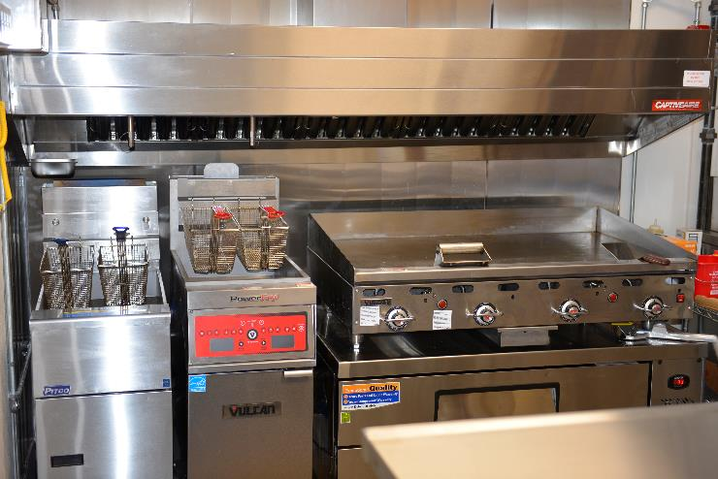
Tecnology used in moder professional kitchens
Technologies are widely used in modern professional kitchens for:
temperature control
financial monitoring
cooking equipment
operational tools
staff training.

Slide 3
Temperature control technology
Technologies are widely used in professional kitchens to monitor temperatures for both equipment and food items to demonstrate compliance with food safety regulations.
Temperature monitoring systems for food preparation, refrigeration, cooking and packaging: - wireless fridge/freezer systems - digital pocket food thermometers - handheld infra red devises - cold chain monitors.
Systems provide alarms/alerts when temperatures go out of range.
They generate reports to make food quality assurance easy.
Eliminates human error from manual checks.

Slide 4
Technology for financial monitoring
A food and beverage control system automates the process of monitoring the flow of food and ingredients and to spot potential cash flow issues to improve stock control.
Elements of a financial system:
Stock control
Recipe and menu costing
Nutritional analysis
Sales analysis
Budget control
Point of sales.

Slide 5
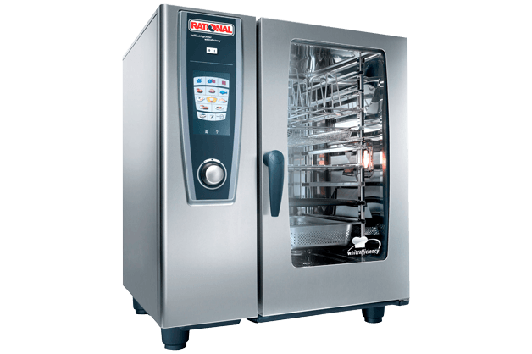
Equipment technology
Modern cooking equipment is designed to provide:
smart ovens
digital control panels
programmable options
temperature probe features
combination cooking methods
pressurised systems
remote access for controlling settings.

Slide 6
Operational technology
Systems are available to support the operational needs of a kitchen to save time and increase efficiency.
Examples include:
staff rostering to manage labour costs and linked to payroll systems
databases of menus/customers/ingredients
emails for communications
ordering systems linked to suppliers
stock control systems
labelling/dating systems
food safety management systems.

Slide 7
Staff training technology
Delivering staff training can be costly and it is often difficult to release staff from the kitchen. Technologies provide a solution by:
providing learning packages to meet individual needs
making learning fun and interactive
the facility to be undertaken at the best time for the staff member
allowing staff to complete at own pace
providing instant feedback on results
providing mobile learning
creating virtual learning environments
providing video-based training.

Slide 8
Risks of technologies
When using technologies in a kitchen environment there are risks that need to be considered:
Lack of training provided to users
Access to sensitive data by unauthorised users
Failure/breakdowns in technology
Misuse of technologies
Over-reliance on technology.

Slide 9
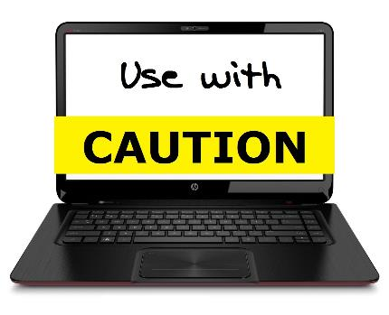
Methods to ensure technology is safe
When using technologies in a kitchen environment it is essential that safety is maintained. This can be achieved by implementing:
Standardised operating procedures
Checklists
Mentoring of staff when using technology
Supervision of the use of technology
Assessment of team skills in the use of technology
Staff training on systems and equipment.

Slide 10
How technology supports kitchen operations
Time saving
Provides real-time information
Easy cooking control
Supports profitability/cost saving
Manages food safety
Supports sustainability
Tracks data to inform business decisions
Provides an audit trail.

Slide 11
Any questions?

