Slide 1
Delivering skills training
PowerPoint presentation
Unit 303: Contribute to business success

Slide 2
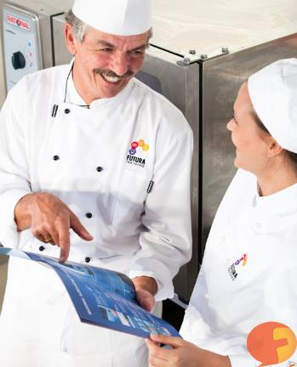
Training
A successful business depends on the contributions
made by its staff.
Staff provide the products and services
that the business offers and they can only
do this effectively if they are aware of the
required standards.
Training must incorporate all aspects of the
business and must be planned to achieve
the desired outcomes.

Slide 3
Skills training
All food businesses are required to comply with legislation, including requirements for the training of all food handlers. This includes:
induction training
ongoing training.
Staff need to be trained to a level commensurate with the tasks they undertake. The training can take many forms:
Formal training provided by the business
Training provided by a training provider
Training that results in a recognised qualification
On line training courses

Slide 4
Induction training
Induction training should be provided to all new employees. It:
integrates employees into the policies and procedures of the business
provides an awareness of legislative requirements
outlines roles and responsibilities of the team
provides an opportunity to assess new staff
provides a starting point for a probationary period
can be used to prove due diligence is being carried out by the employer
records should be kept and stored securely.

Slide 5
On-going training
On-going training is required to maintain skills levels.
Supervisors should continually observe employees to ensure compliance with the organisation’s policies and to meet the legal requirements placed on the business.
Any discrepancies should be recorded and corrective actions, including further training, provided if required.
Annual refresher training should be considered for all kitchen staff, including training to meet legislation requirements and in order to understand and abide by the business’ own policies.
Records must be kept.

Slide 6
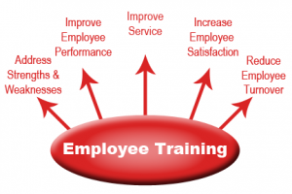
Importance of training
Training staff is mainly focused on achieving the desired business outcomes. To:
achieve organisational objectives
provide staff with the correct skills
deliver service and products
motivate individuals and the team
build team spirit
empower staff
improve staff retention
meet legal obligations.

Slide 7
On-job training
On-job training involves learning by doing a task in the normal work environment. It enables:
skills to be developed by a hands-on method
knowledge to be gained by applying it to a task
training and completing a job role to go hand in hand
supervisors to train members of the team in situ
the member of the team to learn how to perform tasks by actually doing them under guidance
training to take place in the normal job environment.

Slide 8
Benefits of on-job training
There are a number of benefits to the individual, the team and the business, including:
individual job satisfaction
increased motivation
improved efficiency
increased level of skills
cohesion in the team.

Slide 9
On-job training examples
There are a number of kitchen tasks that can be taught through on-job training. including:
assembling equipment
cleaning equipment
chopping vegetables
filleting fish
presenting and garnishing dishes
rolling pastry and lining a flan ring
shaping bread rolls
using a piping bag.

Slide 10
Identifying training needs
It is the responsibility of a chef de partie to identify the training needs of individuals and the team to develop skills whilst ensuring standards are maintained.
Training needs may be identified due to:
new staff being employed
underperformance in the team
new equipment being installed
new techniques being introduced
new dishes on the menu
legislative requirements
development of individuals
team members undertaking a new role
customer feedback.

Slide 11
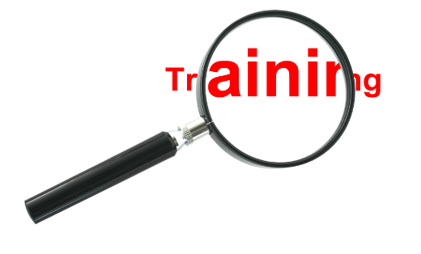
Methods for identifying training needs
A chef de partie can use a number of methods to identify training needs within the team, including:
observation of practices and procedures
questioning individuals and the team
interviewing individuals
during an induction session
during appraisals
through guest feedback
through peer feedback
by carrying out a skills audit.

Slide 12
Structured training plans
A structured training plan should clearly detail:
goals
schedule of training to be delivered
timeframe for completing the training
outline of the activities
who will be delivering the training
It should provide:
consistent high-quality training
measurable outcomes
certainty of the quality and impact of training.

Slide 13
Importance of structured training plans
The aim of a structure training plan is to:
address the learning needs of all employees
be cohesive
ensure efficient use of resources
follow a logical sequence
build on prior knowledge and understanding
provide consistency across the department/business.

Slide 14
Content of a training plan
There are a number of training plan templates that can be used but the key information to include is:
objectives
skills and knowledge to be developed
duration
resources required
responsibilities
costs.

Slide 15
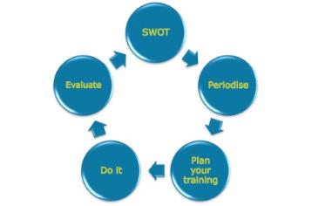
Planning consideration for training
When planning training there are a number of factors to be considered including:
aims and objectives of the training
methods of delivery - demonstration - theory - practical application
staff availability
location - on-job - off-job
resources required to deliver the training.

Slide 16
Training records
HR records
The human resources department keeps records of all skills and outcomes obtained to reflect the skill level of all staff employed.
Logbooks
These are often based on defined outcomes (e.g. qualification outcomes such the City & Guilds specification) and allow for a clear reference of the skills possessed by the graduate.
Portfolio
Provides a personal record of all training achieved such as CPD (continuing professional development) and references as well as workplace samples.

Slide 17
Training records continued
Records of training undertaken by the kitchen team may also be needed for:
food safety inspections
food safety audits
health and safety audits
head office audits.

Slide 18
Monitoring the progress of a training session
Monitoring and ongoing guidance are an important part of checking the progress of training.
Guidance and further instruction must extend beyond the training session into the applied work context.
During a training session regular checks should be made to ensure:
objectives are being met
instructions are understood
learning is taking place
pace of the session is appropriate
attendees are participating and contributing to the session
additional support is provided.

Slide 19
Methods of monitoring the progress of training
A range of methods can be used to monitor the progress of training including:
target setting
observation of performance
questioning to check level of learning / understanding
assessment – formative and summative
guest feedback
review date setting
attendee feedback.

Slide 20
Any questions?

