Slide 1
Guest satisfaction
PowerPoint presentation
Unit 304: Contribute to the guest experience

Slide 2
Customer needs
Different types of food businesses are designed for the needs people have at a particular time.
The main aim of a food operation is to achieve guest satisfaction.
This is achieved by meeting the customer needs, which may include:
physiological – to satisfy their appetite, or dietary needs
economic – value for money, convenient location, fast service
social – dining out with friends, business colleagues, attending functions
psychological – enhance self esteem, fulfilling life-style needs
convenience – eating whilst away from home, the desire for someone else to do the work, the physical impossibility of catering at home.

Slide 3
Customer expectations
Customer expectations of a ‘dining experience’ vary according to the type of restaurant.
All customers will expect:
clean dining areas, cutlery and crockery
adequate seating
appropriate heating, lighting
safe, hygienic environment
quality products.

Slide 4
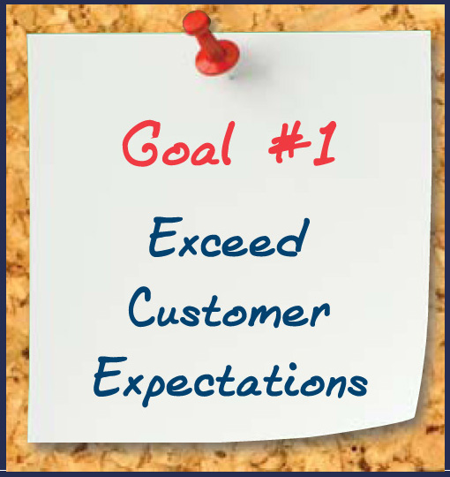
Customer expectations
Customers make a personal choice on where to eat depending on the occasion, this will determine expectations which may include:
style of menu
choice of dishes
accurate information
level of service
speed of service
atmosphere
value for money in relation to the dining experience
the ‘wow’ factor.

Slide 5
Customer expectations
Examples of customer expectations:
 | Price | Service | Food and beverage needs
Business guests | High | High standard, fast and discreet | High level of food on menus, personalised service, fine dining options
Family with young children | Average | Good standard | Children’s meals, healthy and nutritious food options, set menus
Budget travellers | Low | Basic standard | Promotions, happy hours

Slide 6
Guest satisfaction
Customer expectations
Service delivery
Expectations exceeded
Customer expectations
Service delivery
Expectations met
Gap
Customer expectations
Service delivery
Expectations not met

Slide 7
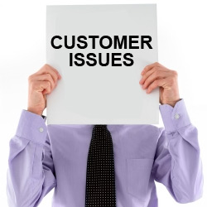
Guest issues
Guest issues that impact on the kitchen and food operation:
Special requirements – dietary needs
Communication difficulties between service staff and kitchen
Guest requests – additional items, changes to menu items
Dissatisfaction with service – cold meals due to slow service
Dissatisfaction with products – quality issues.

Slide 8
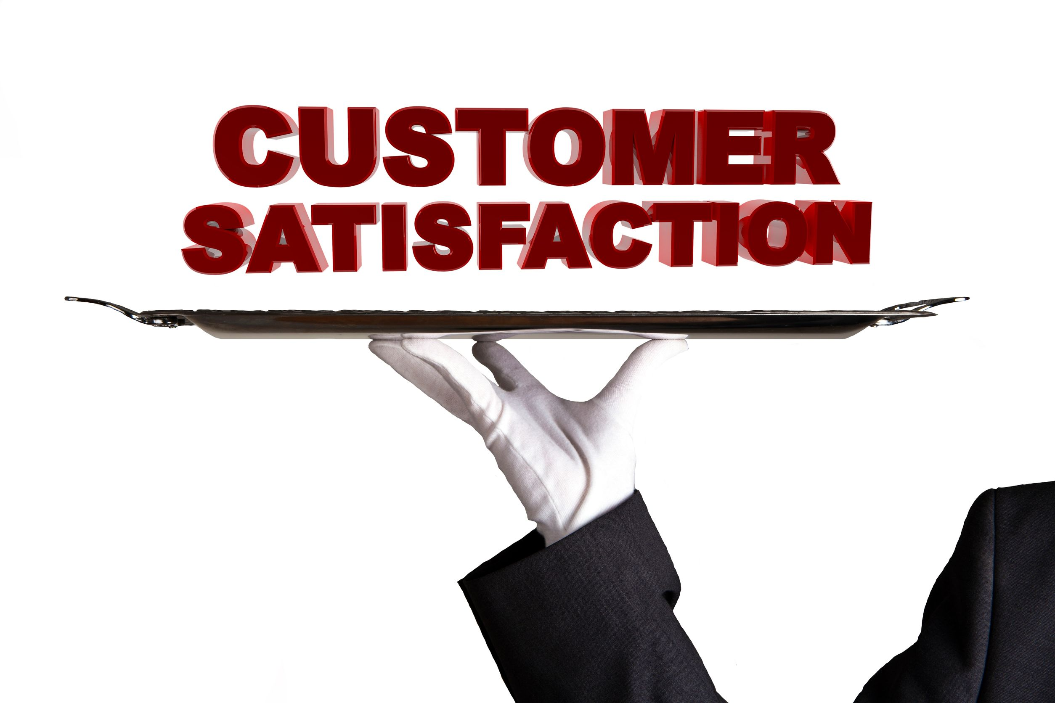
Gathering guest satisfaction levels
Guest satisfaction levels can be gathered using a number of different methods, including:
verbal feedback
questionnaires
letters – written comments (positive/negative)
emails
telephone calls
reviews on social media sites
Influencers’ reviews
mystery customers.

Slide 9
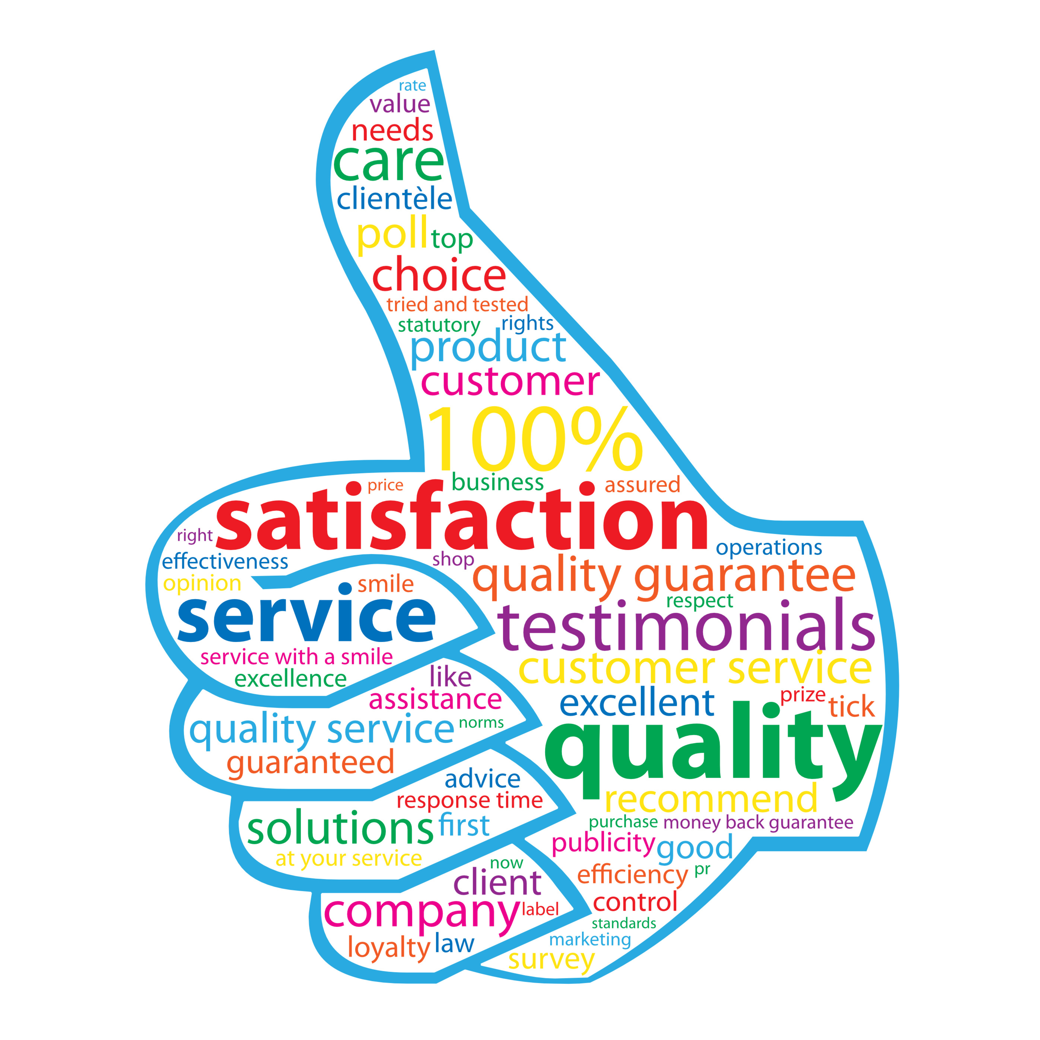
Benefits of positive customer satisfaction
Establishments will be aiming to achieve 100% customer satisfaction as this will:
maintain/improve reputation
increase business levels
increase staff morale
reduce staff turnover
reduce complaints.

Slide 10
Action to maximise guest satisfaction
A chef de partie will play an important role in maximising customer satisfaction through:
proactive supervision of the team
checking products before service to ensure they meet standards
dealing with guest issues efficiently and effectively to avoid complaints
timely delivery of the menu items to meet customer expectations
flexible attitude to meet customer needs
consistency when producing and serving menu items to avoid customer dissatisfaction
training the team to be able to deliver menu items to the required standard.

Slide 11
Any questions?

