Slide 1
Factors influencing eating and drinking experiences
PowerPoint presentation
Unit 304: Contribute to the guest experience

Slide 2
Global influences
There are a number of global influences on the food and drinks served in restaurants, including:
geographical regions around the world
commodities and ingredients
etiquette
cooking techniques
menu structure
social media
conscious consumers.

Slide 3
Availability of food commodities
Commodities and ingredients may be in short supply or not readily available when planning and producing menus.
The external factors that have to be considered when sourcing ingredients are:
climate/seasons
cultural influences
economy
geographical locations.

Slide 4
Climate
Climate is a major factor in the availability of commodities across the globe.
Most foods now available all year round due to:
new modes of production, marketing, distribution and processing
improved quality of convenience products
predictability of price and quality.
With global warming and a higher awareness of sustainability, seasonal produce influence the dishes offered on menus.
Seasonality refers to the times of year when a given type food is at its peak:
either in terms of harvest or its flavor
when the food is the cheapest and the freshest.

Slide 5
Climaric variations
shorter
plentiful
scarce
longer
earlier
later

Slide 6
Cultural and religious influences
Cultural and religious beliefs can have an impact on the availability of foods in restaurants.
Some restaurants will not serve particular commodities.
Different preparation and cooking methods are observed.
Examples of religions include:
Hinduism
Judaism
Islam
Sikhism
Catholicism
Can you suggest any other cultural or religious influences?

Slide 7
Economic influences
The cost of ingredients is a key factor in the availability of ingredients. This can be affected by:
shortages due to poor harvests
increased transportation costs
processing costs
import costs
budgets available.

Slide 8
Geographical location
Different food are produced across the world but availability will be determined by location
Restaurants now consider the impact on the environment when selecting ingredients and so now look to use more locally sourced products to:
reduce air miles
offer sustainable products
support local economies.

Slide 9
Trends
Food trends are continually changing and play a major part in influencing styles of menus and dishes offered to attract customers.
Current trends that influence guests dining experiences include:
celebrity chefs
social media
healthy alternatives
sustainability awareness
food and beverage pairings
Technology, including food ordering apps.

Slide 10
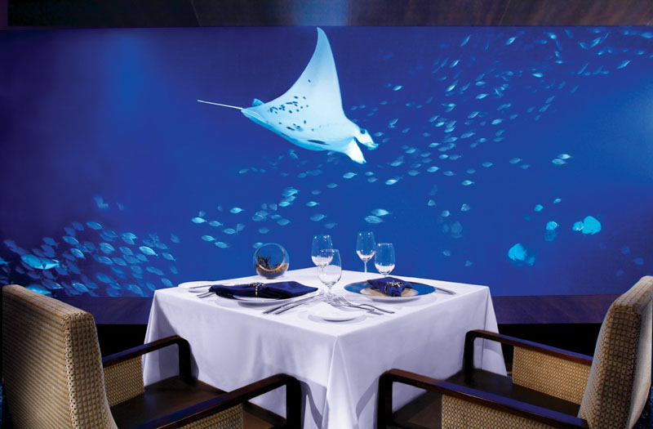
Guest dining experience
A dining experience may be defined as a series of events both tangible and intangible that a customer experiences when eating out.
Tangible – which can be felt by touching or seeing like the food, tables, chairs etc.
Intangible – which can only be sensed or felt like the atmosphere.

Slide 11
Factors that can influence the guest dining experience
There are a number of factors that can influence a dining experience, including:
the restaurant setting
the style or design of the restaurant
the ambience
dishes on the menu and quality of food
beverages offered to accompany the meal
the style of service offered for food and beverages
the reception received on arrival
product knowledge shown by the staff
delivery of the meal experience
reviews of the restaurant.

Slide 12
Media Influences
Customers keep up to date with trends and places to eat through the media which can play a large part in influencing their decisions on where to eat
The key media that influence dining out decisions include:
television
radio
books
magazines
newspapers
social media
internet.

Slide 13
Any questions?

