Slide 1
Planning menus to meet guest requirements
PowerPoint presentation
Unit 304: Contribute to the guest experience

Slide 2
Menu planning
With multicultural influences, most menus feature dishes from around the globe.
The chef de partie should know the key principles of ethnic cuisines and be able to produce them to a professional standard.
All recipes need to be costed and the chef must have measures in place to control costs during production and service.
Being able to calculate recipes, including the waste, and establishing appropriate selling prices to achieve profit is a key skill of a good chef.

Slide 3
Influences on cuisine
Whilst some restaurants are purely based upon a specific cuisine e.g. Italian, French, Greek, etc. many establishments offer a la carte menus that show influences from across the globe. Chefs also use inspiration from other cuisines to create ‘fusion’ dishes that combine classic approaches with a twist.
Cuisine | Key Countries
Asia | Often loosely described as Oriental cuisine it has distinct cuisines with signature dishes and regions within each country: East Asian – Chinese, Japanese and Korean South East Asian – Vietnam, Thailand, Malaysia, Indonesia, Singapore Central Asian – Kazakhstan, Mongolian, Uzbek, Afghan
Indian | Sri Lanka, Pakistan, Bangladesh
Africa | Morocco, Tunisia, Algeria etc.
South America | South American with specific country cuisines e.g. Brazil, Argentina, Chile, Ecuador
North America | Canada. Central America
Middle Eastern | Turkey, Lebanon, Persia, Israel, Egypt etc.
Continental Europe | France, Austria, Switzerland, Germany, Denmark, Sweden, Norway etc. Poland, Hungary, Bulgaria, Russia etc. Italy, Spain, Portugal
Antipodean | Australia, New Zealand Pacific Islands Fiji, Tonga, Suva, Tahiti etc.

Slide 4
Food preferences
Customers will have individual food preferences when dining out which may include:
healthy eating
religious
cultural
lifestyle choices – vegetarian.
These are different to dietary requirements but should be catered for when planning menus.

Slide 5
Dietary requirements
Some customers will have specific dietary requirements due to:
health issues
medical conditions
allergies
food intolerances.
All menus should be balanced and nutritious.

Slide 6
Considerations when planning menus
There are a number of factors to consider when planning menus, including:
availability of food items
guest requirements
occasion
style of restaurant
service style
staff skills
size and design of kitchen
type and amount of equipment available
allocated budget.

Slide 7
Considerations when planning menus
Service style
Purchasing
Equipment and Staffing
Quality Control
Pricing and Portion Control
Budgets
Stock Control
Production systems & processes
set cost and price policy
set specifications and control procedures
security, prevention of waste, loss and fraud
consistent standards
tailored to menu and production needs
standardisation of recipes, methods and yields
calculation of real costs plus GP
analysis of sales, contribution and profit (% and $).
MENU

Slide 8
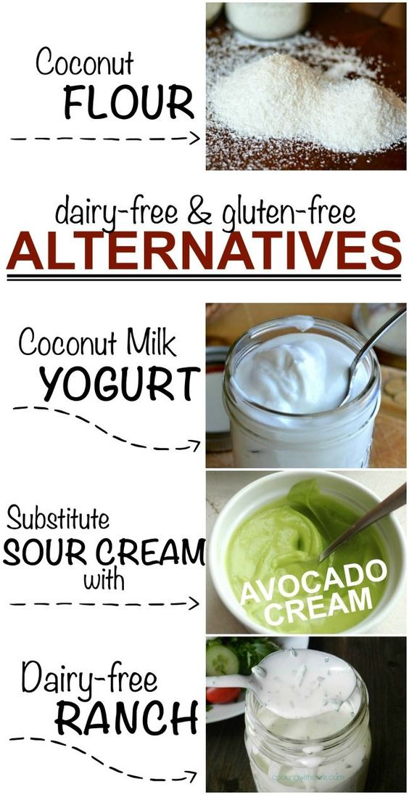
Adapting dishes
Chefs will need to be able to adapt dishes on the menu to ensure:
guests’ dietary needs are met
guest preferences are catered for.
This may include:
substituting ingredients
changing the cooking method
revising recipes.

Slide 9
Any questions?

