Slide 1
Understand sustainability in the hospitality industry
PowerPoint presentation
Unit 305: Sustainability in professional kitchens
Notes:
Introduction
Explain the advantages to a professional kitchen of sourcing produce sustainably.
Positive image as ‘green’ business /responsible business
Marketing/promotional opportunity/ USP – attracts customers to sustainably sourced foods on menus
Increased business/ helps to meet business targets – higher sales price/ turnover
Gives preferred supplier status e.g. trading at events
Cost of produce may be cheaper when in season due to abundance

Slide 2
Describe the impact of using sustainable practices on a global scale for:
climate
environment
animal welfare
ethics
economic
Notes:
Explain ways in which a catering operation could work with suppliers to improve sustainable practices.
Ask suppliers to reduce packaging
Use returnable / recyclable packaging
Supplier to update the catering operation of any changes to traceability or source of supply
Review processes of supply to make improve efficiency of energy use/ fuel / low emission alternatives
Standardise units of produce (eg meat and fish) to reduce wastage
Use online rather than paper correspondence
Sustainably.
Positive image as ‘green’ business /responsible business
Marketing/promotional opportunity/ USP – attracts customers to sustainably sourced foods on menus
Increased business/ helps to meet business targets – higher sales price/ turnover
Gives preferred supplier status eg trading at events
Cost of produce may be cheaper when in season due to abundance

Slide 3
Climate
Climate sustainability in the kitchen
  a research project that is funded by Kone Foundation carried out at the University of Helsinki in 2018-2021
  cultural change where more climate sustainable plant-based foods are emerging in everyday diets
  project develops 30 climate sustainable vegan recipes for lunch restaurants.
www.helsinki.fi/en/projects/climate-sustainability-in-the-kitchen
Notes:
Climate Sustainability in the Kitchen is a research project that is funded by Kone Foundation and carried out in Gender Studies at the University of Helsinki in 2018-2021. In this project we examine cultural change where more climate sustainable plant-based foods are emerging in everyday diets. We examine the phenomenon in variety of contexts, including lunch canteens, households, media discussions and policy making. The project is interdisciplinary, exploring the topic from the perspectives of gender studies, sociology and environmental sciences. Additionally, based on cooperation with various food sector players and NGOs, the project develops 30 climate sustainable vegan recipes for lunch restaurants.

Slide 4
Environmental
Environmental sustainability refers to the rates of renewable resource harvest, pollution creation, and non-renewable resource depletion that can be continued indefinitely.
Reducing a business’s impact on the environment means:
      cutting energy waste
      moving towards zero waste
      reducing water waste
      managing emissions.

Slide 5
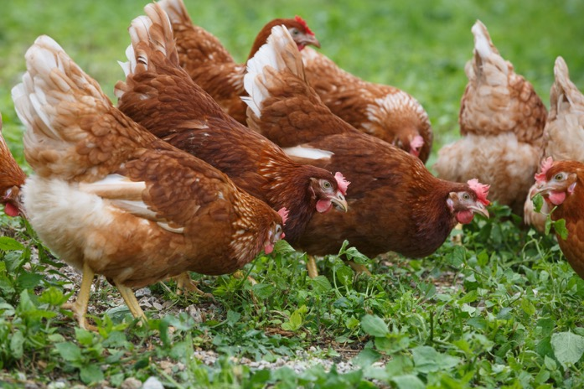
Animal Welfare
    Animal Welfare Approved (AWA) is a food label for meat and dairy products that come from farm animals, to confirm they have been raised to the highest animal welfare and environmental standards.
    Schemes to ensure animal welfare and to provide public confidence in the welfare of animals include:
    free range
    farm assured
Notes:
The programme was founded in 2006 as a market-based solution to the growing consumer demand for meat, eggs and dairy products from animals treated with high welfare and managed with the environment in mind.
It’s now widely accepted that raising animals intensively – indoors or confined on dirt feedlots – is not only bad for animal welfare, but it’s also harming human health and the wider environment. You only have to look at the headlines about the rise of antibiotic-resistant bacteria, environmental pollution from intensive farming systems, and animal welfare abuses to see that our food system is broken.
The AWA programme operates on the simple understanding that the way we raise our animals, the nutritional quality of the meat, milk and eggs they produce, and the impact of farming systems on the environment, are all intrinsically linked. If we manage our animals properly and according to their needs, we don’t have to rely on things like routine antibiotics and other chemical inputs to farm. We know that healthy, content animals produce better tasting, healthier meat, milk and eggs. And we know that pasture-based farming livestock systems can actually have a positive impact on the environment, too.
Activity:
Discuss Farm Assured / Free Range animal welfare.

Slide 6
Ethical
Biodiversity means to maintain and preserve environments e.g. protecting marine life and seabed.
Traceability – supports responsible animal welfare.
Supports local economy –
businesses within the supply
chain and community.
Protects the longevity of
future trade.
Notes:
From choosing to:
buy strawberries out of season,
to buying fair trade food,
joining a community gardening project,
or campaigning against the overuse of plastic in food packaging,
we all make regular ethical decisions about food. These choices are ethical because they involve values – principles, or reasons, for regarding practices as right or wrong.
From choosing to buy strawberries out of season, to buying fair trade food, joining a community gardening project, or campaigning against the overuse of plastic in food packaging, we all make regular ethical decisions about food. These choices are ethical because they involve values – principles, or reasons, for regarding practices as right or wrong.
Biodiversity - maintains and preserves environments eg protecting marine life and seabed
Traceability – supports responsible fishing
Supports local economy - businesses within the supply chain and community
Protects the longevity of future trade
Ethically.
Any two of the following explanations:
Traceability (from farm to fork) – supports responsible farming/ animal welfare
Supports local economy - businesses within the supply chain and community
Farming production methods help to protect environment

Slide 7
Economic
Economic sustainability is an integrated part of sustainability and means that we must use, safeguard and sustain resources (human and material) to create long-term sustainable values by optimal use, recovery and recycling.
Economic benefits include conserving fuel and cutting fuel costs, reducing the health impacts of air and water pollution.

Slide 8
Any questions?

