Slide 1
Understand sustainability in the hospitality industry
PowerPoint presentation
Unit 305: Sustainability in professional kitchens

Slide 2
Evaluate the effectiveness of methods to promote sustainable practices
Methods:
Training
Toolbox talks
Promotion activities – posters
People champions
Objective setting
Target setting.

Slide 3

Evaluate the effectiveness of methods to promote sustainable practices
Training
A training programme allows you to strengthen those skills that each employee needs to improve.

Slide 4

Evaluate the effectiveness of methods to promote sustainable practices
Toolbox talks
An effective toolbox talk involves a short 5–10 minute daily discussion conducted on a jobsite prior to a work shift.

Slide 5
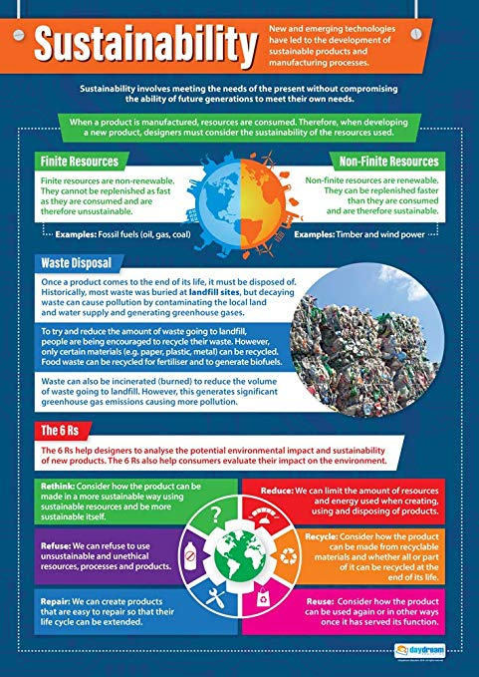
Evaluate the effectiveness of methods to promote sustainable practices
Promotion activities
Posters help draw attention to what the organisation is doing and how employees can get involved.

Slide 6

Evaluate the effectiveness of methods to promote sustainable practices
People champions
Identify people within the organisation responsible for introducing sustainability practices.

Slide 7
Evaluate the effectiveness of methods to promote sustainable practices
Objective setting
Objectives set out what a business is trying to achieve. It is important for leaders and managers to get the process of setting SMART objectives. Inadequately formulated objectives could guide an individual, a team or an organisation in the wrong direction.
S – Specific
M – Measurable
A – Achievable
R – Relevant
T - Timely

Slide 8
Evaluate the effectiveness of methods to promote sustainable practices
Target setting
Setting performance targets can help you deliver the strategic changes that many growing businesses need to make. The top-level objectives of your strategic plan can be implemented through departmental goals. Setting targets based on key performance indicators (KPIs) is an ideal way of doing this.
Activity: Identify and discuss targets for sustainability practices that could be introduced in a professional kitchen.

Slide 9
Any questions?

