Slide 1
Understand sustainability in the hospitality industry
PowerPoint presentation
Unit 305: Sustainability in professional kitchens

Slide 2
How procuring resources can impact on the carbon footprint
Regional
Imported
Food miles
Frequency of delivery
Stock management.
Notes:
Consumer purchasing decisions are the ultimate driver of carbon emissions
in an economy. All carbon emissions can be attributed to the delivery of
products and services to meet the needs of the consumer;
All product and service emissions can be classified into high-level
consumer needs categories as outlined in the chart below. Recreation
and Leisure, Space Heating and Food and Catering are the three consumer
needs with the highest carbon emissions. Together, they account for
almost half of the total UK carbon emissions; and
As we move to a more carbon-constrained world, business will have to
continue to meet customer needs but in a way that generates fewer carbon
emissions.
Source: Carbon Trust

Slide 3
Carbon footprint
A carbon footprint is defined as the total greenhouse gas emissions caused by an individual, event, organisation, or product, expressed as carbon dioxide equivalent.

Slide 4
How procuring resources can impact on the carbon footprint
Regional: Variations in transportation and disposal methods.
Imported: Importing goods in uneconomic volumes regularly would increase the carbon footprint for transportation of goods and services.
Frequency of delivery: Aligning deliveries to reduce their frequency and volume e.g. suppliers who can deliver more variety of goods and products using one vehicle, less frequently.
Stock management: An inventory management system can prevent over ordering and unnecessary deliveries taking place.

Slide 5
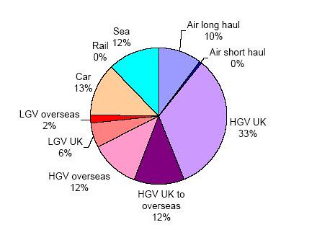
How procuring resources can impact on the carbon footprint
Food miles means the distance food is transported from the time of its making until it reaches the consumer. Food miles are one factor used when testing the environmental impact of food, including the impact on turtles and global warming.
Notes:
Activity – Calculate how many food miles 5 out of season foods used in the restaurant have travelled
Calculate how far your two main suppliers travel by vehicle from their depot

Slide 6
Any questions?

