Slide 1
Understand sustainability in the hospitality industry
PowerPoint presentation
Unit 305: Sustainability in professional kitchens

Slide 2
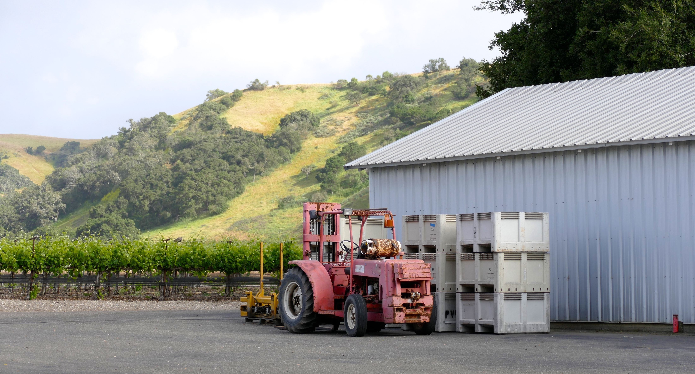
Food sustainable initiatives
Seasonal food commodities
Sustainably produced food
Food accreditation schemes
Fair trade
Soil Association
GM free
Organic
Direct from farmer/source.

Slide 3
Food sustainable initiatives
Seasonal produce refers to the times of year when the harvest or the flavour of a given type food is at its peak. This is usually the time when the item is harvested, with some exceptions; an example being sweet potatoes which are best eaten quite a while after harvest.
Sustainable food production is a method of production using processes and systems that are non-polluting, conserve non-renewable energy and natural resources, are economically efficient, are safe for workers, communities and consumers, and do not compromise the needs of future generations.

Slide 4
Food sustainable initiatives
Food assurance schemes are generally run as product certification schemes that are accredited by the government. These schemes use regular independent inspections to check that members are meeting specific standards and often use logos on consumer products to indicate this fulfilment.
The Fair trade certification system covers a growing range of products, including bananas, honey, coffee, oranges, cocoa beans, cotton, dried and fresh fruits and vegetables, juices, nuts and oil seeds, quinoa, rice, spices, sugar, tea, and wine.

Slide 5
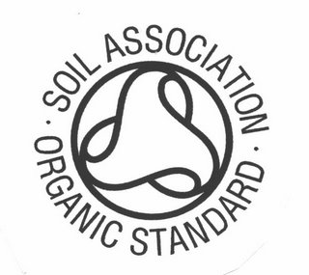
Food sustainable initiatives
The Soil Association is a charity based in the United Kingdom. Founded in 1946, its activities include campaign work on issues including opposition to intensive farming, support for local purchasing and public education on nutrition; as well the certification of organic food.

Slide 6
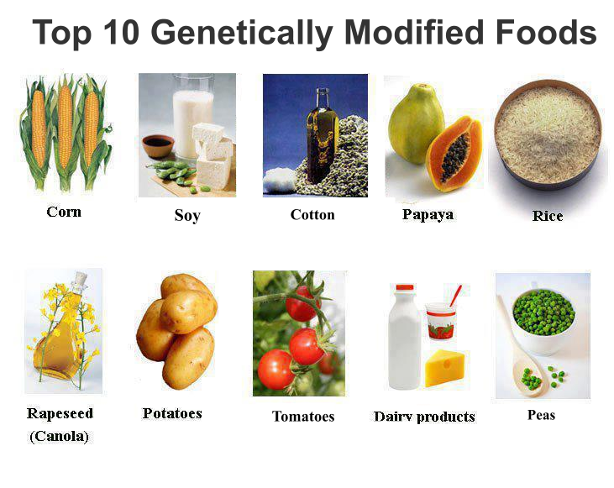
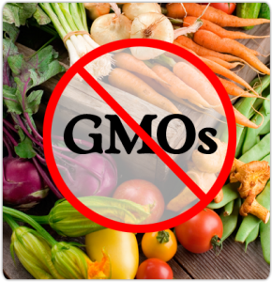
Food sustainable initiatives
Genetically modified (GM) free products or crops are products or crops that do not contain any genetically modified material.
Notes:
Activity = Discuss the advantages and disadvantages of GM food.

Slide 7
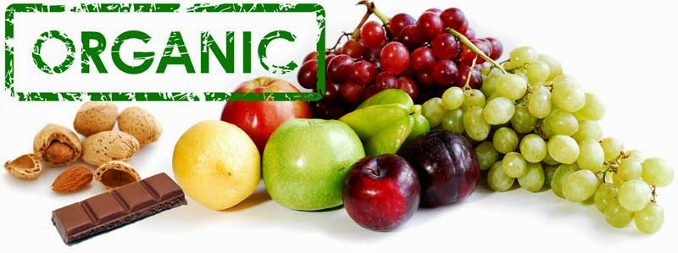
Food sustainable initiatives
Organic food is food produced by methods that comply with the standards of organic farming. Standards vary worldwide, but organic farming features practices that cycle resources, promote ecological balance, and conserve biodiversity.

Slide 8
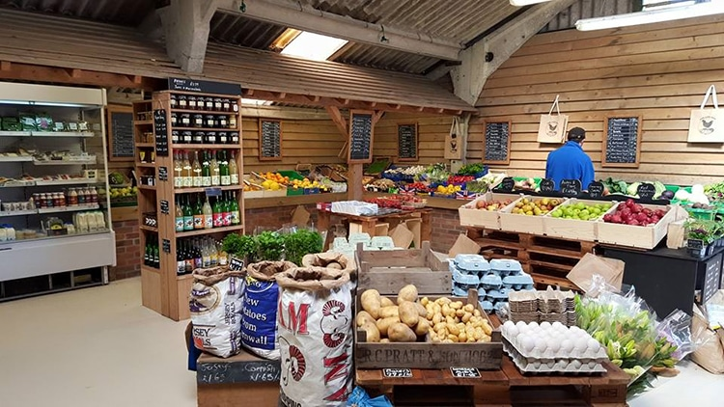
Food sustainable initiatives
Direct from farmer/sources
Advantages:
Transparency, integrity and clarity of what you are purchasing
Farmers and fishermen who you know and trust
Processing food through our own manufacturing sites and abattoirs and distributing through our own network.
Notes:
Morrisons is British farming’s largest supermarket customer, selling 100% British fresh meat, milk and eggs. We also produce most of our own food in 18 manufacturing sites and 493 stores, including bakery, seafood, meat, fruit & veg, flowers and chilled processed products.
We are committed to selling with transparency, integrity and clarity, and do not sell under any brands using fake farm names. We believe in buying directly from farmers and fishermen who we know and trust, processing through our own manufacturing sites and abattoirs and distributing through our own network, the only British supermarket to do so.

Slide 9
Any questions?

