Slide 1
Understand sustainability in the hospitality industry
PowerPoint presentation
Unit 305: Sustainability in professional kitchens

Slide 2
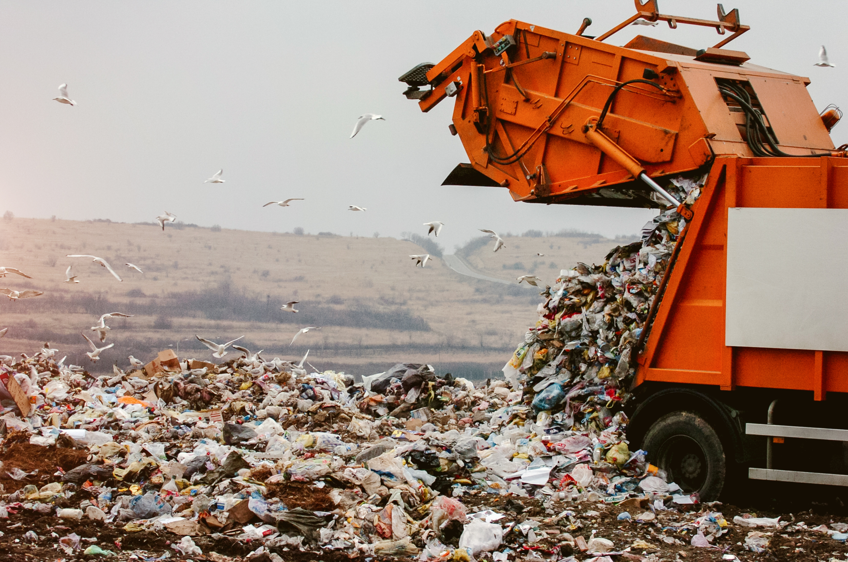
Describe different waste disposal options available to professional kitchens for different types of materials
Landfill
Recycle
Reuse
Waste recovery

Slide 3
Describe different waste disposal options available to professional kitchens for different types of materials
A landfill site is a site for the disposal of waste materials by burial. Landfill is the oldest form of waste treatment.
Recycling is the process of converting waste materials into new materials and objects.
This Photo by Unknown Author is licensed under CC BY-SA-NC

Slide 4
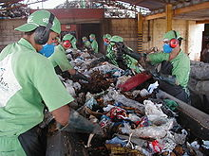
Describe different waste disposal options available to professional kitchens for different types of materials
Reuse is the action of using an item again or for another purpose.
Waste recovery is when your main aim is replacing a non-waste material you would have used in your operation with a waste material that performs the same function. That waste then serves a useful purpose as you're using fewer natural resources.
This Photo by Unknown Author is licensed under CC BY-SA

Slide 5
Evaluate the suitability of waste disposal options available to professional kitchens for different types of materials:
Activity options:
Liquid
Hazardous
Non-recyclable
Paper
Food
Metals
Glass

Slide 6
Any questions?

