Slide 1
Understand sustainability in the hospitality industry
PowerPoint presentation
Unit 305: Sustainability in professional kitchens

Slide 2
Recommend sustainable practices that could be implemented to the professional kitchen
Stock rotation
Menu planning
Reuse system
Reduction in disposables items
Separating waste streams
Energy monitoring and management
Reviewing of processes
Smart procurement
Returnable packaging

Slide 3
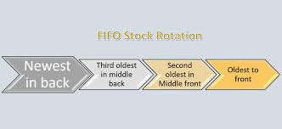
Recommend sustainable practices that could be implemented to the professional kitchen
Food stock rotation consists in using products with an earlier use-by-date first and moving products with a later sell-by date to the back of the shelf. This ensures that food is used within date and prevents unnecessary and costly waste (of food that has passed its expiry date).
Notes:
Image – lastquality.com

Slide 4
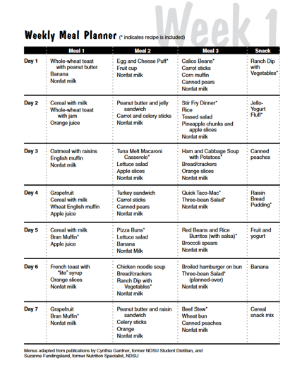
Recommend sustainable practices that could be implemented to the professional kitchen
Menu planning is the process of deciding what you will eat for each meal, including main dishes, side dishes, and desserts. It also entails knowing how many meals to plan for and when to serve them. Daily activities and scheduling variations may complicate the menu planning process.
Good menu planning can be a great
way of preventing food waste
within your organisation and to
help put profits on the bottom line.
This Photo by Unknown Author is licensed under CC BY-SA-NC

Slide 5
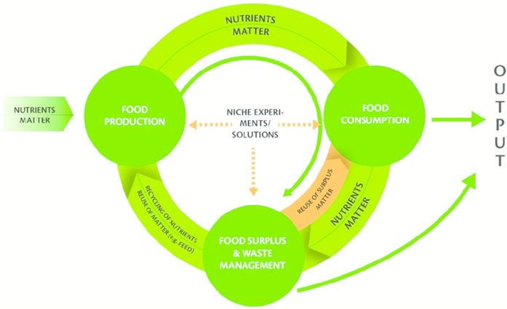
Recommend sustainable practices that could be implemented to the professional kitchen
Reuse system
This is a circular economy regarding the food system. It involves reducing the amount of waste generated in the food system, reuse of food, utilisation of by-products and food waste, and nutrient recycling.
Notes:
Image – researcvhgate.net

Slide 6
Recommend sustainable practices that could be implemented to the professional kitchen
Reduction in disposables items
Start with recycling:
opt for recycled, recyclable, and/or biodegradable packaging
choose reusable products
buy fewer items
buy in bulk
when you can't buy in bulk, choose products with minimal packaging.

Slide 7
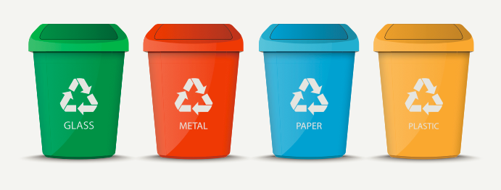
Recommend sustainable practices that could be implemented to the professional kitchen
Separating waste streams
Waste sorting is the process by which waste is separated into different elements. Waste sorting can occur manually at the household and be collected through waste collection schemes, or automatically separated at waste recycling centres.
Notes:
Image:123RF.com

Slide 8
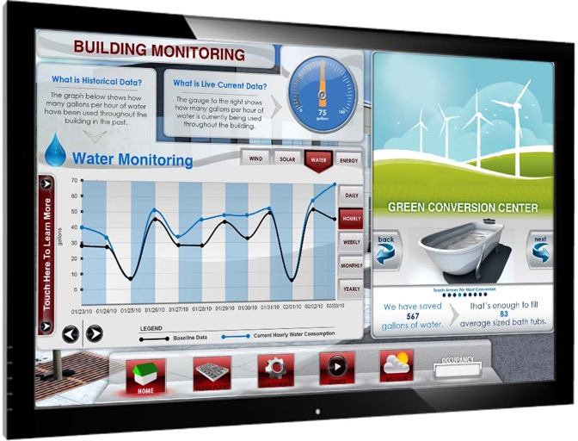
Recommend sustainable practices that could be implemented to the professional kitchen
Energy monitoring and management
Energy management is the means to control and reducing your organisation's energy consumption. This enables you to reduce costs.
Notes:
Image: Smart Energy International

Slide 9
Recommend sustainable practices that could be implemented to the professional kitchen
Reviewing of processes
Activity:
Identify and discuss sustainable practices to reduce energy consumption in a professional kitchen.

Slide 10
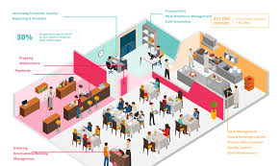
Recommend sustainable practices that could be implemented to the professional kitchen
Smart procurement
A smart food procurement service can drive down your costs whilst maintaining quality.

Slide 11
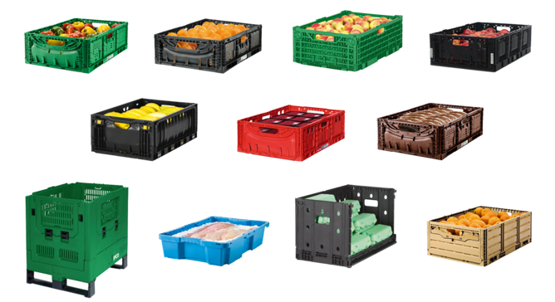
Recommend sustainable practices that could be implemented to the professional kitchen
Returnable packaging
Reusable pallets and containers help businesses achieve zero solid waste targets. Reusable packaging is packaging that is used more than once. Reusable packaging can include primary consumer packages, such as beverage containers, as well as transport and industrial packaging.

Slide 12
Any questions?

