Slide 1
Understand sustainability in the hospitality industry
PowerPoint presentation
Unit 305: Sustainability in professional kitchens

Slide 2
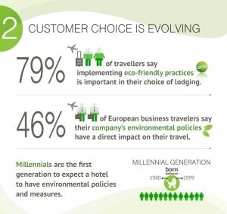
The impact of introducing sustainable practices in a professional kitchen
Reputation
Shows leadership
Employee morale
Competitive advantage
Drives business
Recognition
Environmental
Financial
Notes:
https://www.greenhotelier.org/our-themes/community-communication-engagement/sustainability-in-the-kitchen-food-drink/

Slide 3
Explain the impact of introducing sustainable practices in a professional kitchen
Reputation
Many businesses and industries are making a commitment to sustainability to help avoid the reduction of our world's natural resources. Implementing eco-friendly practices will ultimately improve the health of customers and the environment.
This results in better community relationships, increased customer loyalty, and improved morale and loyalty among staff.

Slide 4
Explain the impact of introducing sustainable practices in a professional kitchen
Financial
Reduced operating costs through bulk buying from local suppliers, demanding reduced packaging, buying seasonally, etc. If you grow your own produce, costs can be cut even more dramatically.

Slide 5
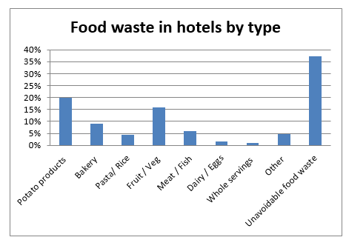
Explain the impact of introducing sustainable practices in a professional kitchen
Shows Leadership
Be clear about your goals. Staff will
be much less likely to question your
motives if you are upfront about why
sustainability is important to your
organisation.
Ensuring staff are aware of waste to
ensure over production or service
is not the norm.
An example of awareness of waste is buffets where you can reduce items on display that could be easily replenished.
Introducing monitoring of waste records will reduce waste and save money.

Slide 6
Explain the impact of introducing sustainable practices in a professional kitchen
Employee morale
It unites them to create a better work culture, work-life balance and contributions to customers and the world.
Employees may see introducing sustainable practices as additional work, e.g. separating waste, recording waste, replenishing the buffet more frequently, and energy conservation.
Employers need to ensure that by introducing sustainable practices employees will be recognised for their efforts.

Slide 7
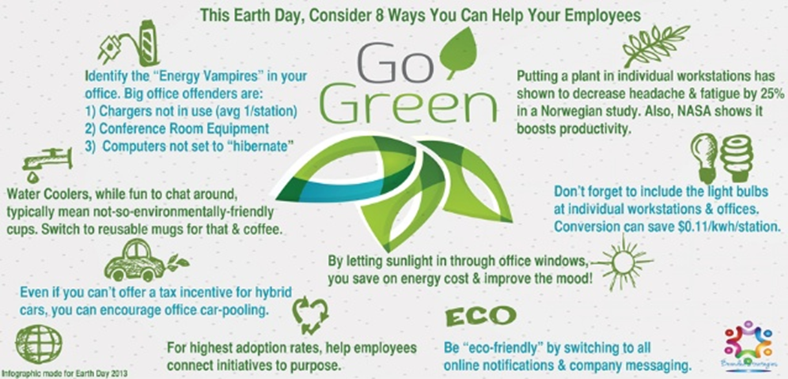
Explain the impact of introducing sustainable practices in a professional kitchen
Employee morale

Slide 8
Explain the impact of introducing sustainable practices in a professional kitchen
Competitive advantage
Development of sustainable business practices lends itself to efficient operations that streamline effort and conserves resources. This enhances employee productivity and reduces cost.
Drive business
Simply put, sustainability is a business approach to creating long-term value by taking into consideration how the organisation operates in the ecological, social and economic environment. Sustainability is built on the assumption that developing such strategies foster company longevity.

Slide 9
Explain the impact of introducing sustainable practices in a professional kitchen
Recognition
The opportunity to enhance brand image is lost if the company doesn't do as it preaches.

Slide 10
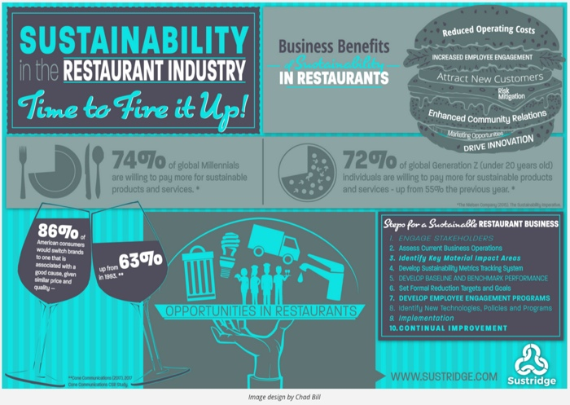
Explain the impact of introducing sustainable practices in a professional kitchen
Environmental

Slide 11
Any questions?

