Slide 1
Understand the role of the supervisor in ensuring compliance with food safety legislation
PowerPoint presentation
Unit 306: Monitoring and supervision of food safety

Slide 2
The purpose of having a food safety management procedure in place.
To ensure safe delivery, storage, preparation, cooking and service of food
To comply with legal requirements
To avoid causing harm
To avoid legal action from government agencies
To avoid civil action (both personal and against the business)
To demonstrate due diligence.

Slide 3
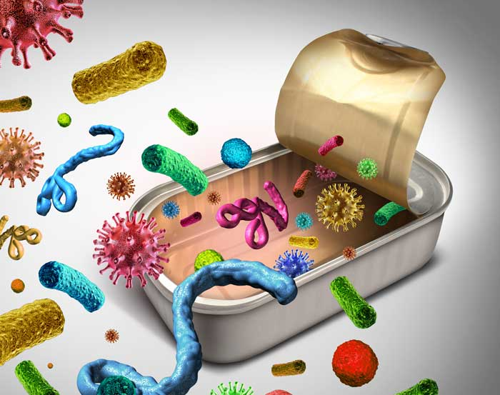
The importance of having a food safety management procedure in place
To ensure the safe:
delivery
storage
preparation
cooking
service
of food.
Notes:
Image: Ledge Inc

Slide 4
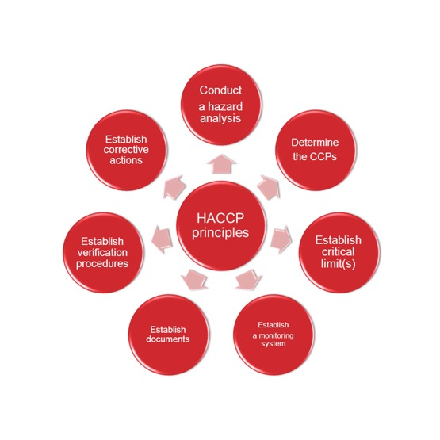
The importance of having a food safety management procedure in place
A food safety management system is a group of practices and procedures put in place to actively control risks and hazards throughout the food process and ensure regulatory compliance. One such system is a Hazard Analysis Critical Control Point (HACCP).

Slide 5

The importance of having a food safety management procedure in place
Due diligence:
Due diligence in food safety refers to being able to prove that your business has done everything reasonably possible to prevent food safety breaches. It helps to prove that you applied all reasonable precautions and due diligence to avoid committing an offence.
Notes:
Image – MS online

Slide 6
The importance of having a food safety management procedure in place
The seven principles of HACCP:
Principle 1: Conduct a hazard analysis
Principle 2: Identify the critical control points
Principle 3: Establish critical limits
Principle 4: Monitor CCP
Principle 5: Establish corrective action
Principle 6: Verification
Principle 7: Record keeping.

Slide 7
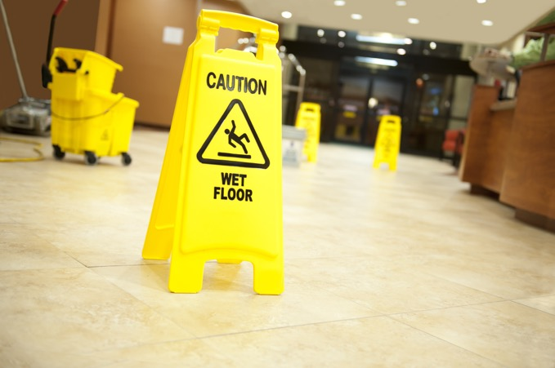
The importance of having a food safety management procedure in place
Principle 1: Conduct a hazard analysis
Prepare a list of steps in the process where significant hazards occur and describe control measures. Hazard analysis is the process used by the HACCP team to determine which potential hazards present a significant health risk to consumers.

Slide 8
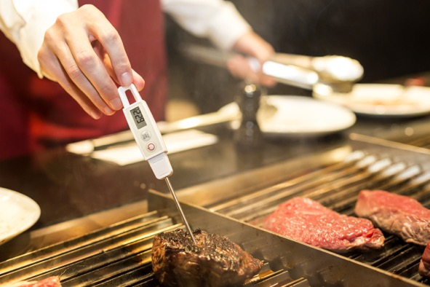
The importance of having a food safety management procedure in place
Principle 2: Identify the critical control points (CCP)
A critical limit is a maximum and/or minimum value to which a biological, chemical, or physical parameters must be controlled at a CCP to prevent, eliminate, or reduce the occurrence of a food safety hazard to an acceptable limit.

Slide 9

The importance of having a food safety management procedure in place
Principle 3: Establish critical limits
The critical limit selected must be adequate to either prevent, eliminate or reduce the identified hazard to an acceptable level.

Slide 10

The importance of having a food safety management procedure in place.
Principle 4: Monitor CCP
Establish monitoring procedures. Monitoring is a planned sequence of observations or measurements used to assess whether a CCP is under control. These observations will be necessary to produce an accurate record and for future use in verification.

Slide 11
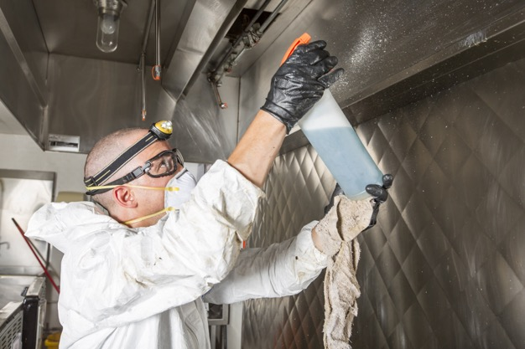
The importance of having a food safety management procedure in place
Principle 5: Establish corrective action
The fifth principle of HACCP is to establish corrective actions to be taken when monitoring indicates that there is a deviation from an established critical limit. Taking appropriate corrective actions in the event of a deviation at a critical control point is essential to producing safe food.

Slide 12
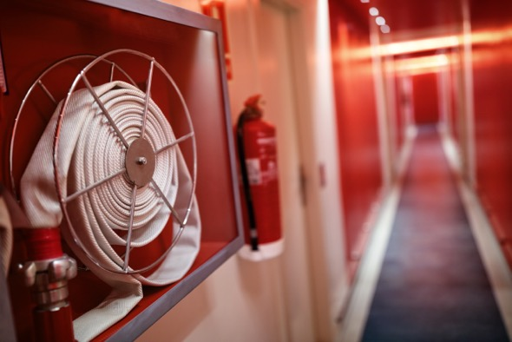
The importance of having a food safety management procedure in place
Principle 6: Verification
HACCP verification is defined as those activities, other than monitoring, that establish the validity of the HACCP plan and ensure that the HACCP system is operating according to the plan.

Slide 13
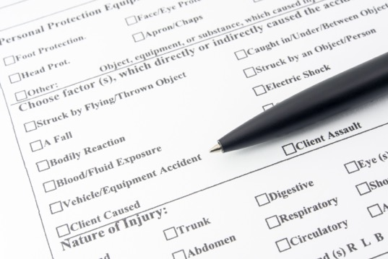
The importance of having a food safety management procedure in place
Principle 7: Record keeping
The seventh and final principle of HACCP is to establish effective record keeping procedures that document the HACCP system. Maintaining complete and accurate records is essential to ensure effective monitoring of the HACCP system and demonstration of compliance with food safety requirements.

Slide 14
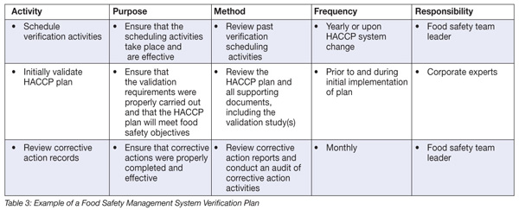
The importance of having a food safety management procedure in place
Verification system to ensure effectiveness of a HACCP plan
A HACCP plan will consist of a number of critical control points. Effective verification is therefore achieved by checking that the systems are in place to control these critical hazards, the controls are being consistently applied and monitoring confirms that they are working effectively.
Notes:
Image: Food Safety Magazine

Slide 15
The importance of having a food safety management procedure in place
Activity 1: Discuss the content of a HACCP chart
Complete a hazard analysis flow chart for the process steps required to produce a roast chicken dish in your restaurant.
Complete a HACCP control chart for the process.
Notes:
Image: Food Safety Magazine

Slide 16
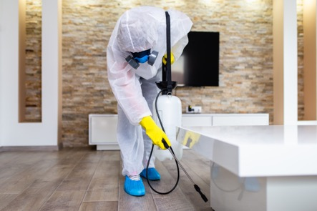
The importance of having a food safety management procedure in place
Pest control
Pests can be carriers of harmful diseases. Their presence poses a serious health hazard to customers because they can contaminate with their urine, droppings, and hair. Without pest control management, food production and storage areas may be at risk.
It is not a legal requirement to have a pest control contract BUT it is a legal requirement that you manage pest control. Even with the help of an external contract, a pest controller cannot do their job without there being 'in-house controls’. This includes a cleaning schedule for your premises and equipment.

Slide 17
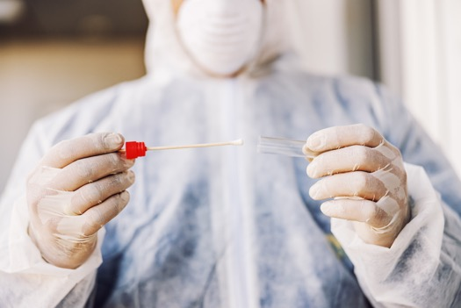
The importance of having a food safety management procedure in place
Swabbing
Environmental swabbing involves the microbiological testing of food preparation surfaces, equipment and utensils using various swab techniques to find out if pathogens are present. It is used to verify whether a food businesses' cleaning and sanitation programs are effective (known as cleaning verification).

Slide 18
The importance of having a food safety management procedure in place
Supervision, instruction and training
Staff involved in food production are a potential source of microbiological, chemical and physical hazards through poor personal hygiene, behaviour, poor work practices or failure to follow instructions. Staff need clear work instructions, sufficient training and supervision so that they can handle food safely.
Types of training
Internal – inhouse induction and refresher training
External – formal recognised face to face or e-learning
Training records should be kept for due diligence.

Slide 19
The importance of having a food safety management procedure in place
Cleaning
Cleaning and disinfection is an important part of the food safety system for all food businesses. Faulty or inadequate cleaning procedures can contribute to food poisoning outbreaks.
Waste disposal
Adequate facilities for storing and disposing of food waste and other rubbish are essential. Stores for waste must be designed and managed in a way that enables them to be kept clean and free of pests. You must get rid of all waste in a hygienic and environmentally friendly way, in accordance with legislation.
Cleaning and waste disposal records need to be kept for due diligence.
Notes:
Source: RSPH

Slide 20
The importance of having a food safety management procedure in place
Maintenance of equipment and building infrastructure
Premises must be clean and maintained in good repair and condition to allow you to follow good food hygiene practices, including protection against contamination and pest control.
All items, fittings and equipment that food touches must be kept in good order, repair and condition and able to be cleaned and disinfected effectively and frequently enough to avoid any risk of contamination.
Records of inspection, maintenance and repairs need to be kept to prove due diligence.

Slide 21
Any questions?

