Slide 1
Understand how to implement food safety management procedures
PowerPoint presentation
Unit 306: Monitoring and supervision of food safety

Slide 2
The procedures for controlling food safety
Procedures
Supply chain
Storage
Cooking
Holding
Cleaning
Delivery
Preparation
Chilling
Re-heating

Slide 3
Procedures for controlling food safety
Supply chain
During the process of distribution food products go through all stages of supply chain, i.e. all processes which describe how food travels from a farm to the consumers' tables.
There are many dangers of food contamination, be it in the very production, during the transport, food storage, or food preparation.
Procedures to enable food quality and safety of food products, companies have to follow legislations, standards and norms at every stage of supply chain.
Notes:
Maintaining food security has become unconditional when it comes to food trade and customer demand. The food put on the market has to be of good quality and safe for consumption, as well as not be a source of disease and infection. For this reason, securing food safety and quality is a matter of international significance and a responsibility of food producers and governments. During the process of distribution food products go through all stages of supply chain, i. e. all processes which describe how food travels from a farm to the consumersʼ tables. The aim of this strategy, called “from the field to the table”, is to achieve full supervision of food safety in the modern world, because the journey leading from food production to the consumer is very time - and space consuming. Along this journey, there are many dangers of food contamination, be it in the very production, during the transport, food storage, or food preparation. In order to enable food quality and sanitary safety of food products, companies have to follow legislations, standards and norms at every stage of supply chain. The aim of this paper is to show how food safety and quality is legally regulated during the distribution in the supply chain, and the ways in which companies ensure a certain high level of hygiene and temperature levels that different kinds of food products require.
Source: https://www.researchgate.net/publication/324389840_Food_safety_and_food_quality_in_the_supply_chain

Slide 4
Explain the procedures for controlling food safety
Delivery
Checks will depend on products and may include:
checking product specifications
checking cleanliness of delivery vehicles
inspecting delivery – packaging, temperatures, date codes and rejecting if necessary
following company procedures and put the delivery into the correct storage straight away.

Slide 5
The procedures for controlling food safety
Storage – ensuring separate storage areas for dry, chilled and frozen foods
Dry storage – dry, cool. adequate size, lighting and pest proofed
Chilled storage – temperature controlled 1–4C
Frozen storage – temperature controlled -18–21C
All foods stored correctly, covered and labelled.
All equipment maintained – defrosted regularly, not overloaded preventing the flow of cold air.

Slide 6
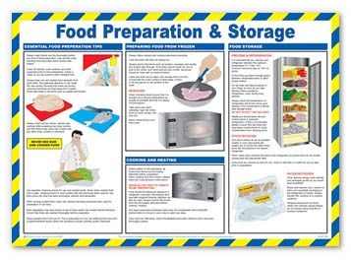
Procedures for controlling food safety
Preparation
Ensure food surfaces are clean and sanitised
Keep raw and cooked food separate
Follow safe practices
Keep food covered
Store food when completed.
Notes:
Image Source - https://www.google.com/url?sa=i&source=images&cd=&cad=rja&uact=8&ved=0ahUKEwj3sP7azavnAhWSohQKHSuCCX4QMwh_KBEwEQ&url=https%3A%2F%2Fwww.pinterest.com%2Fpin%2F162622236517505684%2F&psig=AOvVaw0KbQeJbXj6UQEbBMUE-ppR&ust=1580483427073440&ictx=3&uact=3

Slide 7
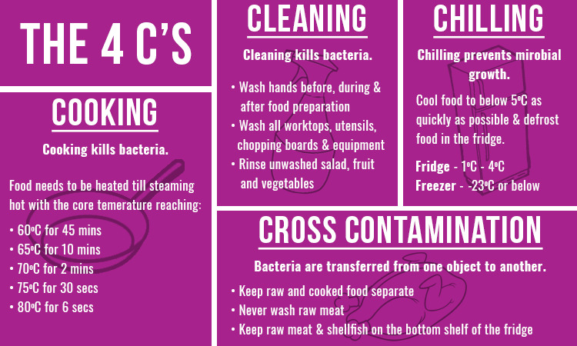
Procedures for controlling food safety
Cooking – to ensure any pathogenic bacteria is destroyed:
plan cooking to ensure not too much food is cooked in advance
measure and record the core temperature
ensure food reaches the minimum temperature/time required.
Notes:
Source - https://www.google.com/url?sa=i&source=images&cd=&cad=rja&uact=8&ved=2ahUKEwiYgZOs0KvnAhXhnFwKHbHuC2M4ZBAzKBowGnoECAEQNg&url=https%3A%2F%2Fwww.livius-training.co.uk%2Ffood-contamination%2F&psig=AOvVaw1bXSPbFpeiCRCa3zi1WxQP&ust=1580484114624324&ictx=3&uact=3

Slide 8
Procedures for controlling food safety
Chilling
Ensure food is cooled in sufficient time
Protect food from contamination
Use an approved method of cooling / chilling – ice bath, chiller machine, dividing into smaller containers
Not placing hot food into a refrigerator
Notes:
Source - https://www.google.com/url?sa=i&source=images&cd=&cad=rja&uact=8&ved=2ahUKEwiYgZOs0KvnAhXhnFwKHbHuC2M4ZBAzKBowGnoECAEQNg&url=https%3A%2F%2Fwww.livius-training.co.uk%2Ffood-contamination%2F&psig=AOvVaw1bXSPbFpeiCRCa3zi1WxQP&ust=1580484114624324&ictx=3&uact=3

Slide 9
Procedures for controlling food safety
Holding
Ensure hot holding equipment has been switched on and at the correct temperature before putting any cooked food in
Ensure food is held above 63C
Check temperatures to ensure food remains out of the danger zone(5–63C)
Rotate/replace hot food regularly throughout service.

Slide 10
Explain the procedures for controlling food safety
Re-heating
Ensure food reaches the minimum temperature for the minimum time
Reheat food only once
Discard food that has been reheated and unused

Slide 11
Explain the procedures for controlling food safety
Cleaning
Ensure all food is put away or covered before any cleaning takes place.
Food handlers should wash their hands after handling cleaning chemicals and before preparing, cooking or serving food
Notes:
Source - https://www.google.com/url?sa=i&source=images&cd=&cad=rja&uact=8&ved=2ahUKEwiYgZOs0KvnAhXhnFwKHbHuC2M4ZBAzKBowGnoECAEQNg&url=https%3A%2F%2Fwww.livius-training.co.uk%2Ffood-contamination%2F&psig=AOvVaw1bXSPbFpeiCRCa3zi1WxQP&ust=1580484114624324&ictx=3&uact=3

Slide 12
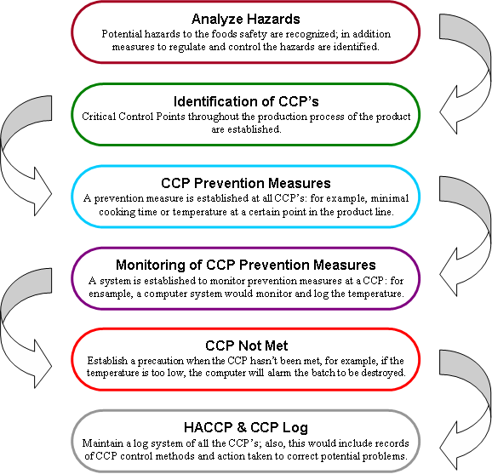
Critical control points, critical limits and corrective actions
Critical control points (CCPs):
The points at which it is critical for an intervention to be taken by the food handler in order to maintain food safety
Notes:
Source - https://www.google.com/url?sa=i&source=images&cd=&cad=rja&uact=8&ved=0ahUKEwjUm-yy0avnAhWrSxUIHVGQBQkQMwh8KA4wDg&url=https%3A%2F%2Fwikieducator.org%2FHazard_Analysis_Critical_Control_Point&psig=AOvVaw1TKE_ng6Ds722rPP7i_rvY&ust=1580484416573552&ictx=3&uact=3

Slide 13
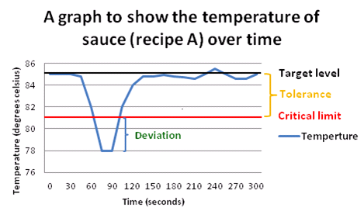
Critical control points, critical limits and corrective actions
Critical limits (CLs):
The maximum acceptable limits set by management within the HACCP analysis for the safe production of food.
Notes:
Image source = https://www.google.com/url?sa=i&source=images&cd=&cad=rja&uact=8&ved=0ahUKEwiAo4vm0avnAhW1qHEKHaoOBQcQMwhcKAAwAA&url=http%3A%2F%2Fwww.foodsafety.company%2F2016%2F11%2Fhaccp-critical-limits.html&psig=AOvVaw3j5KowZ76wGB4qrLm0Ka0Z&ust=1580484524107048&ictx=3&uact=3

Slide 14
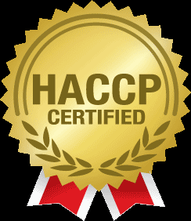
Critical control points, critical limits and corrective actions
Critical actions (Cas):
The actions that must be taken by the food handler where a CCP is identified to ensure the safe production of food; these actions must form part of the management HACCP plan and must be regularly reviewed and amended if required.
Notes:
Image source - https://www.google.com/url?sa=i&source=images&cd=&cad=rja&uact=8&ved=0ahUKEwj_zIa106vnAhWRQEEAHfC6Di0QMwhkKAIwAg&url=https%3A%2F%2Fwww.pinterest.com%2Fpin%2F863283822295472959%2F&psig=AOvVaw3lURv3CAwE0C0WkWSKidhz&ust=1580484958104946&ictx=3&uact=3

Slide 15
Any questions?

