Slide 1
Understand how to implement food safety management procedures
PowerPoint presentation
Unit 306: Monitoring and supervision of food safety

Slide 2
Food safety management records used within a food safety management system
Food safety management records
A FSMS is a systematic approach to controlling food safety hazards within a food business in order to ensure that food is safe to eat. All businesses are required to put in place, implement and maintain a FSMS based on the principles of Hazard Analysis Critical Control Point (HACCP).
Larger multi-site companies will have developed their own systems and will include the following documents:

Slide 3
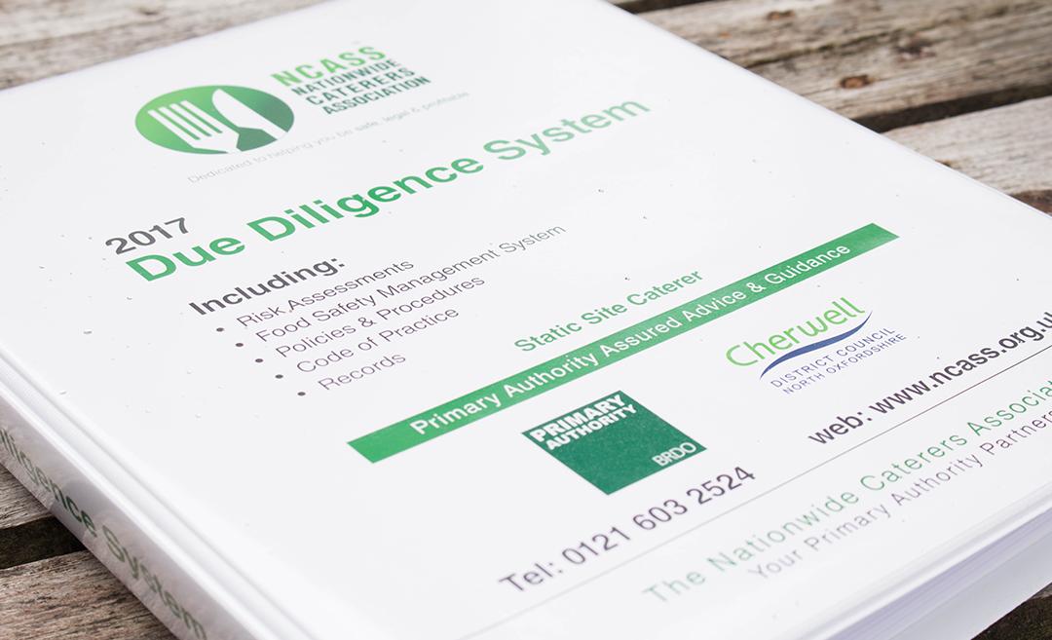
Food safety management records
HACCP plan
Suppliers list
Delivery records
Temperature control records
Staff training records
Staff sickness records
Pre and post-employment records

Slide 4
Food safety management records
Fitness to work records
Cleaning records and schedules
Monitoring of cleaning records and schedules
Recommended sample keeping
Visitor records/policy
Pest control
Maintenance records
Waste management policy.

Slide 5
Any questions?

