Slide 1
Understand the role of the supervisor in ensuring compliance with food safety legislation
PowerPoint presentation
Unit 306: Monitoring and supervision of food safety

Slide 2
Responsibilities of employers and employees in respect of food safety legislation and procedures for compliance
To ensure good food safety practice in food businesses, it is important that both employers and employees understand their responsibilities to ensure:
a practical approach to food safety is achieved
supervising others to achieve food safety standards
compliance with the law.

Slide 3
Employer responsibilities
Registering the food business
Ensuring training is provided commensurate with employees’ level of responsibility
Ensuring policies and procedures are in place for training
Recruitment and day-to-day staffing levels, supervision
Implementation of food safety management procedures

Slide 4
Employer responsibilities (continued)
Supply of appropriate sanitary accommodation
Potable water supply
Adequate washing facilities
Equipment, materials and PPE (personal protective equipment)
Record keeping and accident reporting,
Compliance with environmental health agencies
Provide sufficient ventilation.

Slide 5
Employee responsibilities
To comply with the law
To follow instructions and comply with employer’s processes/procedures
To attend instruction/training/ supervision
Good personal hygiene
Reporting of illness
Reporting of errors/omissions in employer processes/procedures e.g. hand washing facilities, kitchen and cleaning equipment such as fridges, infrastructure faults, deliveries.

Slide 6
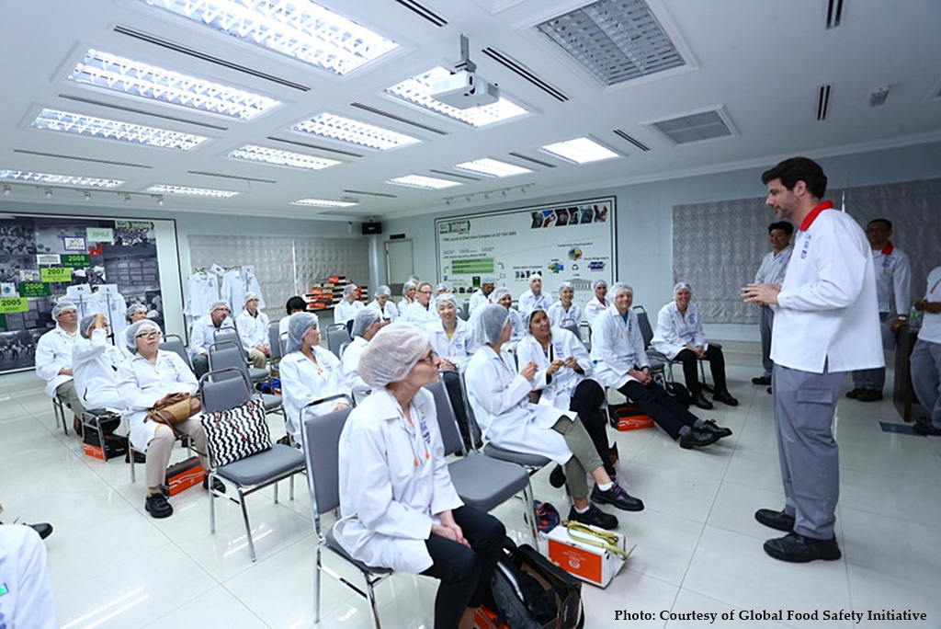
Activity
Design a food safety induction course for new members of staff working in the kitchen as food handlers to include:
Personal hygiene practices
Food storage
Food preparation
Cleaning
Cross contamination.

Slide 7
Any questions?

