Slide 1
Understand the role of the supervisor in ensuring compliance with food safety legislation
PowerPoint presentation
Unit 306: Monitoring and supervision of food safety

Slide 2
The role of a supervisor in the monitoring of food safety
Being aware of all relevant food safety legislation and standards that are applicable to the food business
Monitoring all food handlers to make sure that all food handling tasks are properly and safely carried out
Knowing how to recognise, prevent and minimise food safety hazards in the food business
Ensuring that food handlers maintain safe personal hygiene
Ensuring that a business’s food safety program is up-to-date and accurately maintained
Completing all required training.

Slide 3
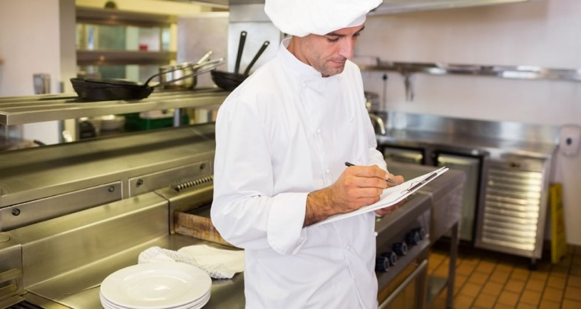
Being aware of all relevant food safety legislation and standards that are applicable to the food business
Completing higher level food safety supervisory training
Keeping up to date through government and trade publications
Seeking advice and guidance from specialists an enforcement authorities.
Notes:
Tutors to expand
Phot source : https://www.google.com/url?sa=i&source=images&cd=&cad=rja&uact=8&ved=0ahUKEwjThNCMhKvnAhWNEBQKHWThCNkQMwhpKAgwCA&url=http%3A%2F%2Fwww.allstatestraining.com.au%2Fcourses%2Fsitss00051-food-safety-supervision&psig=AOvVaw2pcEItog_h4QuZMhtksMro&ust=1580463666827865&ictx=3&uact=3

Slide 4
Monitoring all food handlers to make sure that all food handling tasks are properly and safely carried out
Observing food handlers in the workplace
Ensuring food handlers have the facilities and equipment to ensure food handling tasks are completed safely:
Wash hand basins, soap and drying facilities
Specialist cleaning materials and equipment for after use, daily and weekly cleaning
Working and calibrated cold storage fridges and freezers
Complete food safety records and audits.

Slide 5
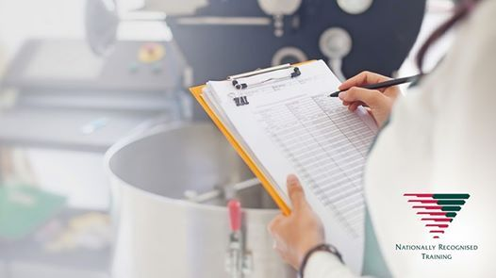
Knowing how to recognise, prevent and minimise food safety hazards in the food business
Ensure HACCP systems are in place and reviewed
Provide a reporting system to allow staff to report food safety hazards they are unable to rectify themselves
Carry out unannounced food safety inspections to identify areas of concern.

Slide 6
Ensuring that food handlers maintain safe personal hygiene
Provide clean appropriate protective clothing and suitable changing facilities
Monitor personal hygiene of food handlers and visibility to the customers impressions.

Slide 7
Ensuring that a business’s food safety program is up to date and accurately maintained
Complete audits of the food safety records:
daily check sheets
temperature records
delivery records
waste records
cleaning schedule
training records
Review HACCP on change of menu or introduction of new equipment.
Notes:
Tutor to show examples of completed records

Slide 8
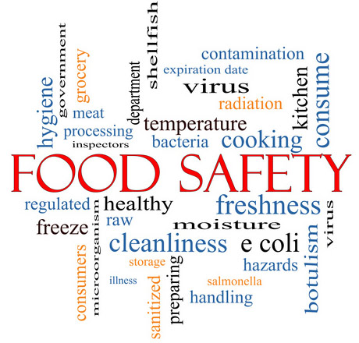
Completing all required training
Ensure all staff are appropriately trained:
Induction
Formal qualifications at Level 2 or 3
Annual refresher training.
Notes:
Photo source bdtraining.ie - https://www.google.com/url?sa=i&source=images&cd=&ved=2ahUKEwjf3fyphavnAhVynVwKHRZNDCQ4ZBAzKAMwA3oECAEQBw&url=http%3A%2F%2Fwww.bdtraining.ie%2F&psig=AOvVaw1iKyA0o9N0YfW76wKZVfwk&ust=1580463940065768&ictx=3&uact=3

Slide 9
Any questions?

